Slide 1

An introduction to Python
for absolute beginners
Bob Dowling
University Computing Service
scientific-computing@ucs.cam.ac.uk
http://www.ucs.cam.ac.uk/docs/course-notes/unix-courses/PythonAB
Notes:
Welcome to the Computing Service's course “Introduction to Python”.
This course is designed for people with absolutely no experience of programming. If you have any experience in programming other languages you are going to find this course extremely boring and you would be better off attending our course "Python for Programmers" where we teach you how to convert what you know from other programming languages to Python.
This course is based around Python version 3. Python has recently undergone a change from Python 2 to Python 3 and there are some incompatibilities between the two versions. The older versions of this course were based around Python 2 but this course is built on Python 3.
Python is named after Monty Python and its famous flying circus, not the snake. It is a trademark of the Python Software Foundation.

Slide 2
Course outline ― 1
Who uses Python & what for
What sort of language it is
How to launch Python
Python scripts
Text
Names for values
Reading in user data
Numbers
Conversions
Comparisons
Truth & Falsehood

Slide 3
Course outline ― 2
Assignment
Names
Our first “real” program
Loops
if… else…
Indentation
Comments

Slide 4
Course outline ― 3
Lists
Indices
Lengths
Changing items
Extending lists
Methods
Creating lists
Testing lists
Removing from lists
for… loop
Iterables
Slices

Slide 5
Course outline ― 4
Files
Reading & writing
Writing our own functions
Tuples
Modules
System modules
External modules
Dictionaries
Formatted text

Slide 6

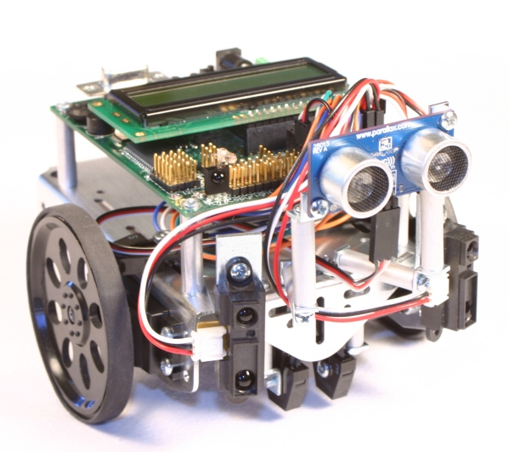
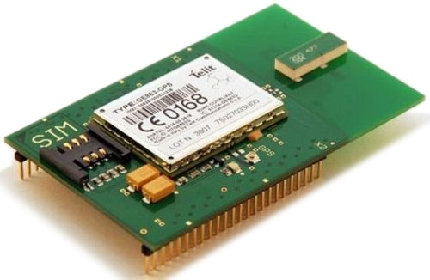
Who uses Python?
On-line games
Web services
Applications
Science
Instrument control
Embedded systems
en.wikipedia.org/wiki/List_of_Python_software
Notes:
So who uses Python and what for?
Python is used for everything! For example:
“massively multiplayer online role-playing games” like Eve Online, science fiction’s answer to World of Warcraft,
web applications written in a framework built on Python called “Django”,
desktop applications like Blender, the 3-d animation suite which makes considerable use of Python scripts,
the Scientific Python libraries (“SciPy”),
instrument control and
embedded systems.

Slide 7
What sort of language is Python?
Compiled
Interpreted
Explicitly
compiled
to machine
code
Explicitly
compiled
to byte
code
Implicitly
compiled
to byte
code
Purely
interpreted
C, C++,
Fortran
Java, C#
Python
Shell,
Perl
Notes:
What sort of language is Python? The naïve view of computer languages is that they come as either compiled languages or interpreted languages.
At the strictly compiled end languages like C, C++ or Fortran are "compiled" (converted) into raw machine code for your computer. You point your CPU at that code and it runs.
Slightly separate from the strictly compiled languages are languages like Java and C# (or anything running in the .net framework). You do need to explicitly compile these programming languages but they are compiled to machine code for a fake CPU which is then emulated on whichever system you run on.
Then there is Python. Python does not have to be explicitly compiled but behind the scenes there is a system that compiles Python into an intermediate code which is stashed away to make things faster in future.
But it does this without you having to do anything explicit yourself. So from the point of view of how you use it you can treat it as a purely interpreted language like the shell or Perl.

Slide 8
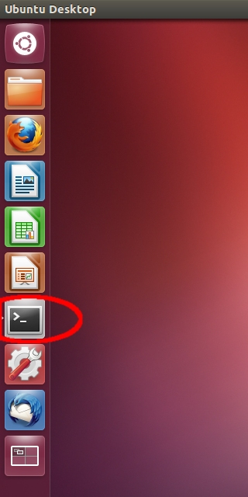
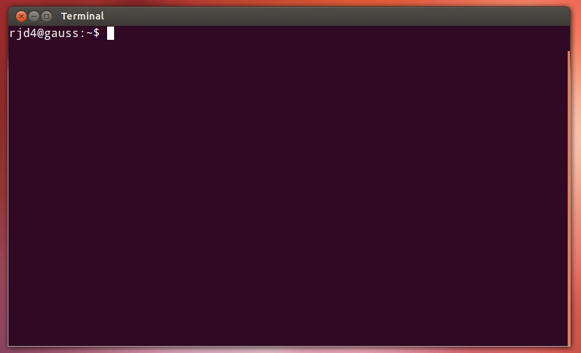
Running Python ― 1
Notes:
We are going to use Python from the command line either directly or indirectly.
So, first I need a Unix command line. I will get that from the GUI by clicking on the terminal icon in the desktop application bar.

Slide 9
Running Python ― 2
Unix prompt
Unix command
Introductory blurb
$
python3
Python
3.2.3
(default, May 3 2012, 15:54:42)
[GCC 4.6.3] on linux2
>>>
Python version
Python prompt
Notes:
Now, the Unix interpreter prompts you to give it a Unix command with a short bit of text that ends with a dollar. In the slides this will be represented simply as a dollar.
This is a Unix prompt asking for a Unix command.
The Unix command we are going to give is “python3”. Please note that trailing “3”. The command “python” gives you either Python 2 or Python 3 depending on what system you are on. With this command we are insisting on getting a version of Python 3.
The Python interpreter then runs, starting with a couple of lines of blurb. In particular it identifies the specific version of Python it is running. (3.2.3 in this slide.)
Then it gives a prompt of its own, three “greater than” characters. The Python 3 program is now running and it is prompting us to give a Python command.
You cannot give a Unix command at a Python prompt (or vice versa).

Slide 10
Quitting Python
>>>
exit()
Any one
of these
>>>
quit()
>>>
Ctrl
+
D
Notes:
There are various ways to quit interactive Python. There are two commands which are equivalent for our purposes: quit() and exit(), but the simplest is the key sequence [Ctrl]+[D].

Slide 11
A first Python command
Python prompt
Python command
>>>
print('Hello, world!')
Hello, world!
Output
>>>
Python prompt
Notes:
There is a tradition that the first program you ever run in any language generates the output “Hello, world!”.
I see no reason to buck tradition. Welcome to your first Python command; we are going to output “Hello, world!”.
We type this command at the Python prompt. The convention in these slides is that the typewriter text in bold face is what you type and the text in regular face is what the computer prints.
We type “print” followed by an opening round brackets and the text “Hello, world!” surrounded by single quotes, ending with a closing round bracket and hitting the Return key, [↲], to indicate that we are done with that line of instruction.
The computer responds by outputting “Hello, world!” without the quotes.
Once it has done that it prompts us again asking for another Python command with another Python prompt, “>>>”.

Slide 12
Python commands
Python “function”
Round brackets
― “parentheses”
print
(
(
'Hello, world!'
)
Function’s “argument”
print
≠
PRINT
“Case sensitive”
Notes:
This is our first Python “function”. A function takes some input, does something with it and (optionally) returns a value. The nomenclature derives from the mathematics of functions, but we don’t need to fixate on the mathematical underpinnings of computer science in this course.
Our function in this case is “print” and the command necessarily starts with the name of the function.
The inputs to the function are called its “arguments” and follow the function inside round brackets (“parentheses”).
In this case there is a single argument, the text to print.
Note that Python, as with many but not all programming languages, is “case sensitive”. The word “print” is not the same as “Print” or “PRINT”.

Slide 13
Python text
Quotation marks
'
Hello, world!
'
The body
of the text
!
The quotes are not
part of the text itself.
Notes:
The text itself is presented within single quotation marks. (We will discuss the choice of quotation marks later.)
The body of the text comes within the quotes.
The quotes are not part of the text; they merely indicate to the Python interpreter that “hey, this is text!”
Recall that the the printed output does not have quotes.

Slide 14
Quotes?
print
Command
'print'
Text
Notes:
So what do the quotes “do”?
If there are no quotes then Python will try to interpret the letters as something it should know about. With the quotes Python simply interprets it as literal text.
For example, without quotes the string of characters p-r-i-n-t are a command; with quotes they are the text to be printed.

Slide 15
Python scripts
File in home directory
print('Hello, world!')
Run from Unix prompt
hello1.py
Unix prompt
Unix command
to run Python
$
python3
hello1.py
Python script
Hello, world!
Python script’s output
$
Unix prompt
Notes:
So we understand the “hello, world” command and how to run it from an interactive Python. But serious Python programs can’t be typed in live; they need to be kept in a file and Python needs to be directed to run the commands from that file.
These files are called “scripts” and we are now going to look at the Python script version of “hello, world”.
In your home directories we have put a file called “hello1.py”. It is conventional that Python scripts have file names ending with a “.py” suffix. Some tools actually require it. We will follow this convention and you should too.
This contains exactly the same as we were typing manually: a single line with the print command on it.
We are going to make Python run the instructions out of the script. We call this “running the script”.
Scripts are run from the Unix command line. We issue the Unix command “python3” to execute Python again, but this time we add an extra word: the name of the script, “hello1.py”.
When it runs commands from a script, python doesn’t bother with the lines of blurb and as soon as it has run the commands (hence the output) it exists immediately, returning control to the Unix environment, so we get a Unix prompt back.

Slide 16
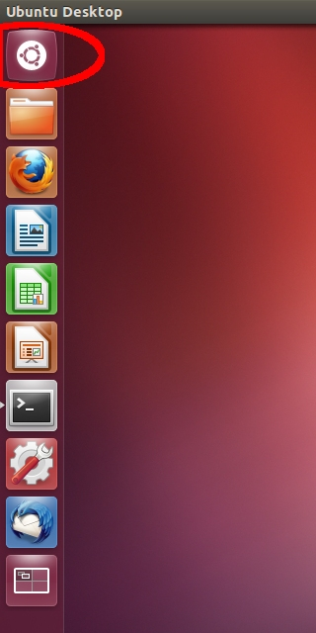
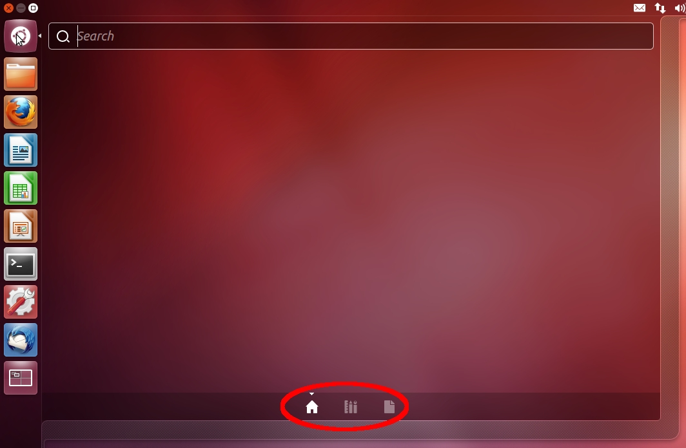
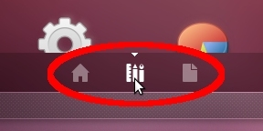
Editing Python scripts ― 1
Notes:
To edit scripts we will need a plain text editor. For the purposes of this course we will use an editor called “gedit”. You are welcome to use any text editor you are comfortable with (e.g. vi or emacs).
Unfortunately the route to launch the editor the first time is a bit clunky. Actually, it’s a lot clunky.
1. Click on the “Dash Home” icon at the top of the icon list.
This launches a selection tool that starts blank. If you have been using some other files then these may show as “recent files”.
2. At the bottom of the widget you will see the “house” icon highlighted. Click on the “three library books” icon next to it.
This switches the selector to the library of applications.

Slide 17
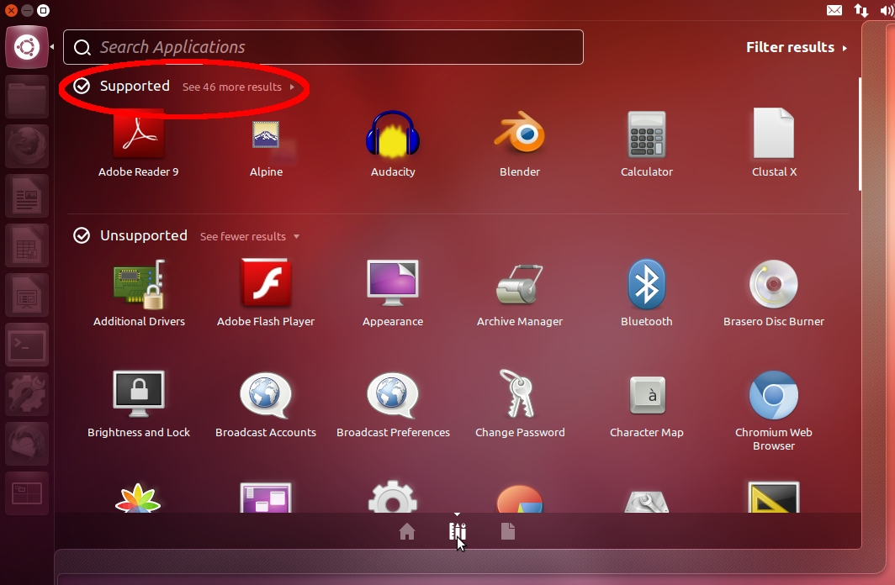
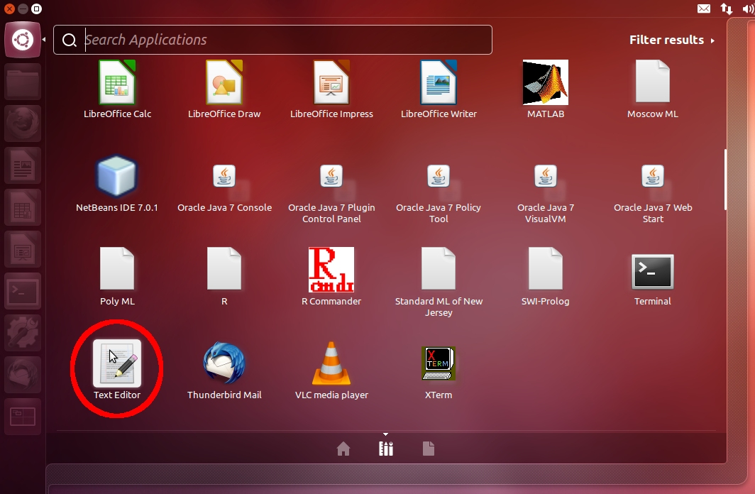
Editing Python scripts ― 2
Notes:
3. Click on the “see more results” text to expose the complete set of supported applications.
4. Scroll down until you see the “Text Editor” application. (The scroll mouse tends to work better than dragging the rather thin scroll bar.)
5. Click the “Text Editor” icon.

Slide 18
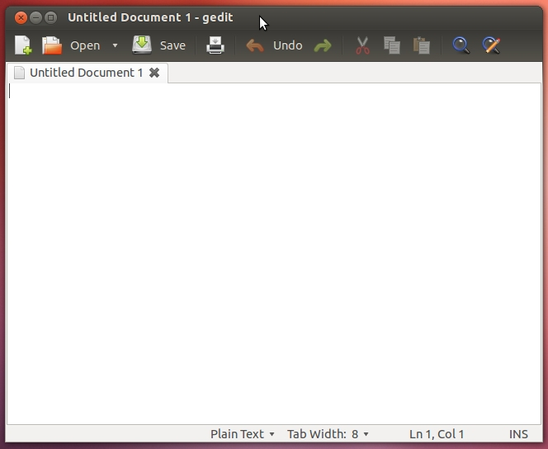
Editing Python scripts ― 3
Notes:
This will launch the text editor, gedit.

Slide 19
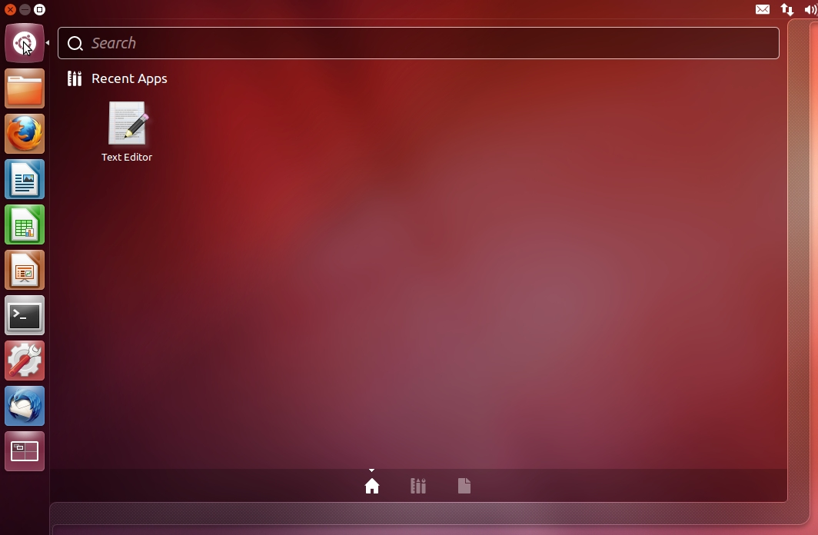
Editing Python scripts ― 4
Notes:
Future launches won’t be anything like as painful. In future the text editor will be immediately available in “Recent Apps”.

Slide 20
Progress
Interactive Python
Python scripts
print() command
Simple Python text

Slide 21
Exercise 1
1. Print “Goodbye, cruel world!” from interactive Python.
2. Edit exercise1.py to print the same text.
3. Run the modified exercise1.py script.
❢ Please ask if you have questions.
2 minutes
Notes:
During this course there will be some “lightning exercises”. These are very quick exercises just to check that you have understood what’s been covered in the course up to that point.
Here is your first.
First, make sure you can print text from interactive Python and quit it afterwards.
Second, edit the exercise1.py script and run the edited version with the different output.
This is really a test of whether you can get the basic tools running. Please ask if you have any problems!

Slide 22
A little more text
Full “Unicode” support
print('ℏэłᏓዐ, ω☺ⲗր∂‼')
www.unicode.org/charts/
hello2.py
Notes:
Now let’s look at a slightly different script just to see what Python can do.
Python 3 has excellent support for fully international text. (So did Python 2 but it was concealed.)
Python 3 supports what is called the “Unicode” standard, a standard designed to allow for characters from almost every language in the world. If you are interested in international text you need to know about the Unicode standard. The URL shown will introduce you to the wide range of characters supported.
The example in the slide contains the following characters:
ℏ PLANCK’S CONSTANT DIVIDED BY TWO PI
э CYRILLIC SMALL LETTER E
ł LATIN SMALL LETTER L WITH BAR
Ꮣ CHEROKEE LETTER DA
ዐ ETHIOPIC SYLLABLE PHARYNGEAL A
ω GREEK SMALL LETTER OMEGA
☺ WHITE SMILING FACE
ր ARMENIAN SMALL LETTER REH
ⲗ COPTIC SMALL LETTER LAUDA
∂ PARTIAL DIFFERENTIAL
‼ DOUBLE EXCLAMATION MARK

Slide 23
Getting characters
˘
AltGr
+
Shift
+
#
g
Linux
ğ
Character Selector
“LATIN SMALL
LETTER G
WITH BREVE”
\u011f
Notes:
I don’t want to get too distracted by international characters, but I ought to mention that the hardest part of using them in Python is typically getting them into Python in the first place.
There are three “easy” ways.
There are key combinations that generate special characters. On Linux, for example, the combination of the three keys [AltGr], [Shift], and [#] set up the breve accent to be applied to the next key pressed.
Perhaps easier is the “Character Selector” application. This runs like a free-standing “insert special character” function from a word processor. You can select a character from it, copy it to the clipboard and paste it into any document you want.
Finally, Python supports the idea of “Unicode codes”. The two characters “\u” followed by the hexadecimal (base 16) code for the character in the Unicode tables will represent that character. You have all memorized your code tables, haven’t you?

Slide 24
Text: a “string” of characters
>>>
type('Hello, world!')
<class 'str'>
A string of characters
Class: string
Length: 13
Letters
str
13
H
e
l
l
o
,
␣
w
o
r
l
d
!
Notes:
We will quickly look at how Python stores text, because it will give us an introduction to how Python stores everything.
Every object in Python has a “type” (also known as a “class”).
The type for text is called “str”. This is short for “string of characters” and is the conventional computing name for text. We typically call them “strings”.
Internally, Python allocates a chunk of computer memory to store our text. It stores certain items together to do this. First it records that the object is a string, because that will determine how memory is allocated subsequently. Then it records how long the string is. Then it records the text itself.

Slide 25
Text: “behind the scenes”
str
13
72
101
108
108
111
44
32
…
100
33
>>>
'\u011f'
011f₁₆
'ğ'
>>>
ord('ğ')
287₁₀
287
>>>
chr(287)
'ğ'
ğ
Notes:
In these slides I’m going to represent the stored text as characters because that’s easier to read. In reality, all computers can store are numbers. Every character has a number associated with it. You can get the number corresponding to any character by using the ord() function and you can get the character corresponding to any number with the chr() function.
Mathematical note:
The subscript 10 and 16 indicate the “base” of the numbers.

Slide 26
Adding strings together: +
“Concatenation”
print('Hello, ' + 'world!')
hello3.py
>>>
'Hello, ' + 'world!'
'Hello, world!'
>>>
Notes:
Now let’s do something with strings.
If we ‘add’ two strings together Python joins them together to form a longer string.
Python actually permits you to omit the “+”. Don’t do this.

Slide 27
Pure concatenation
>>>
'Hello,␣' + 'world!'
'Hello, world!'
>>>
'Hello,' + '␣world!'
Only simple
concatenation
'Hello, world!'
>>>
'Hello,' + 'world!'
No spaces added
automatically.
'Hello,world!'
Notes:
This joining together is very simple. If you want words split by a space you have to put the space in.

Slide 28
Single & double quotes
>>>
'Hello, world!'
Single quotes
'Hello, world!'
Single quotes
>>>
"Hello, world!"
Double quotes
'Hello, world!'
Single quotes
Notes:
It doesn’t matter whether we write our strings with single or double quotes (so long as they match at the two ends). Python simply notes that we are defining a string.

Slide 29
Python strings: input & output
'Hello, world!'
Single or double
quotes on input.
"Hello, world!"
Create same
string object.
'Hello, world!'
Single quotes on output.
Notes:
Internally there are no quotes, just a record that the object is text.
When Python comes to display the string and declares “this is text” itself it uses single quotes.

Slide 30
Uses of single & double quotes
>>>
print('He said "hello" to her.')
He said "hello" to her.
>>>
print("He said 'hello' to her.")
He said 'hello' to her.
Notes:
Having two sorts of quotes can be useful in certain circumstances. If you want the text itself to include quotes of one type you can define it surrounded by the other type.

Slide 31
Why we need different quotes
>>>
print('He said 'hello' to her.')
File "<stdin>", line 1
print('He said 'hello' to her.')
^
SyntaxError: invalid syntax
✘
Notes:
You must mix the quotes like that. If you do not then Python will be unable to make sense of the command.
We will look at Python’s error messages in more detail later.

Slide 32
Adding arbitrary quotes
>>>
print('He said \'hello\' to her.')
He said 'hello' to her.
\'
'
Just an ordinary
character.
\"
"
“Escaping”
Notes:
There is a more general solution to the “quotes within quotes” problem.
Preceding each quote within the body of the text signals to Python that this is just an ordinary quote character and should not be treated specially.
Note that what is encoded in the string is a single character. The backslash is a signal to the Python interpreter as its constructs the string. Once the string is constructed, with quotes in it, the backslash’s work is done.
This process of flagging a character to be treated differently than normal is called “escaping” the character.

Slide 33
Putting line breaks in text
Hello,
world!
What we want
>>>
print('Hello,
↵
Try this
world')
>>>
>>>
print('Hello,
↵
File "<stdin>", line 1
print('Hello,
^
✘
SyntaxError: EOL while
scanning string literal
“EOL”: End Of Line
Notes:
We will follow the theme of “inserting awkward characters into strings” by looking at line breaks.
We cannot insert a line break by hitting the [↵] key. This signals to Python that it should process the line so far and Python cannot; it is incomplete.

Slide 34
Inserting “special” characters
>>>
print('Hello,
\n
world!')
Hello,
world!
Treated as
a new line.
\n
Converted into a
single character.
str
13
H
e
l
l
o
,
↵
w
o
r
l
d
!
>>>
len
('Hello,\nworld!')
13
len() function: gives
the length of the object
Notes:
Again, the backslash character comes to our rescue.
If we create a string with the sequence “\n” then Python interprets this as the single character ↵.
Python can tell us exactly how many characters there are in a string. The len() function tells us the length of the string in characters. There are 13 characters in the string created by 'Hello,\nworld!'. The quotes are not part of the text and the \n becomes a single character.

Slide 35
The backslash
Special
Ordinary
\'
'
\"
"
Ordinary
Special
\n
↵
\t
⇥
Notes:
We have used backslash again, this time for a slightly different result. Backslash before a character with special significance, such as the quote character, makes the character “ordinary”. Used before an ordinary character, such as “n”, it produces something “special”.
Only a few ordinary characters have special characters associated with them but the two most commonly useful are these:
\n ↵ new line
\t ⇥ tab stop

Slide 36
\n: unwieldy for long text
'SQUIRE TRELAWNEY, Dr. Livesey, and the\n
rest of these gentlemen having asked me\n
to write down the whole particulars\nabou
t Treasure Island, from the\nbeginning to
the end, keeping nothing\nback but the b
earings of the island,\nand that only bec
ause there is still\ntreasure not yet lif
ted, I take up my\npen in the year of gra
ce 17__ and go\nback to the time when my
father kept\nthe Admiral Benbow inn and t
he brown\nold seaman with the sabre cut f
irst\ntook up his lodging under our roof.'
Single
line
Notes:
The “\n” trick is useful for the occasional new line. It is no use for long texts where we want to control the formatting ourselves.

Slide 37
Special input method for long text
'''
SQUIRE TRELAWNEY, Dr. Livesey, and the
rest of these gentlemen having asked me
to write down the whole particulars
about Treasure Island, from the
beginning to the end, keeping nothing
back but the bearings of the island,
and that only because there is still
treasure not yet lifted, I take up my
pen in the year of grace 17__ and go
back to the time when my father kept
the Admiral Benbow inn and the brown
old seaman with the sabre cut first
took up his lodging under our roof.
'''
Triple
quotes
Multiple
lines
Notes:
Python has a special trick precisely for convenient definition of long, multi-line text.
If you start the text with a “triple quote” then the special treatment of hitting the [↵] key is turned off. This lets you enter text “free form” with natural line breaks.
The triple quote is three quote characters with no spaces between them. The quote character used can be either one but the triple use at one end must match the one used at the other end.

Slide 38
Python’s “secondary” prompt
>>>
'''Hello,
world'''
...
Python asking for more
of the same command.
Notes:
The triple quote lets us see another Python feature. If we type a long string raw then after we hit ↵ we see Python’s “secondary prompt”. The three dots indicate that Python is expecting more input before it will process what it has in hand.

Slide 39
It’s still just text!
>>>
'Hello,\nworld!'
'Hello
\n
world'
Python uses \n to represent
line breaks in strings.
>>>
...
'''Hello,
world!'''
'Hello\nworld'
Exactly the same!
Notes:
It is also important to note that triple quotes are just a trick for input. The text object created is still a standard Python string. It has no memory of how it was created.
Also note that when Python is representing the content of a string object (as opposed to printing it) it displays new lines as “\n”.

Slide 40
Your choice of input quotes:
Four inputs:
'Hello,\nworld!'
"Hello,\nworld!"
'''Hello,
world!'''
"""Hello,
world!"""
Same result:
str
13
H
e
l
l
o
,
↵
w
o
r
l
d
!
Notes:
We have now seen four different ways to create a string with an embedded new line. They all produce the same string object.

Slide 41
Progress
International text
print()
Concatenation of strings
Special characters
Long strings

Slide 42
Exercise 2
1. Replace XXXX in exercise2.py so it prints the following
text (with the line breaks) and then run the script.
coffee
café
caffè
Kaffee
è
\u00e8
AltGr
+
;
e
é
\u00e9
AltGr
+
#
e
3 minutes
Notes:
There is more than one way to do this.
You can get the line breaks with \n in a single-quoted string or with literal line breaks in a triple-quoted string. An alternative, but not in keeping with the exercise, is to have four print() statements.
You can get the accented characters by using the \u sequences or you can type them in literally with the keyboard combinations shown. (Linux only)

Slide 43
Attaching names to values
“variables”
message = 'Hello, world!'
print(message)
>>>
message='Hello, world!'
>>>
message
hello4.py
'Hello, world!'
>>>
type(message)
<class 'str'>
message
str
13
H
e
l
l
o
,
␣
w
o
r
l
d
!
Notes:
Now we will move on to a serious issue in learning any computing language: how to handle names for values.
Compare the two scripts hello1.py and hello4.py. They both do exactly the same thing.
We can enter the text of hello4.py manually if we want using interactive Python, it will work equally well there.
The first line of hello4.py creates the string ‘Hello, world!’ but instead of printing it out directly the way that hello1.py does, it attaches a name, “message”, to it.
The second line runs the print() function, but instead of a literal string as its argument it has this name instead. Now the name has no quotes around it, and as I said earlier this means that Python tries to interpret it as something it should do something with. What it does is to look up the name and substitute in the attached value.
Whenever the name is used, Python will look it up and substitute in the attached value.

Slide 44

Attaching names to values
message = 'Hello, world!'
print(message)
>>>
type(print)
<class 'builtin_function_or_method'>
hello4.py
print
function
message
str
13
H
e
l
l
o
,
␣
w
o
r
l
d
!
Notes:
Both “print” and “message” are the same this way. Both are names attached to Python objects. “print” is attached to a chunk of memory containing the definition of a function and “message” is attached to a chunk of memory containing the text.

Slide 45
Reading some text into a script
message = input('Yes?␣')
print(message)
$
python3
input1.py
input1.py
input('Yes?␣')
Yes?
Boo!
message = …
Boo!
print(message)
Notes:
Now that we know how to attach names to values we can start receiving input from the user of our script.
For this we will use the cunningly named “input()” function.
This function takes some (typically short) text as its argument. It prints this text as a prompt and then waits for the user to type something back (and press [↵]. It then returns whatever the user typed (without the [↵]) as its value.
We can use this function on the right hand side of an assignment.
Recall that the assignment completely evaluates the right hand side first. This means that it has to evaluate the input() function, so it prompts the user for input and evaluates to whatever it was that the user typed.
Then the left hand side is processed and the name “message” is attached to this value.
We can then print this input text by using the attached name.

Slide 46
Can't read numbers directly!
✘
$
python3
input2.py
number = input('N?␣')
print(number + 1)
N?
10
input2.py
Traceback (most recent call last):
File "input2.py", line 2, in <module>
print(
number
+
1
)
TypeError:
Can't convert 'int' object to str implicitly
string
integer
Notes:
In the previous example script input1.py we simply took what we were given by input() and printed it. The print() function is a flexible beast; it can cope with almost anything.
The script hello2.py attempts to take what is given and do arithmetic with it, namely add 1 to it. It fails, even though we type a number at input()’s prompt.
This also gives us an error message and it’s time to investigate Python’s error messages in more detail.
The first (the “trace back”) tells us where the error was. It was on line 2 of the file input2.py. It also tells us what was on the line. Recall that with syntax errors it also pointed out where in the line it realized something was going wrong.
The second part tells us what the error was: we tried to add a string (text) and an integer (a number). More precisely, Python couldn’t convert the things we were adding together into things that we could add.

Slide 47
input(): strings only
✘
$
python3
input2.py
number = input('N?␣')
print(number + 1)
N?
10
input2.py
str
input('N?␣')
2
1
0
≠
int
10
Notes:
The problem is that the input() function always returns a string and the string “character 1 followed by character 0” is not the same as the integer ten.
We will need to convert from the string to the integer explicitly.

Slide 48
Some more types
>>>
type('Hello, world!')
<class 'str'>
string of characters
>>>
type(42)
<class 'int'>
integer
>>>
type(3.14159)
<class 'float'>
floating point number
Notes:
To date we have seen only two types: “str” and “builtin_function_or_method”. Here are some more.
Integers (whole numbers) are a type called “int”.
Floating point numbers (how computers approximate real numbers) are a type called “float”.
The input() function gave is a “str”. We want an “int”.

Slide 49
Converting text to integers
>>>
int('10')
str
int
2
1
0
10
10
>>>
int('␣-100␣')
str
6
␣
-
1
0
0
␣
-100
int
-100
✘
>>>
int('100-10')
ValueError:
invalid literal for int() with base 10: '100-10'
Notes:
There is a function — also called “int()” ― that converts the textual representation of an integer into a genuine integer.
It copes with extraneous spaces and other junk around the integer but it does not parse general expressions. It will take the textual form of a number, but that's it.

Slide 50
Converting text to floats
>>>
float('10.0')
'10.0' is a string
10.0
10.0 is a floating
point number
>>>
float('␣10.␣')
10.0
Notes:
There is a similar function called float() which creates floating point numbers.

Slide 51
Converting between ints and floats
>>>
float(10)
10.0
>>>
int(10.9)
10
Truncates
fractional part
>>>
int(-10.9)
-10
Notes:
The functions can take more than just strings, though. They can take other numbers, for example. Note that the int() function truncates floating point numbers.

Slide 52
Converting into text
>>>
str(10)
integer
string
'10'
>>>
str(10.000)
float
string
'10.0'
Notes:
There is also a str() function for turning things into strings.

Slide 53
Converting between types
int()
anything
integer
float()
anything
float
str()
anything
string
Functions named after the type they convert into.
Notes:
In general there is a function for each type that converts whatever it can into that type.

Slide 54
Reading numbers into a script
text = input('N?␣')
number = int(text)
print(number + 1)
$
python3
input3.py
input3.py
N?
10
11
Notes:
So finally we can see what we have to do to make our failing script work: we need to add a type conversion line.

Slide 55
Progress
Names
Values
name = value
Types
strings
integers
floating point numbers
Reading in text
input(prompt)
Type conversions
str() int() float()

Slide 56
Exercise 3
Replace the two XXXX in exercise3.py to do the following:
1. Prompt the user with the text “How much?␣”.
2. Convert the user’s answer to a floating point number.
3. Print 2.5 plus that number.
3 minutes

Slide 57
Integers
ℤ
{… -2, -1, 0,
1, 2, 3, 4 …}
Notes:
Now that we have some rudimentary understanding of Python it’s time to dive in a little deeper to the three types we have met so far.
We are going to start with the whole numbers, “integers” in technical language.
Mathematical note:
The fancy Z is the mathematical symbol for the integers based on the German word Zahlen.

Slide 58
Integer addition & subtraction
>>>
20+5
25
>>>
20␣-␣5
Spaces around the
operator don’t matter.
15
“No surprises”
Notes:
We can start our handling of integers with some very basic arithmetic.
Note that spaces around the plus and minus character are ignored.
Adding or subtracting two integers simply gives a third integer.

Slide 59
Integer multiplication
There is no “×” on the keyboard.
Linux:
AltGr
+
Shift
+
,
Use “*” instead
>>>
20␣*␣5
100
Still no surprises
Notes:
The arithmetical operations addition and subtraction have their usual mathematical symbols reflected on the standard keyboard. We have a plus sign and a minus sign (actually a “hyphen”) character and we use them.
There is no multiplication symbol on the standard keyboard. You can generate it as one of the octopus-friendly key combinations, but it’s not a simple key.
Instead, the computing profession has settled on using the asterisk (“*”) to represent multiplication. On your keyboards this is [Shift]+[8].
Multiplying two integers gives a third integer.

Slide 60
Integer division
There is no “÷” on the keyboard.
Linux:
AltGr
+
Shift
+
.
Use “/” instead
>>>
20␣/␣5
4.0
This is a floating point number!
Surprise!
Notes:
There is no division symbol on the keyboard without holding three keys down at the same time. Again a convention has arisen to use the forward slash character (strictly called a “solidus”) for division.
So far there have been no surprises in Python’s integer arithmetic. That changes with division.
Not all integer division can be achieved precisely. You cannot divide 3 into 5 exactly. Because of this Python 3 always returns a type of number capable of representing fractional values (a floating point number) even when the division would have been exact.

Slide 61
Integer division gives floats !
!
Fractions
Floats sometimes
Consistency
Floats always
>>>
20␣/␣40
0.5
>>>
20␣/␣30
0.6666666666666666
Notes:
The designers of Python decided that consistency of output was important and therefore because it might sometimes need to use a float it should always use a float.
Note that even floating point numbers cannot exactly represent all fractions. ½ can be precisely represented but ⅔ cannot. We will return to the imprecision of floating point numbers when we look at them in detail.
(If you really want to stick to integers then Python 3 offers the “//“ operator which returns an integer answer, rounded strictly down in case of fractional answers.)

Slide 62
Integer powers
There is no “4²” on the keyboard.
Use “**” instead
>>>
4␣**␣2
Spaces around the
operator don’t matter.
16
>>>
4*␣*2
Spaces in the
operator do!
SyntaxError: invalid syntax
Notes:
Just as there is no mathematical symbol on the keyboard for multiplication and division, there is no symbol at all for raising to powers. Mathematically we represent it by superscripting the power after the number being raised.
We can’t do this on the keyboard so instead we cheat and invent our own symbol for the operation.
Computing has split for this operation. Some languages use the circumflex accent (“^”) and others, including Python, use a double asterisk, “**”.
Note that while spaces around the operator are ignored you can’t split the two asterisks.

Slide 63
Integer remainders
e.g. Is a number even or odd?
Use “%”
>>>
4␣%␣2
0
>>>
5␣%␣2
1
>>>
-5␣%␣2
1
Remainder is always non-negative
Notes:
There’s one last integer arithmetic operator we will use once in a while.
Another way to look at division is to ask what the remainder is after a division. Python represents this concept by using the percent sign between to numbers to represent the remainder when the first number is divided by the second.
We will use it for one purpose only in this course: to determine if a number is even or odd. If a number’s remainder when divided by 2 is 0 then it’s even and if the remainder is 1 then it’s odd.

Slide 64
How big can a Python integer be?
>>>
>>>
2**2
2**2
4
4
>>>
4**2
16
>>>
16**2
256
>>>
>>>
>>>
256**2
256**2
256**2
65536
65536
65536
>>>
65536**2
4294967296
Notes:
Now we will look at the numbers themselves. We can ask the question “how big can an integer be?” Mathematically, of course, there is no limit. In a computer there are always limits. Each computer has only a finite amount of memory to store information so there has to be a limit. We will see that Python has no limits in principle and it is only the technical limit of the computer that can restrict us. In practice this is never an issue for the size of integers.
We will experiment with large integers by repeated squaring. We start with a 2 and keep squaring.

Slide 65
How big can a Python integer be?
>>>
4294967296**2
18446744073709551616
>>>
18446744073709551616**2
340282366920938463463374607431768211456
>>>
340282366920938463463374607431768211456**2
1157920892373161954235709850086879078532699846 65640564039457584007913129639936
>>>
115792089237316195423570985008687907853269
984665640564039457584007913129639936**2
1340780792994259709957402499820584612747936582 0592393377723561443721764030073546976801874298 1669034276900318581864860508537538828119465699 46433649006084096
Notes:
Python takes it in its stride and happily carries on.

Slide 66
How big can a Python integer be?
10443888814131525066917527107166243825799642490473837803842334832839
53907971557456848826811934997558340890106714439262837987573438185793
60726323608785136527794595697654370999834036159013438371831442807001
18559462263763188393977127456723346843445866174968079087058037040712
84048740118609114467977783598029006686938976881787785946905630190260
94059957945343282346930302669644305902501597239986771421554169383555
98852914863182379144344967340878118726394964751001890413490084170616
75093668333850551032972088269550769983616369411933015213796825837188
09183365675122131849284636812555022599830041234478486259567449219461
70238065059132456108257318353800876086221028342701976982023131690176
78006675195485079921636419370285375124784014907159135459982790513399
61155179427110683113409058427288427979155484978295432353451706522326
90613949059876930021229633956877828789484406160074129456749198230505
71642377154816321380631045902916136926708342856440730447899971901781
46576347322385026725305989979599609079946920177462481771844986745565
92501783290704731194331655508075682218465717463732968849128195203174
57002440926616910874148385078411929804522981857338977648103126085903
00130241346718972667321649151113160292078173803343609024380470834040
3154190336
There is no limit!
Except for
machine
memory
Notes:
The Python language has no limit on the size of integer.

Slide 67
Big integers
2
C / C++
Fortran
4
16
int
INTEGER*4
256
long
INTEGER*8
65536
4294967296
long long
INTEGER*16
18446744073709551616
Out of the reach
of C or Fortran!
3402823669209384634…
63374607431768211456
Notes:
This may sound rather trivial but, in fact, Python is quite exceptional in this regard. The compiled languages have to allocate space for their integers in advance and so place limits on how large they can grow.

Slide 68
Floating point numbers
ℝ
✗
1.0
0.33333333
3.14159265
2.71828182
Notes:
And that’s it for whole numbers. Now we will look at floating point numbers, a computer’s way of storing fractional values. This is a computer’s approximation to the real numbers. As we will see it is a problematic approximation.
The fancy ℝ is the mathematical symbol for the real numbers, from the English word Real.

Slide 69
Basic operations
>>>
20.0 + 5.0
>>>
20.0 - 5.0
25.0
15.0
>>>
20.0 * 5.0
>>>
20.0 / 5.0
100.0
4.0
>>>
20.0 ** 5.0
Equivalent to integer arithmetic
3200000.0
Notes:
For our basic operations, floating point numbers behave just the same as integers, using the same operators to achieve the same results. Floating point division creates a floating point number.

Slide 70
Floating point imprecision
>>>
1.0 / 3.0
0.3333333333333333
>>>
10.0 / 3.0
If you are relying on
this last decimal place,
you are doing it wrong!
3.3333333333333335
≈ 17 significant figures
Notes:
So let’s see our first problem.
Floating point arithmetic is not exact, and cannot be.
Floating point numbers on modern hardware tends to give a precision of 17 significant figures. You do see the occasional issue as shown on the slide but, frankly, if you are relying on the exact value of the final decimal place you are doing it wroing.

Slide 71
Hidden imprecision
!
>>>
0.1
0.1
>>>
0.1 + 0.1
0.2
>>>
0.1 + 0.1 + 0.1
Really: if you are relying on
this last decimal place,
you are doing it wrong!
0.30000000000000004
Notes:
Not all imprecision is overt. Some of it can creep up on you.
Computers work in base 2. They can store numbers like ½ and ⅞ exactly. But they cannot store numbers like 1/10 exactly, just like we can’t represent ⅓ exactly in a decimal expansion.
The errors in storing 1/10 are small enough, though, that they are invisible at first. However, if they accumulate they become large enough to show through.
Really: don’t depend on precise values.

Slide 72
How big can a Python float be? ― 1
>>>
65536.0**2
So far, so good.
4294967296.0
>>>
4294967296.0**2
Switch to
“scientific notation”
1.8446744073709552e+19
1.8446744073709552
e+19
1.8446744073709552
×10¹⁹
Notes:
Let’s ask the same question about floats as we asked about integers: how large can they be?
We will repeat our approach of repeated squaring. We fast-forward to start at 65536.0 squared and notice that we soon get anomolous responses.
When we square 4,294,967,296 we get a number with the letter “e” in it. User’s of pocket calculators at school may recognise this representation: it indicates a number between 1.0 and 9.999… multiplied by a power of 10.
Floating point numbers can only hold roughly 17 significant figures of accuracy. This means that when the integer needs more than 17 digits something has to give.

Slide 73
Floats are not exact
>>>
4294967296.0**2
Floating point
1.8446744073709552e+19
>>>
4294967296**2
Integer
18446744073709551616
1.8446744073709552×10¹⁹
18446744073709552000
-
18446744073709551616
384
Notes:
The approximation isn’t bad. The error is 384 in 18446744073709551616, or approximately 2×10⁻¹⁷.

Slide 74
How big can a Python float be? ― 2
>>>
1.8446744073709552e+19**2
3.402823669209385e+38
>>>
3.402823669209385e+38**2
1.157920892373162e+77
>>>
1.157920892373162e+77**2
So far, so good.
1.3407807929942597e+154
>>>
1.3407807929942597e+154**2
Too big!
OverflowError: (34,
'Numerical result out of range')
Notes:
If we accept that our answers are now only approximate we can keep squaring. The “e-number” representation of scientific notation is accepted on input by Python.
When we come to square 1.3407807929942597×10¹⁵⁴, though, we hit another issue, this one fatal.
We get an “overflow error”. This means we have tried to create a floating point number larger than Python can cope with. Under some circumstances the “too big” problem gives rise to a sort-of-number called “inf” (standing for “infinity”).

Slide 75
Floating point limits
1.2345678901234567
×
10^{N}
17 significant figures
-325 < N < 308
Positive values:
4.94065645841×10⁻³²⁴ < N < 8.98846567431×10³⁰⁷
Notes:
Just for the record, floating point numbers have limits both in terms of the largest and smallest numbers they can contain.

Slide 76
Complex numbers
ℂ
ℑ
z²
z
ℜ
>>>
(1.25+0.5j)**2
(1.3125+1.25j)
Notes:
Python also supports complex numbers, using j for the square root of -1. We will not use them in this course, but you ought to know they exist.

Slide 77
Progress
Arithmetic
+ - * / ** %
Integers
No limits!
Floating point numbers
Limited size
Limited precision
Complex numbers

Slide 78
Exercise 4
Replace the XXXX in exercise4.py to evaluate
and print out the following calculations:
1. 223 ÷ 71
2. (1 + 1/10)¹⁰
3. (1 + 1/100)¹⁰⁰
4. (1 + 1/1000)¹⁰⁰⁰
3 minutes

Slide 79
Comparisons
5 < 10
✔
5 > 10
✘
✘
✘
✘
✘
✘
✘
✘
✘
Notes:
We can do arithmetic on numbers. What else?
We need to be able to compare numbers.
Is 5 less than 10? Yes it is.
Is 5 greater than 10? No it isn’t.

Slide 80
Comparisons
>>>
5 < 10
Asking the question
✔
True
>>>
5 > 10
Asking the question
✘
✘
✘
✘
✘
✘
✘
✘
✘
False
Notes:
Now let’s see that in Python.
The “less than” character appears on the keyboard so we don’t need anything special to express the concept like “**” for powers.
Python seems to answer the questions with “True” and “False”.

Slide 81
True & False
>>>
type(True)
<class 'bool'>
“Booleans”
5
+
10
15
int
int
int
5
<
10
True
bool
Notes:
The important thing to understand is that this is not just Python reporting on a test but rather the value generated by the test. True and False are (the only) two values of a special Python type called a “Boolean” used for recording whether something is true or not.
Just as the “+” operator takes two integers and returns an integer value, the “<” operator takes two integers and returns a Boolean.
Booleans are named after George Boole, whose work laid the ground for modern algebraic logic. (His classic book’s full title is “An Investigation of the Laws of Thought on Which are Founded the Mathematical Theories of Logic and Probabilities”, in true Victorian style.)

Slide 82
True & False
bool
✓
True
Only two values
bool
✗
False
Notes:
The boolean type has precisely two values.

Slide 83
Six comparisons
Maths
Python
=
==
Double equals sign
≠
!=
<
<
>
>
≤
<=
≥
>=
Notes:
There are six comparison operations in Python.
The equality comparison is defined in Python with a double equals sign, “==”. The sign is doubled to distinguish comparison from assignment.
There is no “not equals” symbol on the standard keyboard. Instead, Python uses the “!=” pair of characters. (As with “**” there must be no space between the two characters.)
“Less than” and “greater than” we have already covered. These are implemented directly by the “<” and “>” characters.
There are no “less than or equal to” or “greater than or equal to” keys, though, so Python resorts to double character sequences again.

Slide 84
Equality comparison & assignment
=
name = value
Attach a name to a value.
==
value₁ == value₂
Compare two values
Notes:
If ever there was a “classic typo” in programming it is the confusion of “=” and “==”. Be careful.

Slide 85
Textual comparisons
>>>
'cat' < 'dog'
Alphabetic ordering
True
>>>
'Cat' < 'cat'
Uppercase before lowercase
True
>>>
'Dog' < 'cat'
All uppercase before lowercase
True
Notes:
Booleans typically arise from comparisons. We can compare more than numbers (integers or floating point). We can also compare strings.
Text comparisons are based around the ordering of characters in the Unicode character set. Note that all the uppercase letters in the Latin alphabet precede all the lowercase letters. So any text that starts with an uppercase letter counts as “less than“ any text that starts with a lowercase letter.

Slide 86
Ordering text is complicated
Python inequalities use Unicode character numbers.
This is over-simplistic for “real” use.
“Collation” is a whole field of computing in itself
Alphabetical order?
Traditional German usage?
German:
z < ö
Dictionary:
of < öf
Swedish:
ö < z
Phone book:
öf < of
Notes:
Please note, however, that this is just a comparison of strings. It is not a general comparison of text. Ordering text is called “collation” and is a very compicated field.
For example, different languages order characters differently. Some countries have different orderings for different purposes.
If you want to learn more about this field, start with the Unicode page on collation: http://www.unicode.org/reports/tr10/

Slide 87
“Syntactic sugar”
0 < number
0 < number < 10
and
number < 10
>>>
number = 5
>>>
0 < number < 10
True
Notes:
A common requirement is to determine if a number lies in a particular range. For this purpose, Python supports the mathematical notation a < b < c. The inequalities can be any combination that make sense.

Slide 88
Converting to booleans
float()
Converts to floating point numbers
<class 'float'>
int()
Converts to integers
<class 'int'>
str()
Converts to strings
<class 'str'>
bool()
Converts to booleans
<class 'bool'>
Notes:
As with all Python types there is a function named after the type that tries to convert arbitrary inputs into Booleans. Given that there are only two Boolean values this tends to be a very simple function.

Slide 89
Useful conversions
''
False
Empty string
'Fred'
True
Non-empty string
0
False
Zero
1
True
Non-zero
12
True
-1
True
Notes:
The empty string is mapped to False. Every other string is mapped to True.
For integers, 0 is mapped to False and every other value to True.
For floating point numbers, 0.0 is mapped to False and every other value to True.

Slide 90
Boolean operations
bool
?
bool
bool
bool
Numbers have +, –, * …
✓
bool
What do booleans have?
✗
Notes:
Boolean types have their own arithmetic just like ordinary numbers. It was the algebra of these that George Boole developed.

Slide 91
Boolean operations ― “and”
bool
and
bool
bool
True
and
True
True
Both have
to be True
True
and
False
False
False
and
True
False
False
and
False
False
Notes:
The first operation on Booleans is the “and” operator.
The and of two booleans values is True if (and only if) both its inputs are True. If either is False then its output is False.
>>> True and False
False
>>> True and True
True

Slide 92
Boolean operations ― “and”
>>>
4 < 5 and 6 < 7
4 < 5
True
and
True
True
6 < 7
True
>>>
4 < 5 and 6 > 7
4 < 5
True
and
False
False
6 > 7
False
Notes:
We are much more likely to encounter the input booleans as the results of comparisons that as literal values.

Slide 93
Boolean operations ― “or”
bool
or
bool
bool
True
or
True
True
At least
one has
to be True
True
or
False
True
False
or
True
True
False
or
False
False
Notes:
The next boolean operation to look at is “or”. The results of this operation is True if either of its inputs are True and False only if both its inputs are False.

Slide 94
Boolean operations ― “or”
>>>
4 < 5 or 6 < 7
4 < 5
True
or
True
True
6 < 7
True
>>>
4 < 5 or 6 > 7
4 < 5
True
or
True
True
6 > 7
False
Notes:
Again, we tend to encounter it more often with other tests than with literal booleans.

Slide 95
Boolean operations ― “not”
bool
not
bool
not
True
False
not
False
True
Notes:
The final operation is “not”. This takes only one input and “flips” it. True becomes False and vice versa.

Slide 96
Boolean operations ― “not”
>>>
not 6 < 7
6 < 7
True
not
False
False
>>>
not 6 > 7
6 > 7
False
not
True
True

Slide 97
Ambiguity in expressions
3 + 6 / 3
✘
✔
✘
✘
✘
✘
✘
✘
✘
✘
(3 + 6) / 3
3 + (6 / 3)
3
5

Slide 98
Division before addition
3
+
6 / 3
Division first
3
+
2
Addition second
5

Slide 99
“Order of precedence”
First
x**y
-x
+x
x%y
x/y
x*y
x-y
x+y
x==y
x!=y
x>=y
x>y
x<=y
x<y
not x
x and y
x or y
Last

Slide 100
Progress
Comparisons
== != < > <= >=
Numerical comparison
5 < 7
Alphabetical ordering
'dig' < 'dug'
Booleans
True
False
Boolean operators
and or not
Order of precedence

Slide 101
Exercise 5
Predict whether these expressions will evaluate to True or False.
Then try them.
1.
'sparrow' > 'eagle'
2.
'dog' < 'Cat' or 45 % 3 == 15
3.
60 - 45 / 5 + 10 == 1
3 minutes

Slide 102
Names and values: “assignment”
>>>
alpha = 100
1.
alpha =
100
int
Python creates
an “integer 100”
in memory.
100
2.
alpha =
100
Python attaches
the name “alpha” to the value.
alpha
int
100
Notes:
Now let’s go back to the attaching of names to values that we saw with our hello3.py script.
Consider the simple Python instruction shown.
Python does two things, strictly in this order:
First, it notices the literal value 100 (an integer). So Python allocates a chunk of memory large enough and creates a Python object in it that contains a Python integer with value 100.
Second, it creates the name “alpha” and attaches it to the integer.

Slide 103
Assignment: right to left
alpha
=
100
“RHS”: right hand side
Evaluated first
“LHS”: left hand side
Processed second
Notes:
The key thing to note is that the processing happens right to left. Everything to the right hand side is processed first. Only after that processing is done is the left hand side considered.
In this example it’s trivial. It will become less trivial very soon so remember that the right hand side is evaluated before the left hand side is even looked at.
ps: Computing uses the phrases “left hand side” and “right hand side” so often that they are typically written as “LHS” and “RHS”.

Slide 104
Simple evaluations
>>>
beta = 100 + 20
1.
100
+
20
RHS
int
function
int
100
+
20
2.
int
120
3.
beta
int
LHS
120
Notes:
We can see a slightly more involved example if we put some arithmetic on the RHS.
Again, the RHS is evaluated first.
First, Python notices three “tokens”: the 100, the name “+” and the 20. It creates two integer objects just as it did with the previous example and it looks up a pre-existing function object that does addition of integers.
Second, Python triggers the addition function to generate a third integer with the value 120.
This completes the evaluation of the RHS.
Third, Python creates a name “beta” and attaches it to the freshly created integer 120.

Slide 105
Names on the RHS — 1
>>>
gamma = alpha + 40
alpha
+
40
RHS
1.
alpha
2.
int
function
int
100
+
40
3.
int
140
Notes:
Now we will consider a more significantly involved example, one with a name on the RHS.
First, Python recognizes the three tokens on the RHS. These are the name “alpha” the “+” and the literal integer 40.
Second, it looks up the names. The “alpha” is replaced by the integer 100 and the name “+” is replaced by the actual function that does addition. The token 40 is replaced by the actual integer 40 in memory.
Third, it runs the function to give an integer 140 object in memory.

Slide 106
Names on the RHS — 2
>>>
gamma = alpha + 40
LHS
4.
gamma
int
140
Notes:
Only after all that is the LHS considered, and the name “gamma” is created and attached to the newly minted integer.

Slide 107
Same name on both sides — 0
Starting
position
gamma
int
140
>>>
print(gamma)
140
Notes:
Now (finally!) we get to the interesting case.
We start with the name gamma being attached to the value 140.

Slide 108
Same name on both sides — 1
RHS
>>>
gamma = gamma + 10
1.
gamma
+
10
2.
gamma
3.
int
function
int
140
+
10
4.
int
150
Notes:
Then we run an assignment that has the name gamma on both the left and right hand sides.
Again, first of all Python focuses exclusively on the RHS.
The expression “gamma + 10” is evaluated to give rise to an integer 150 in Python memory.

Slide 109
Same name on both sides — 2
LHS
>>>
gamma = gamma + 10
int
150
RHS
5.
gamma
int
140
int
150
RHS
6.
gamma
int
140
Notes:
Only once that evaluation is complete does Python turn its attention to the LHS.
The name gamma is going to be attached to the integer 150 in Python memory. No attention is paid to where the integer 150 came from.
The name gamma is already in use and is attached to the integer 140. Its attachment is changed to the new integer 150.

Slide 110
Same name on both sides — 3
LHS
>>>
gamma = gamma + 10
int
150
7.
✗
gamma
int
No longer
used.
140
gamma
int
8.
150
Notes:
Once that is done there are no remaining references to the old integer 140. Python automatically cleans it up, freeing the space for re-use.
This is a process called “garbage collection”. In some languages you have to free up unused space yourself; in Python the system does it for you automatically.

Slide 111
“Syntactic sugar”
thing += 10
thing = thing + 10
thing -= 10
thing = thing - 10
thing *= 10
thing = thing * 10
thing /= 10
thing = thing / 10
thing **= 10
thing = thing ** 10
thing %= 10
thing = thing % 10
Notes:
The operation of modifying a value is so common that Python, and some other languages, have short-cuts in their syntax to make the operations shorter to write. These operations are called “augmented assignments”.
This sort of short-cut for an operation which could already be written in the language is sometimes called “syntactic sugar”.

Slide 112
Deleting a name ― 1
>>>
print(thing)
Traceback (most recent call last):
File "<stdin>", line 1, in <module>
NameError: name 'thing' is not defined
Unknown
variable
>>>
thing = 1
>>>
print(thing)
1
Notes:
There’s one last aspect of attaching names to values hat we need to consider. How do we delete the attachment?
First of all, let’s see what it looks like when we refer to a name that isn’t known to the system. The error message is quite straightforward:
name 'thing' is not defined
If we then create the name and attach it to a value, the integer 1 in this example, we can then use the name without error message.

Slide 113
Deleting a name ― 2
>>>
print(thing)
1
Known
variable
>>>
del thing
>>>
print(thing)
Traceback (most recent call last):
File "<stdin>", line 1, in <module>
NameError: name 'thing' is not defined
Unknown
variable
Notes:
To delete the attachment we use the Python command “del”. The command
del thing
returns us to the state where the name is no longer known.
You can delete multiple names with the slightly extended syntax
del thing1, thing2, thing3
This is equivalent to
del thing1
del thing2
del thing3
but slightly shorter.

Slide 114
Common mistake
!
a = 10
b = 7
a = a + b
a = 17
a has now changed!
b = a - b
b = a - b
= 17 - 7
= 10
b ≠ 10 - 7 = 3
Later in the course: “tuples”
(a,b) = (a+b, a-b)
Notes:
While we are looking at attaching names to values and changing those values, we will take the time to review a common “rookie mistake” especially among people who do linear transformations.
Suppose we want to encode the mapping
we need to be careful not to use a “half-transformed” state in the second half of the transformation. If we calculate the new value for one coordinate we can’t (trivially) use it in the calculation of the new value of the second coordinate.
Later in this course when we look at “tuples” we will see a slick Python way to fix this problem.
$$\left(\begin{matrix}a \\ b\end{matrix}\right)→\left(\begin{matrix}a+b \\ a−b\end{matrix}\right)$$

Slide 115
Progress
Assignment
thing = thing + 10
Deletion
del thing
Strictly right to left
thing =
thing + 10
2nd
1st
+= etc. “syntactic sugar”
thing += 10

Slide 116
Our first “real” program
$
python3 sqrt.py
We have to write sqrt.py
Number?
2.0
1.414213562373095
First, the maths.
Then, the Python.
Notes:
We now have enough to make a start on “real programming”. We will need some more Python elements but we can meet them as we need them rather than up front.
We are going to write a program that prompts for a number and then calculates and prints out its square root.
First we will review the maths of calculating square roots so that we know what we are coding. Then we will do it in Python.

Slide 117
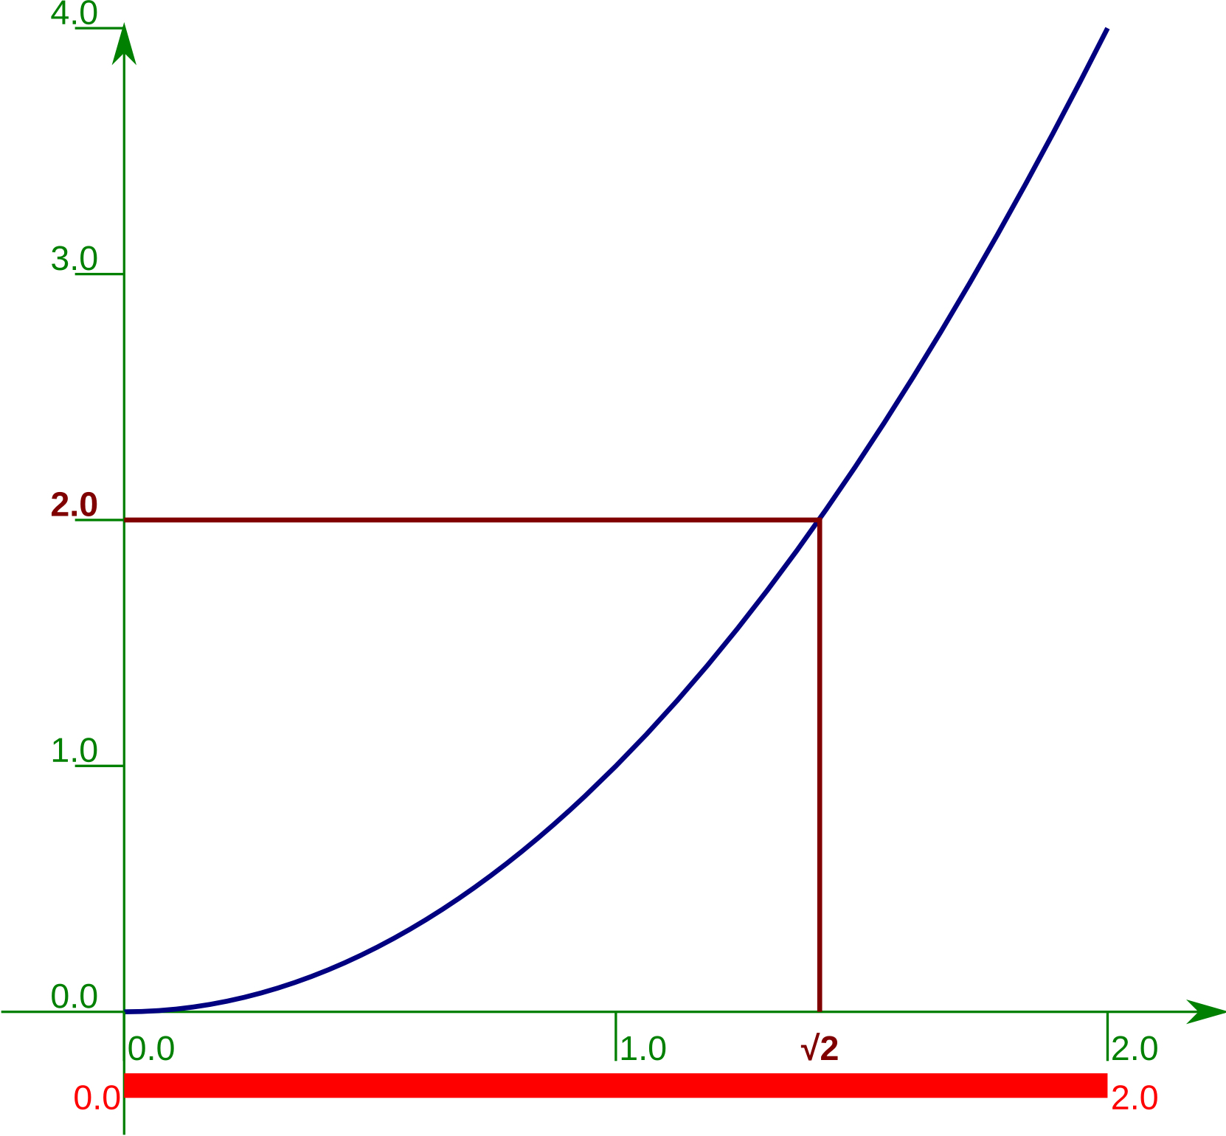
Square root of 2.0 by “bisection”
0.0 too small for √2
2.0 too large for √2
“Interval of uncertainty”
0.0 < √2 < 2.0
Notes:
The technique we are going to use is called “bisection”. If you know this technique you can relax for the next few slides. Please don’t snore. ☺
We are going to go through it by hand for a few iterations because when we come to implement it in Python it is important that any confusion is due to the Python, and not the maths the Python is implementing.
The trick is to identify a range of values that must contain the actual value of √2. That is, we identify a lower bound that is less than √2 and an upper bound that is greater than √2.
We then have some way (which we will explain in the following slides) to improve that estimate by reducing the length of that interval of uncertainty. To be precise, we will cut the uncertainty in half which is why the process is called “bisection”.
We start by taking a lower bound of x=0, which is definitely lower than x=√2 because y=0²=0<2, and an upper bound of x=2, which is definitely higher than x=√2 because y=2²=4>2.

Slide 118
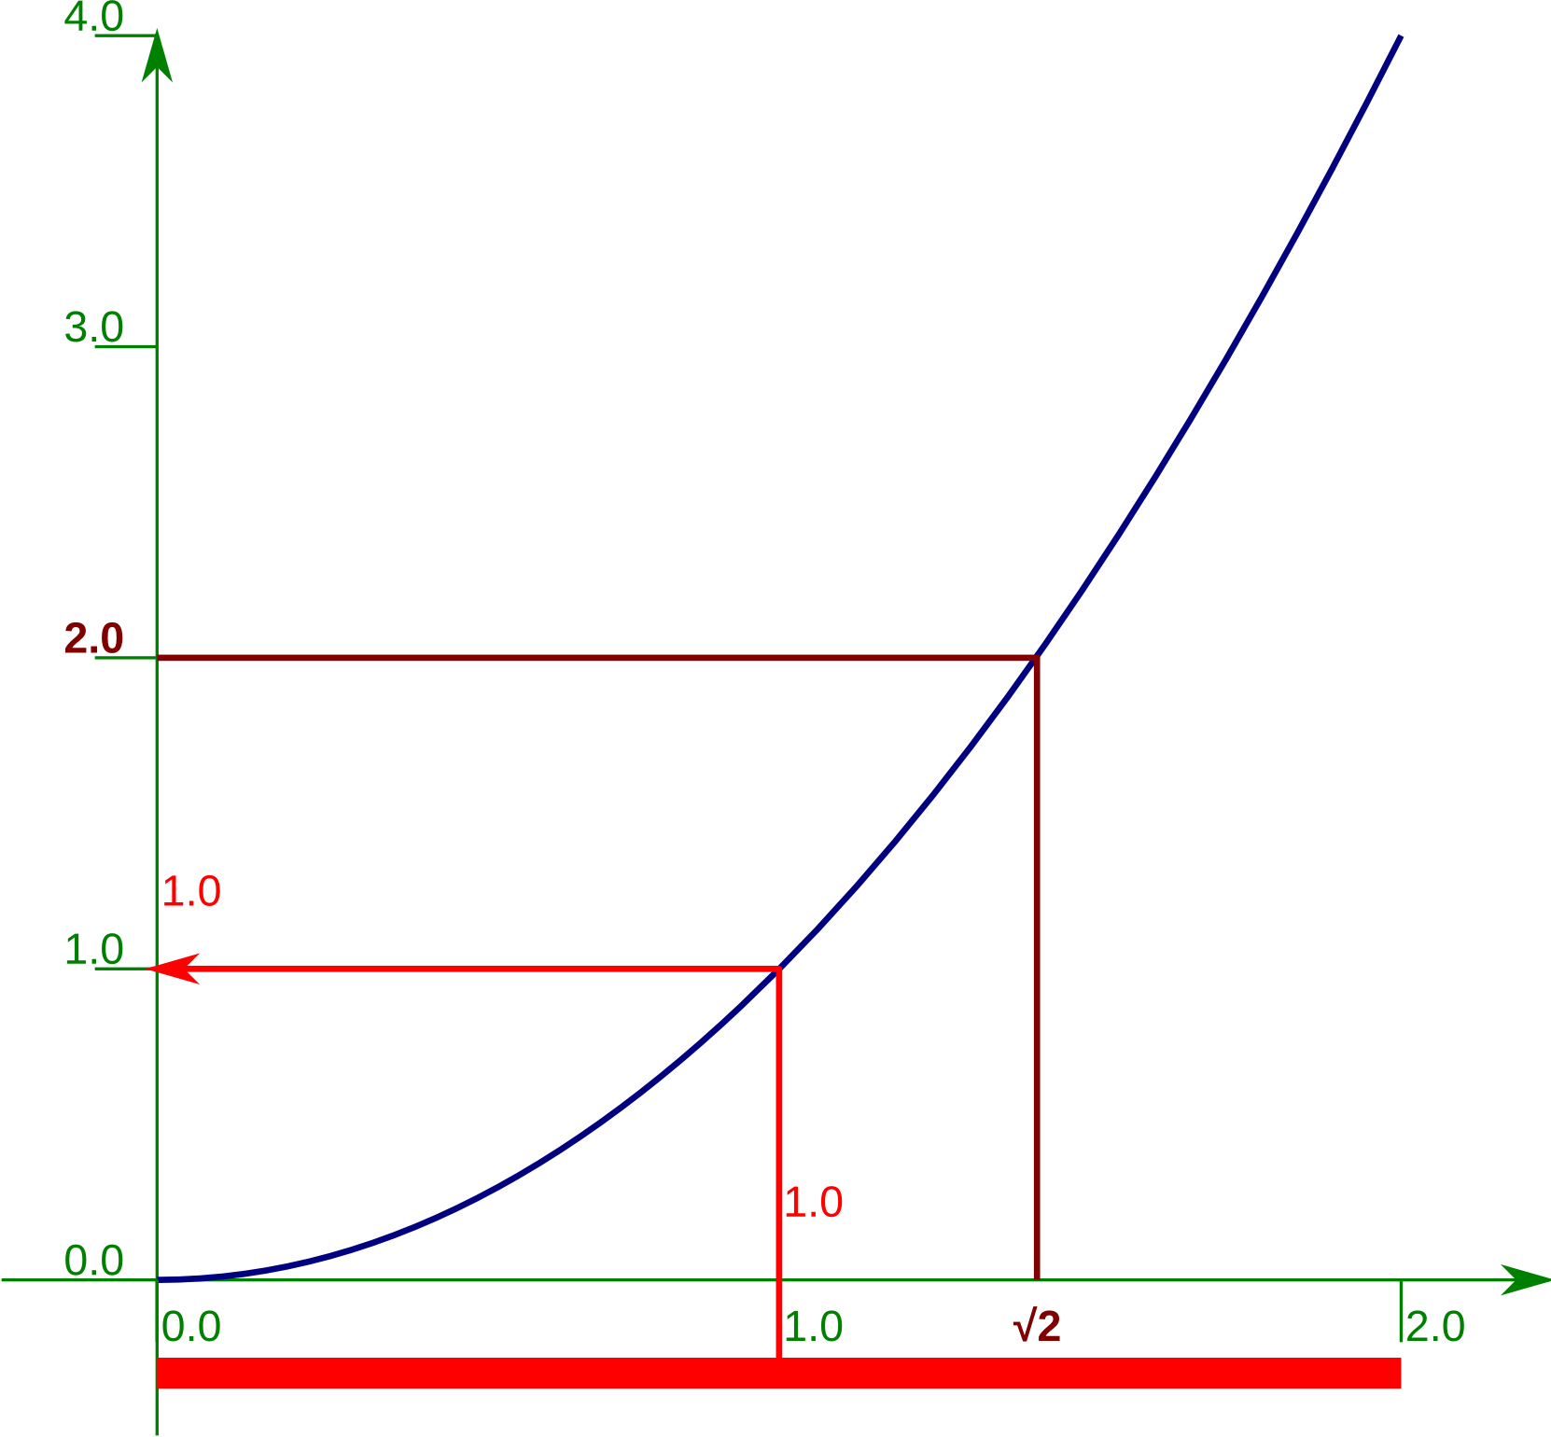
Square root of 2.0 by bisection — 1
(0.0 + 2.0) / 2.0
1.0
1.0**2
1.0
Mid-point: 1.0
Notes:
So, what's the trick for halving the interval of uncertainty?
We find the midpoint of the interval. In this case it’s obvious: the half-way point between x=0 and x=2 is x=1.
Then we square it to find its corresponding value of y. In this case y=1²=1.

Slide 119
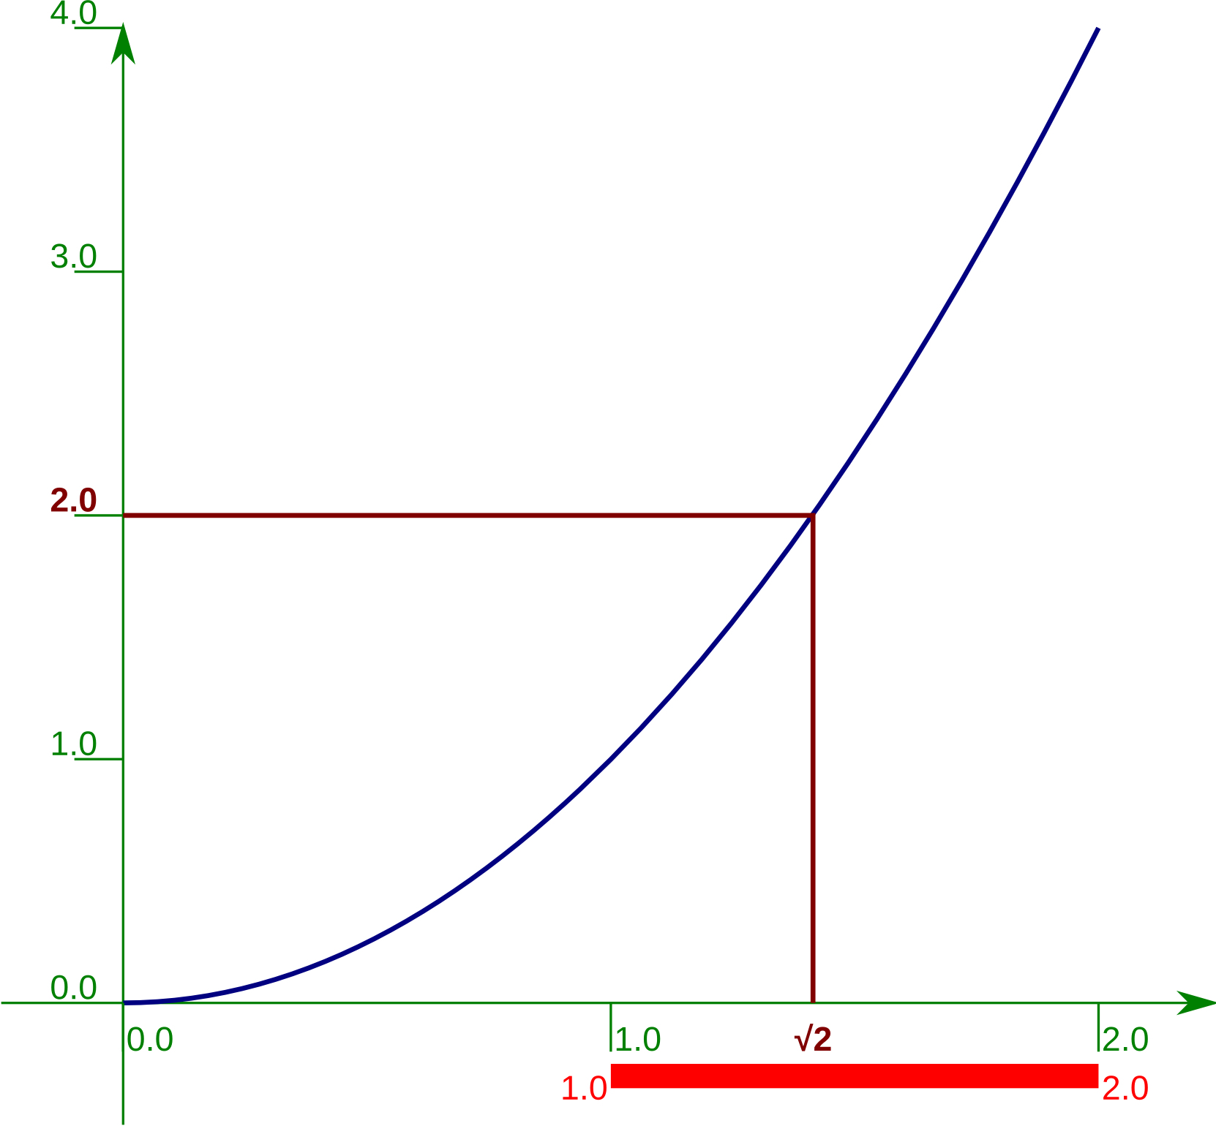
Square root of 2.0 by bisection — 2
1.0**2 < 2.0
so change lower bound
1.0 < √2 < 2.0
Notes:
So what?
Well, y=1 is less than y=2 so the corresponding x-value, x=1 makes an acceptable lower bound for the interval of uncertainty. And if we change our lower bound to this value then our interval only runs from x=1 to x=2 with total length 1, rather than its original length 2.
We have halved our uncertainty.
If we can do this trick multiple times then we will reduce the interval of uncertainty very quickly to a length so small as to be irrelevant.

Slide 120
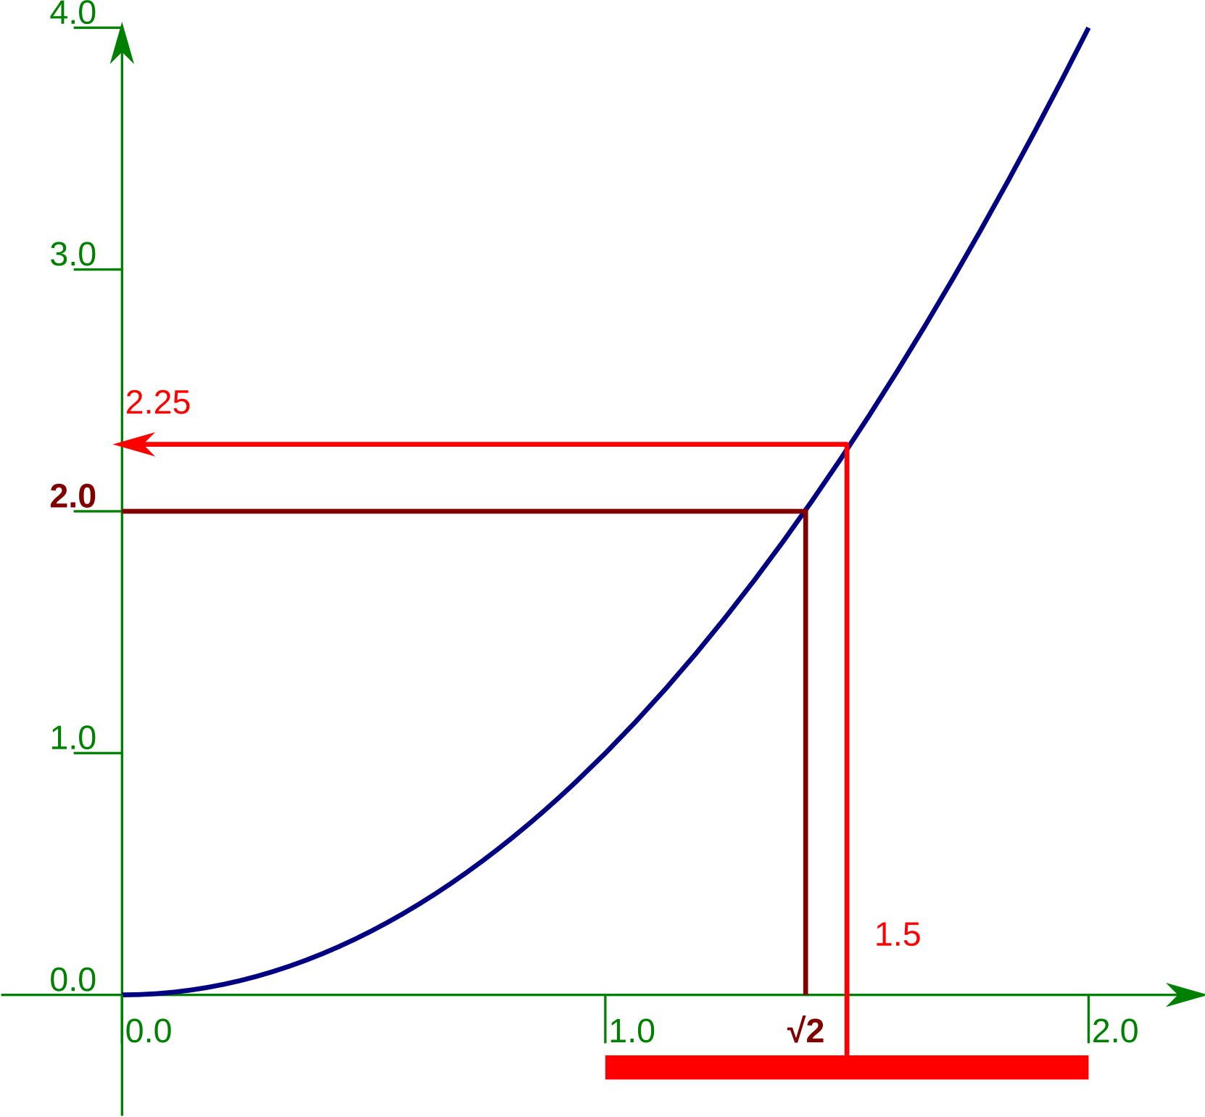
Square root of 2.0 by bisection — 3
(1.0 + 2.0) / 2.0
1.5
1.5**2
2.25
Mid-point: 1.5
Notes:
So we do it again. The new mid-point lies at x=1.5. This has a corresponding y-value of y=2.25.

Slide 121
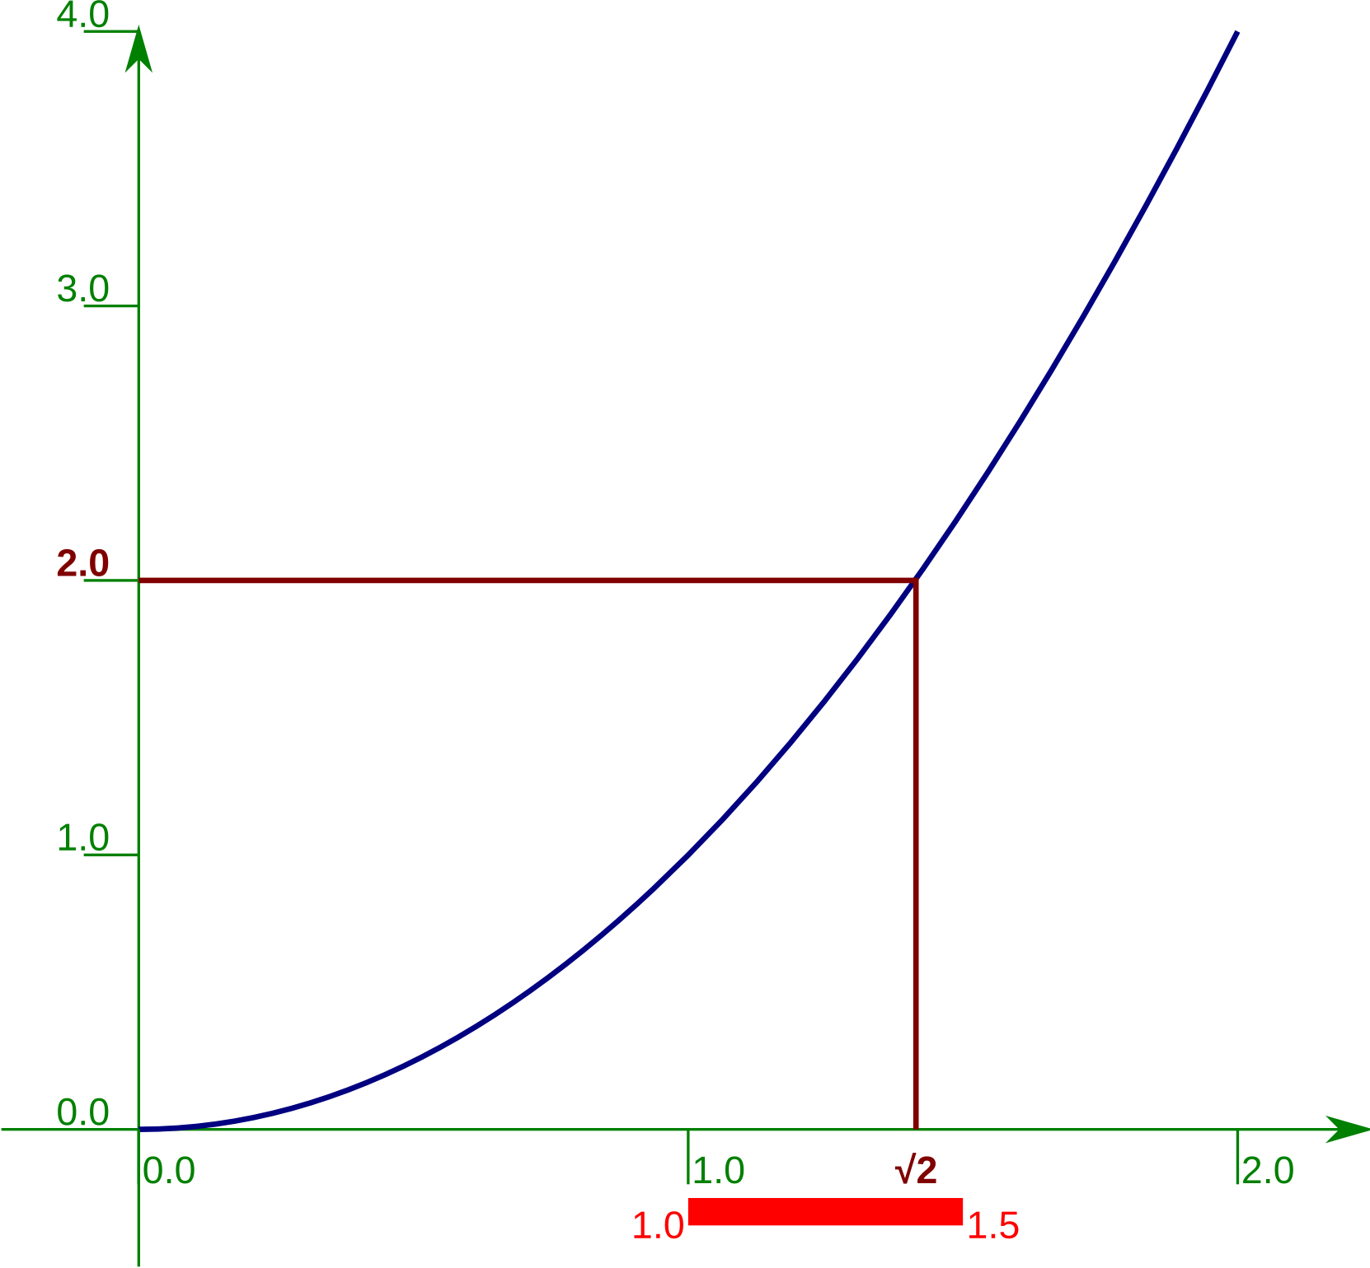
Square root of 2.0 by bisection — 4
1.5**2 > 2.0
so change upper bound
1.0 < √2 < 1.5
Notes:
y=2.25 is greater than y=2 so we can use the corresponding x-value of x=1.5 as our new upper bound. Now the interval of uncertainty is halved in length again to be ½.

Slide 122
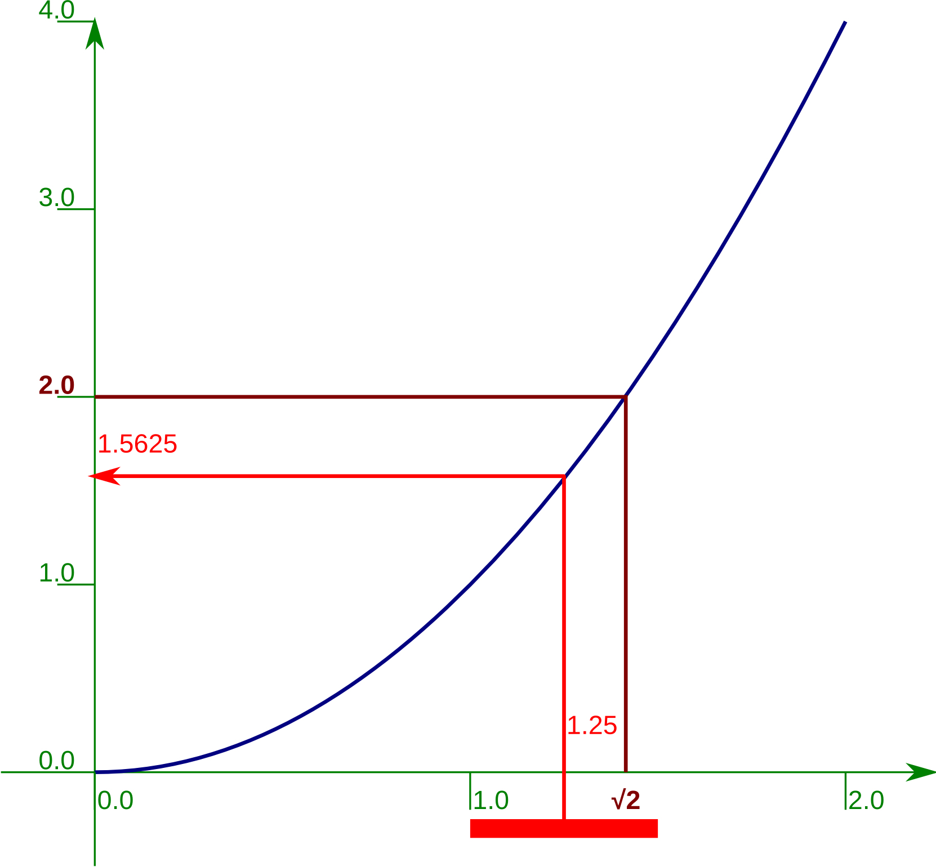
Square root of 2.0 by bisection — 5
(1.0 + 1.5) / 2.0
1.25
1.25**2
1.5625
Mid-point: 1.25
Notes:
We find the new mid-point again, x=1.25. Squaring this gives the corresponding y-value y=1.5625.

Slide 123
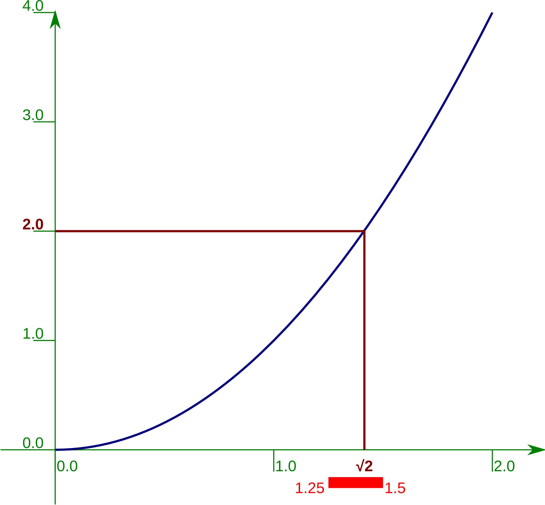
Square root of 2.0 by bisection — 6
1.25**2 < 2.0
so change lower bound
1.25 < √2 < 1.5
Notes:
y=1.5625 is less than y=2 so we change the lower bound. Our interval of uncertainty now has length ¼.

Slide 124
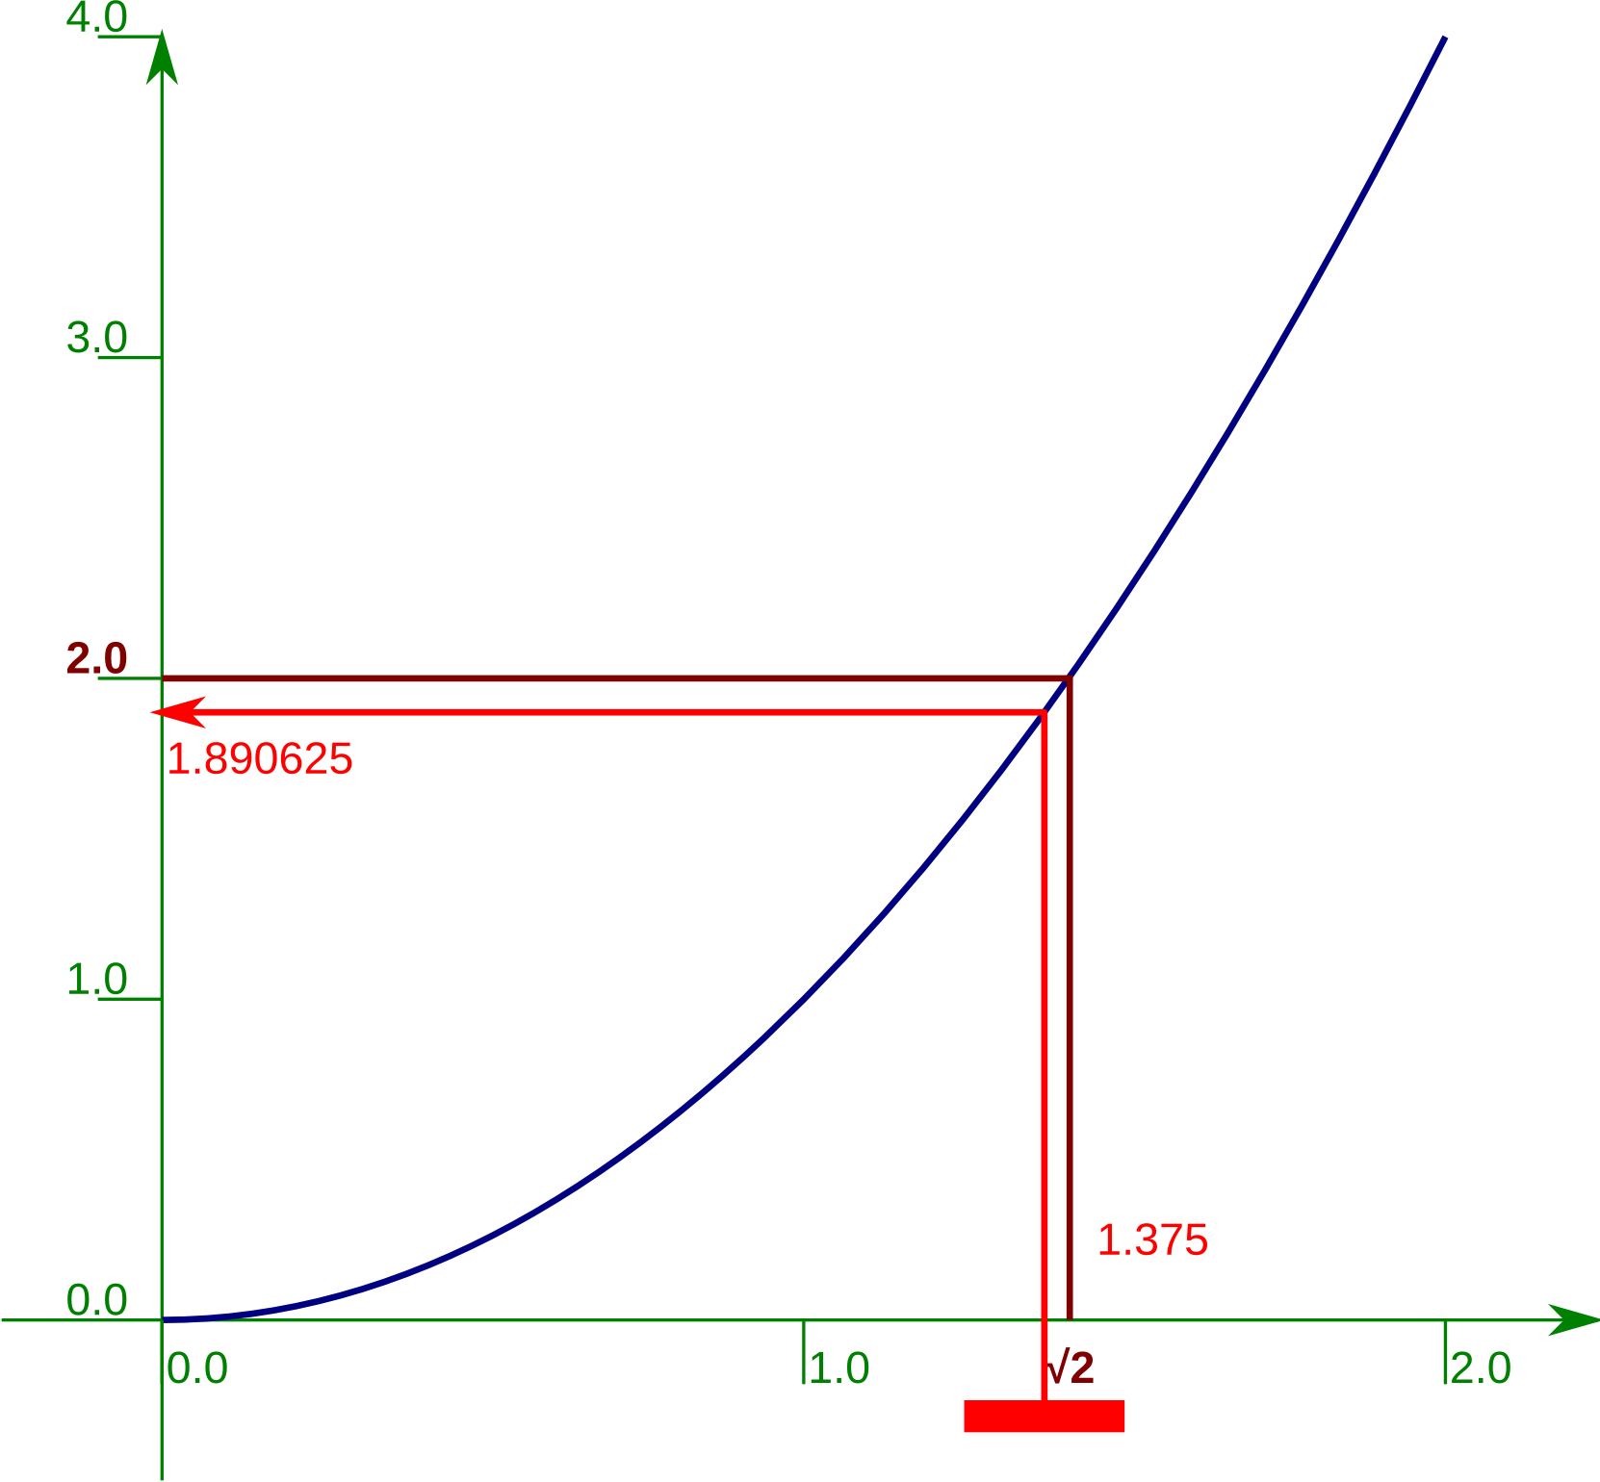
Square root of 2.0 by bisection — 7
(1.25 + 1.5) / 2.0
1.375
1.375**2
1.890625
Mid-point: 1.375
Notes:
And again…

Slide 125
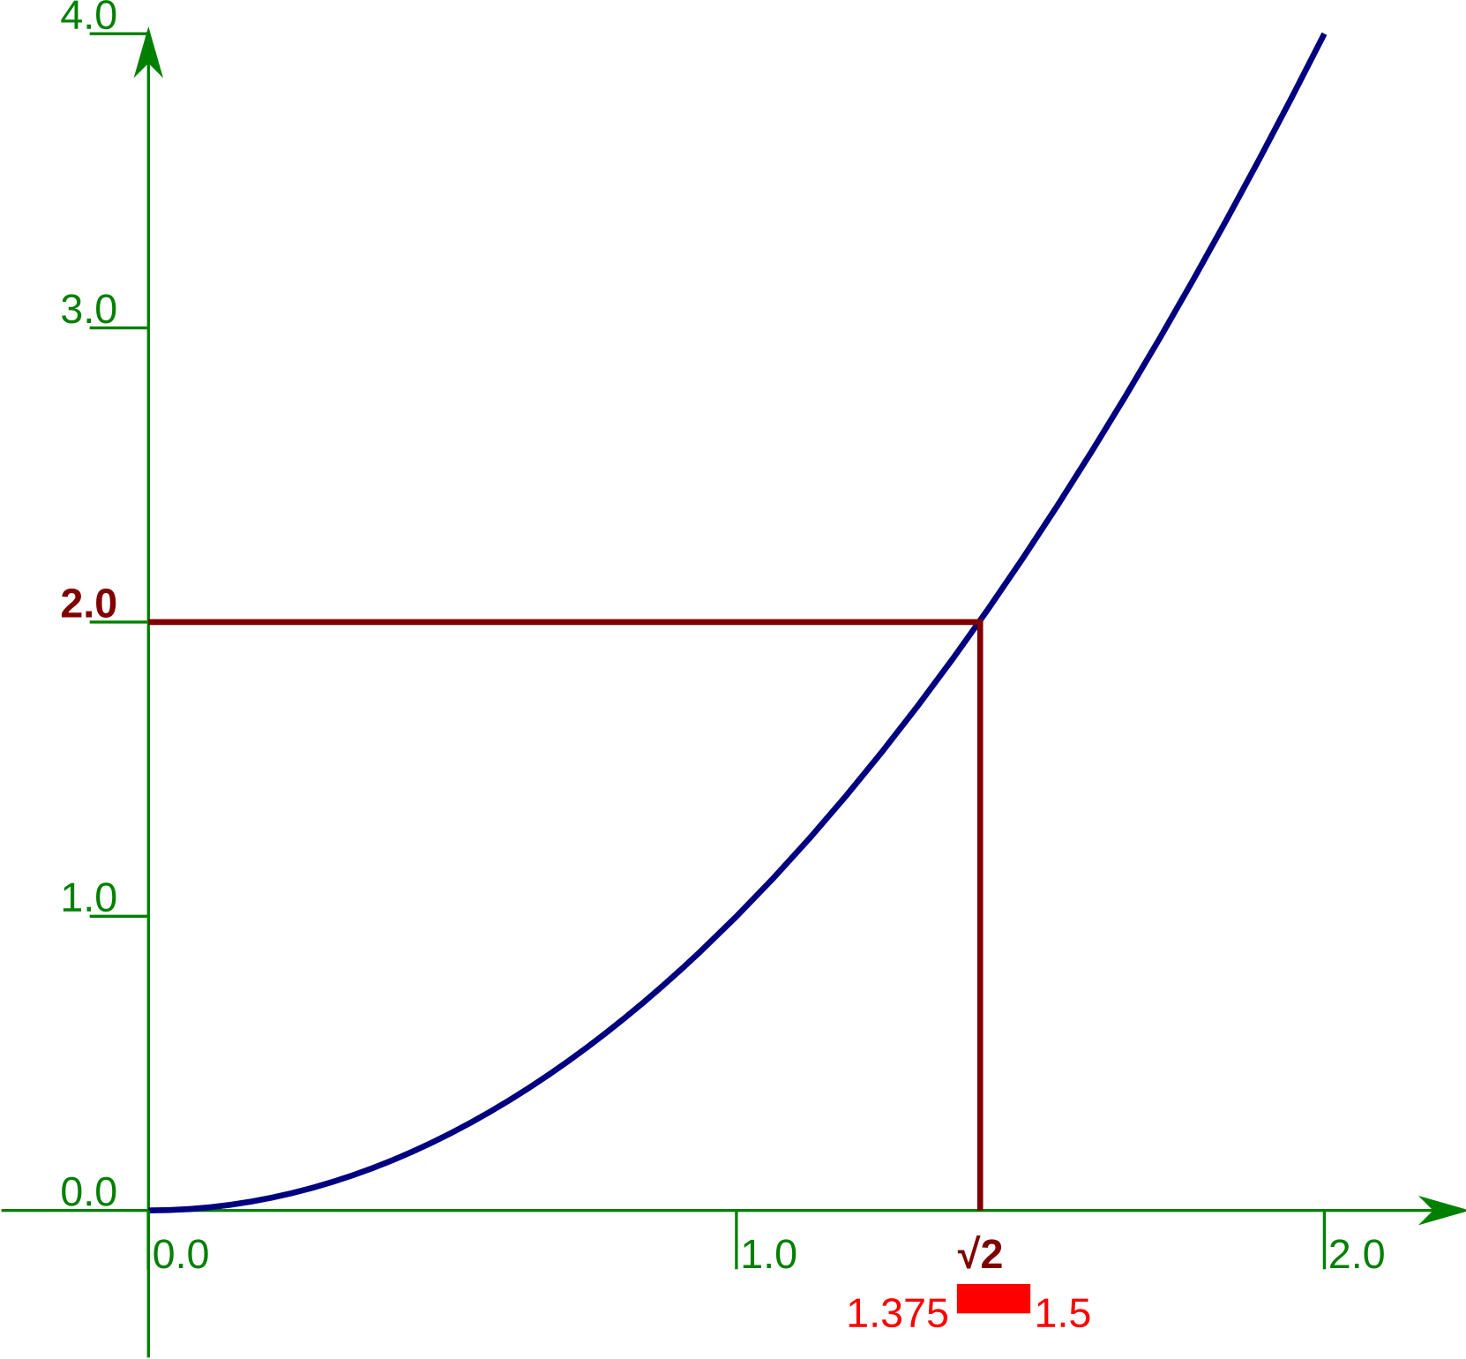
Square root of 2.0 by bisection — 8
1.375**2 < 2.0
so change lower bound
1.375 < √2 < 1.5
Notes:
…to give an interval of length ⅛.

Slide 126
Exercise 6
One more iteration.
Find the mid-point.
Square it.
Compare the square to 2.0.
Do you change the
lower or upper bound?
2 minutes
1.375 < √2 < 1.5
Notes:
Please make sure that you understand the principle and do one more iteration by hand.

Slide 127
Understanding before Programming
Notes:
Apologies for spending so long on the maths but this is a general situation. You must understand the situation before you can program it.

Slide 128
And now using Python!
lower = 0.0
upper = 2.0
middle = (lower+upper)/2
Notes:
So now let's start the implementation of this process in Python.
We will do exactly the same maths, but this time with Python syntax.
First we set the end points for the interval of uncertainty and attach names to the two x-values.
The names lower and upper are attached to the end points:
lower = 0.0
upper = 2.0
We establish the x-value of the mid-point and attach the name middle to it:
middle = (lower+upper)/2
This is exactly where we started last time, but we have attached Python names to the values.

Slide 129
And now using Python — 2
middle**2 < 2.0
True
lower = middle
print(lower, upper)
1.0
2.0
Notes:
Next, we find the y‑value corresponding to the mid-point (by squaring the x‑value 1.0) and ask if it is less than 2.0, the number whose square root we are looking for.
middle**2 < 2.0
Recall that this will return a Python boolean value: True or False.
The squared value is 1.0 which is less than 2.0 (i.e. we get True) so we raise the lower limit of the interval to the mid-point.
lower = middle
In this example we print the x‑value at each end of the interval to track our progress.

Slide 130
And now using Python — 3
middle = (lower+upper)/2
print(
middle,
middle**2)
1.5
2.25
Notes:
So we do it again.
We re-calculate the x‑value for the mid-point. Note that because we changed the value the name lower was attached to the Python instruction is identical to the one we gave first time round:
middle = (lower+upper)/2
We do some additional printing to track progress.

Slide 131
And now using Python — 4
middle**2 < 2.0
False
upper = middle
print(lower, upper)
1.0
1.5
Notes:
Again, we ask if the mid-point’s y‑value (i.e. its x‑value squared) is above or below our target of 2.0:
middle**2 < 2.0
and this time get a boolean False. Because the value is greater than 2.0 (our test evaluates to False) we change the value of the upper bound of the interval by attaching the name upper to the x‑value of the mid-point:
upper = middle
The values being handled are exactly the same as they were when we did it as “raw maths” but this time they have names.

Slide 132
And now using Python — 5
middle = (lower+upper)/2
print(
middle,
middle**2)
1.25
1.5625
Notes:
We now do a third iteration.

Slide 133
And now using Python — 6
middle**2 < 2.0
True
lower = middle
print(lower, upper)
1.25
1.5
Notes:
This time the test evaluates to True so we change lower.

Slide 134
And now using Python — 7
middle = (lower+upper)/2
print(
middle,
middle**2)
1.375
1.890625
Notes:
Fourth iteration.

Slide 135
And now using Python — 8
middle**2 < 2.0
True
lower = middle
print(lower, upper)
1.375
1.5
Notes:
And another True so we change lower again.
And that's enough of stepping through it manually.

Slide 136
Looking at the Python code
lower = 0.0
upper = 2.0
middle = (lower+upper)/2
print(middle, middle**2)
middle**2 < 2.0
✔
?
✘
lower = middle
upper = middle
print(lower, upper)
Notes:
Let’s look at the Python code we have used.
We started by initializing our interval of uncertainty:
lower = 0.0
upper = 2.0
Then we started the operations we would repeat by calculating the x‑value of the mid-point:
middle = (lower+upper)/2
We squared this and compared the squared y‑value with 2.0, our target value:
middle**2 < 2.0
and, based on whether this evaluated to True or False we ran either:
lower = middle
or:
upper = middle
Then we ran the iteration again.

Slide 137
Looking at the Python structures
lower = 0.0
upper = 2.0
Set up
Loop
middle = (lower+upper)/2
print(middle, middle**2)
Choice
middle**2 < 2.0
✔
?
✘
lower = middle
upper = middle
print(lower, upper)
Notes:
Structurally, we need to be able to do two things beyond our current knowledge of Python. We need to be able to run certain instructions time and time again (“looping”) and we need to be able to choose one of two different actions depending on whether a boolean value is True or False.

Slide 138
Looping
Before
Loop test
Should the
loop run
(again)?
✘
✔
Loop body
What is
run each
loop?
After
Notes:
We will address looping first.
A loop has a number of components.
Strictly not part of the loop are the “before” and “after” sections but these give context and may use values needed by the loop.
The loop itself must have some sort of test to indicate whether the loop should run again or whether the looping can stop and control can pass to the “after” code.
Then there must be the set of instructions that will be run each time the loop repeats. We call this the “body” of the loop.

Slide 139
Loop example: Count from 1 to 10
Before
number = 1
Loop test
number <= 10
✘
✔
✘
✔
Loop body
print(number)
number += 1
After
print('Done!')
Notes:
Let’s consider an example that’s simpler than our square root loop: counting from 1 to 10.
Our “before” block initializes the attachment of a name number to a value 1:
number = 1
Our test sees if number is attached to a value less than or equal to 10 (our final value):
number <= 10
Recall that this evaluates to a boolean value.
If the test evaluates to True then we run the loop body. This has two lines, the first to print the value of number and the second to increase it by one:
print(number)
number += 1
If the test evaluates to False then we don’t loop and exit the structure. We have a pointless print statement as a place-holder for more substantive code in serious scripts:
print('Done!')
This is what we want to encode in Python.

Slide 140
Loop example: Count from 1 to 10
number = 1
number = 1
while
number <= 10
:
number <= 10
✘
✔
␣␣␣␣
␣␣␣␣
print(number)
number += 1
print(number)
number += 1
print('Done!')
print('Done!')
Notes:
This is how we encode the structure in Python. We will examine it element by element, but at first glance we observe a “while” keyword and a colon on either wise of the test and the loop body being indented four spaces.

Slide 141
Loop test: Count from 1 to 10
number = 1
“while” keyword
loop test
while
number <= 10
:
colon
␣␣␣␣
␣␣␣␣
print(number)
number += 1
print('Done!')
Notes:
We will start by looking at what we have done to the test. The test itself is
number <= 1
which is a Python expression that evaluates to a boolean, True or False.
We precede the test expression with the Python keyword “while”. This is what tells Python that there’s a loop coming. It must be directly followed by an expression that evaluates to a Boolean.
We follow the test expression with a colon. This is the marker that the expression is over and must be the last element on the line.
Note that the test evaluates to True for the loop to be run and False for the loop to quit. We are testing for “shall the loop keep going” not “shall the loop stop”. Python tests for while, not until.

Slide 142
Loop body: Count from 1 to 10
number = 1
while
number <= 10
:
␣␣␣␣
␣␣␣␣
print(number)
number += 1
loop body
indentation
print('Done!')
Notes:
The loop body, the code that is repeated, appears on the lines following the “while line”. Both its lines are indented by four spaces each.
Note that the “after” section is not indented.

Slide 143
Loop example: Count from 1 to 10
number = 1
while number <= 10 :
print(number)
number += 1
print('Done!')
$
python3 while1.py
1
2
3
4
5
6
7
8
9
10
Done!
while1.py
$
Notes:
First let’s check that this really works. In the file while1.py in your home directories you will find exactly the code shown in the slide. Run it and watch Python count from 1 to 10.

Slide 144
Python’s use of indentation
number = 1
while number <= 10 :
Four spaces’ indentation
indicate a “block” of code.
␣␣␣␣
␣␣␣␣
print(number)
number += 1
The block forms
the repeated lines.
p
rint('Done!')
The first unindented line
marks the end of the block.
Notes:
The four spaces of indentation are not cosmetic. A sequence of lines that have the same indentation form blocks in Python and can be thought of as a single unit of code. In this case both lines get run (again) or neither of them do.
The indented block is ended by the first line that follows it with no indentation.

Slide 145
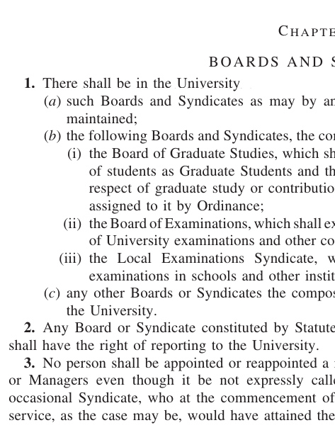
c.f. “legalese”
1
1(a)
1(b)
1(b)(i)
1(b)(ii)
1(b)(iii)
1(c)
2
3
Notes:
If this seems a little alien consider the “legalese” of complex documents. They have paragraphs, sub-paragraphs and sub-sub-paragraphs etc., each indented relative to the one containing them.

Slide 146
Other languages
Shell
while ...
do
␣␣␣␣...
␣␣␣␣...
done
do ... done
Syntax
␣␣␣␣...
Clarity
C
while ...
{
␣␣␣␣...
␣␣␣␣...
}
{ ... }
Syntax
␣␣␣␣...
Clarity
Notes:
Marking blocks of code is one of the places where computing languages differ from one another.
Some have special words that appear at the start and end of blocks like “do” and “done”. Others use various forms of brackets like “{” and “}”.
Interestingly, programmers in these languages typically also indent code within the blocks for visual clarity. Python simply uses the indentation for its core syntax rather than just for ease of reading.
Purely for interest, the Shell and C versions of while1.py are also in your home directory as while1.sh and while1.c.

Slide 147
Progress
while ... :
before
while test :
␣␣␣␣action₁
␣␣␣␣action₂
␣␣␣␣action₃
afterwards
test to keep looping
code blocks
␣␣␣␣indentation

Slide 148
Exercise 7
For each script:
while2.py
␣␣␣␣
Predict what it will do.
while3.py
␣␣␣␣
Run the script.
while4.py
␣␣␣␣
Were you right?
while5.py
while6.py
To kill a running script:
Ctrl
+
C
5 minutes

Slide 149
Back to our square root example
uncertainty
tolerance
0.0
2.0
2.0
1.0×10^{–15}
1.0
2.0
1.0
What we want
1.0
1.5
0.5
1.25
1.5
0.25
1.375
1.5
0.125
What we get
Notes:
Now let’s return to our square root example. We have a loop the body of which halves the length of the interval of uncertainty. We need to put this into a Python loop so we need a corresponding loop test.
One typical approach is to test to see if the interval is longer than some acceptable value. In this case we will demand that the interval have length no longer than 10⁻¹⁵. (It will take 51 halvings to get from an initial length of 2.0 to something less than 10⁻¹⁵.)
A common name for an “acceptable uncertainty” is a “tolerance”: the amount of uncertainty we are prepared to tolerate.

Slide 150
Keep looping while … ?
uncertainty
>
tolerance
while uncertainty > tolerance :
␣␣␣␣
Do stuff.
␣␣␣␣
␣␣␣␣
␣␣␣␣
Notes:
We need a Python test for this. Recall that Python needs a test that evaluates to True for the loop body to run. Our test then is ”is the current uncertainty larger than the acceptable tolerance?”
We will set a name, tolerance, to have the value 1.0e-15, calculate an uncertainty each loop and perform the test
uncertainty > tolerance
If this is True then we need to keep going.
If it is False then we can stop.

Slide 151
Square root: the loop
tolerance = 1.0e-15
Set up
lower = 0.0
upper = 2.0
uncertainty = upper - lower
Loop
while uncertainty > tolerance :
middle = (lower + upper)/2
?
Choice
print(lower, upper)
uncertainty = upper - lower
Notes:
So, if we return to our basic structure we can now see how Python’s while syntax fits in.
We establish a tolerance.
We establish an initial uncertainty.
We test for
uncertainty > tolerance
as the loop test.
We recalculate the uncertainty at the end of the loop block for use in the next round of the test.
All we have to do now is to add in the choice block.

Slide 152
Choosing
Choice
middle**2 < 2.0
✔
?
✘
lower = middle
upper = middle
middle**2 < 2.0
True
or
False
True
lower = middle
False
upper = middle
Notes:
Once again we have a test followed by some actions. This time, however, the test doesn’t decide whether or not to run a block of code again, but rather which of two blocks of code to run once.
Our test ― a Python expression that evaluates to a boolean ― is simply:
middle**2 < 2.0
and if this evaluates to True then we change the lower bound:
lower = middle
and if it evaluates to False then we change the upper bound:
upper = middle
Either way, once one or the other has run we move on and do not return to the test.

Slide 153
Simple example
text = input('Number? ')
number = int(text)
if number % 2 == 0:
print('Even number')
else:
print('Odd number')
print('That was fun!')
$
python3 ifthenelse1.py
Number?
Even number
That was fun
8
$
python3 ifthenelse1.py
Number?
Odd number
That was fun
7
ifthenelse1.py
Notes:
Again, we will look at an example that demonstrates just the structure.
There is a script in your home directories called ifthenelse1.py which illustrates the structure on its own.
Mathematical note:
The script tests for a number being even by using the “remainder” operator “%” to calculate the remainder if we divide by 2 and testing for that remainder being 0.

Slide 154
if…then… else… ― 1
if keyword
Test
if
number % 2 == 0
:
Colon
␣␣␣␣
print('Even number')
else :
␣␣␣␣
upper = middle
print('That was fun!')
Notes:
The first line of the test looks very similar to the while syntax we have already seen. In this case, however, it uses a new keyword: “if”.
The if keyword is followed by the test: a Python expression that evaluates to a boolean.
The line ends with a colon.

Slide 155
if…then… else… ― 2
if
number % 2 == 0
:
␣␣␣␣
print('Even number')
Run if test is True
Indentation
else :
␣␣␣␣
upper = middle
print('That was fun!')
Notes:
The test line is immediately followed by the block of code that is run if the test evaluates as True.
Because it is a block of code it is indented by four spaces to mark it as a block. This example has a single line, but the block can be as long as you want.
This block is sometimes called the “then-block” because “if the test is True then run this block”.

Slide 156
if…then… else… ― 3
if
number % 2 == 0
:
␣␣␣␣
print('Even number')
else :
else: keyword
␣␣␣␣
upper = middle
Run if test is False
Indentation
print('That was fun!')
Notes:
After the then-block comes another new keyword, “else:”. This is not indented and is level with the “if” to indicate that it is not part of the then-block.
It is then followed by a second block of code, know as the “else-block”. This is the code that is run if the test evaluates as False.
Again, because it is a block of code it is indented.
The else keyword and its corresponding block are optional. You can do nothing if the test returns False. The then-block is compulsory.

Slide 157
if…then… else… ― 4
if
number % 2 == 0
:
␣␣␣␣
print('Even number')
else :
␣␣␣␣
upper = middle
Run afterwards
regardless of test
print('That was fun!')
Notes:
After the else-block the script continues. The print line is unindented so is not part of the else-block. This line is run regardless of the result of the test.

Slide 158
Our square root example
middle = (lower + upper)/2
Before
if
middle**2 < 2.0
:
␣␣␣␣
lower = middle
if… block
else :
␣␣␣␣
upper = middle
print(lower, upper)
After
Notes:
Let’s return to our square root example.
Here we have the creation of a mid-point x-value followed by an if-test on it:
middle = (lower+upper)/2
if middle**2 < 2.0:
This switches between two single-line code blocks. If the test evaluates to True then the then-block is run:
lower = middle
and if it evaluates to False then the else-block is run:
else:
upper = middle
After one or other is run the print statement is always run:
print(lower, upper)
All we have to do now is to fit it inside our while loop.

Slide 159
Progress
if ... :
before
if test :
␣␣␣␣action₁
␣␣␣␣action₂
else:
␣␣␣␣action₃
afterwards
else:
choice of two
code blocks
␣␣␣␣indentation

Slide 160
Exercise 8
For each script:
ifthenelse2.py
␣␣␣␣
Predict what it will do.
ifthenelse3.py
␣␣␣␣
Run the script.
ifthenelse4.py
␣␣␣␣
Were you right?
ifthenelse5.py
5 minutes

Slide 161
Back to our example
tolerance = 1.0e-15
lower = 0.0
upper = 2.0
uncertainty = upper - lower
while uncertainty > tolerance :
middle = (lower + upper)/2
if starts
indented
if middle**2 < 2.0 :
lower = middle
Doubly
indented
else :
upper = middle
print(lower, upper)
uncertainty = upper - lower
Notes:
So how do we embed an if-test with its two code blocks inside a while-loop as the loop’s body?
The body of the while-loop is indented four spaces. So we start the if-test indented four spaces and make its indented blocks doubly indented.

Slide 162
Levels of indentation
tolerance = 1.0e-15
lower = 0.0
upper = 2.0
uncertainty = upper - lower
while uncertainty > tolerance :
␣␣␣␣
middle = (lower + upper)/2
4 spaces
␣␣␣␣
if middle**2 < 2.0 :
␣␣␣␣␣␣␣␣
lower = middle
8 spaces
␣␣␣␣
else :
␣␣␣␣␣␣␣␣
upper = middle
␣␣␣␣
print(lower, upper)
␣␣␣␣
uncertainty = upper - lower
Notes:
So if our standard indentation is four spaces then the doubly indented sections are indented eight spaces.
This is a simple example with only two levels of indentation. Python can ‘nest’ blocks much further than this.

Slide 163
Trying it out
tolerance = 1.0e-15
lower = 0.0
upper = 2.0
uncertainty = upper - lower
while uncertainty > tolerance :
middle = (lower + upper)/2
if middle**2 < 2.0:
lower = middle
else:
upper = middle
print(lower, upper)
uncertainty = upper - lower
$
python3 sqrt1.py
1.0 2.0
1.0 1.5
1.25 1.5
1.375 1.5
1.375 1.4375
1.40625 1.4375
1.40625 1.421875
...
1.414213... 1.414213...
☺
sqrt1.py
Notes:
The file sqrt1.py in your home directories contains the code as described in the slide. It produces a very nice approximation to the square root of 2.

Slide 164
Script for the square root of 2.0
tolerance = 1.0e-15
lower = 0.0
upper = 2.0
√2.0
uncertainty = upper - lower
while uncertainty > tolerance :
␣␣␣␣
middle = (lower + upper)/2
␣␣␣␣
if middle**2 < 2.0 :
√2.0
␣␣␣␣␣␣␣␣
lower = middle
␣␣␣␣
else :
␣␣␣␣␣␣␣␣
upper = middle
␣␣␣␣
print(lower, upper)
␣␣␣␣
uncertainty = upper - lower
Notes:
So now we have the script for the square root of 2. The next thing to do is to generalize it to produce square roots of any number.

Slide 165
Input target
text = input('Number? ')
number = float(text)
…
if middle**2 < number :
Notes:
Obviously we have to input the number whose square root we want. We have already seen how to do this and to convert it from a string into a floating point number:
text = input('Number? ')
number = float(text)
Once we have the number the test
middle**2 < 2.0
is straightforwardly extended to
middle**2 < number

Slide 166
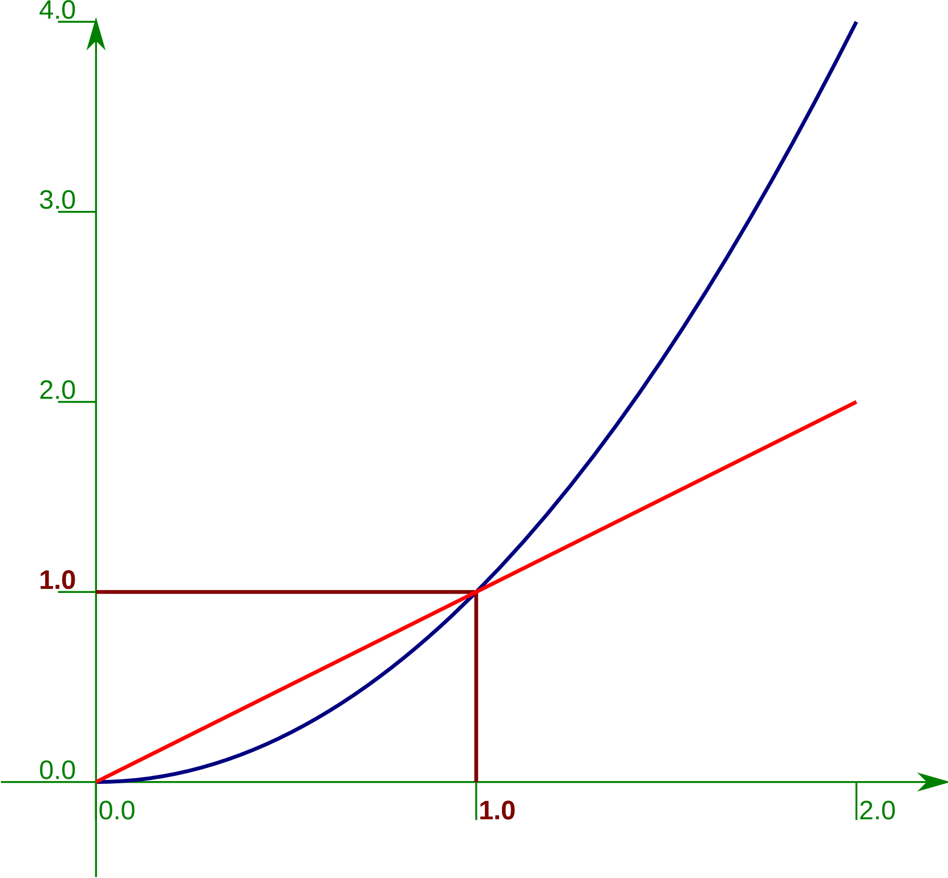
Initial bounds?
lower = ?
upper = ?
x > 1.0
1.0 < √x < x
1.0 > x
1.0 > √x > x
if...then...else...
Notes:
We have to set initial bounds for our interval of uncertainty.
This is where it is important that you think about the problem before coding. If the number whose square root is sought is less than 1 then the square root is bigger than the number and less than 1. If it is larger than 1 then its square root is less than the number and bigger than 1.
In Python terms this means we can test for the number being less than 1 and set the bounds accordingly.

Slide 167
Initial bounds
if number < 1.0 :
␣␣␣␣lower = number
␣␣␣␣upper = 1.0
else :
␣␣␣␣lower = 1.0
␣␣␣␣upper = number
Notes:
It looks like this.

Slide 168
Generic square root script?
text = input('Number?␣')
number = float(text)
if number < 1.0:
␣␣␣␣lower = number
␣␣␣␣upper = 1.0
else:
␣␣␣␣lower = 1.0
␣␣␣␣upper = number
tolerance = 1.0e-15
uncertainty = upper - lower
while uncertainty > tolerance:
␣␣␣␣middle = (lower+upper)/2.0
␣␣␣␣if middle**2 < number:
␣␣␣␣␣␣␣␣lower = middle
␣␣␣␣else:
␣␣␣␣␣␣␣␣upper = middle
␣␣␣␣uncertainty = upper - lower
print(lower, upper)
User input
Initialization
Processing
Output
sqrt2.py
Notes:
This gives us enough of a script to see the overarching structure of a script:
We start with getting the data we need from the outside world. (“input”)
Then we set up any initial state we need based on that. (“initialization”)
Then we do our processing.
Finally we reveal our results. (“output”)
Typically the processing phase takes longest to run, but note that, as here, it is often not the majority of the lines of code.

Slide 169
Negative numbers?
Need to catch negative numbers
if number < 0.0:
␣␣␣␣print('Number must be positive!')
␣␣␣␣
exit()
Quit immediately
"else" is optional
Notes:
We can improve our code. A step missing from the previous script is “input validation” where we check that the input makes sense. We ought to check that we have not been asked to generate the square root of a negative number.

Slide 170
“Chained” tests
text = input('Number?␣')
number = float(text)
if number < 0.0:
␣␣␣␣print('Number must be positive!')
␣␣␣␣exit()
if number < 1.0:
␣␣␣␣lower = number
␣␣␣␣upper = 1.0
else:
␣␣␣␣lower = 1.0
␣␣␣␣upper = number
...
User input
Input validation
Initialization
Notes:
The input validation phase comes straight after the input itself.

Slide 171
“Chained” tests ― syntactic sugar
text = input('Number?␣')
number = float(text)
if number < 0.0:
␣␣␣␣print('Number must be positive!')
␣␣␣␣exit()
elif
number < 1.0:
elif: “else if”
␣␣␣␣lower = number
␣␣␣␣upper = 1.0
else:
␣␣␣␣lower = 1.0
␣␣␣␣upper = number
...
sqrt3.py
Notes:
However, it can be integrated with the initialization phase, and often is. After all, if you can’t initialize from the input then the input isn’t valid.
This leads us to a multi-stage test of the number whose square root we want:
Is it less than 0?
If not, is it less than 1?
If not then…
Python has an extension to the simple if…else… test to allow for the “if not then is it…” situation.
“elif” introduces a test and a corresponding block of code. The code is called only if the previous if… test failed and its own test passes.

Slide 172
Without elif…
text = input('Number?␣')
number = float(text)
if number < 0.0:
␣␣␣␣print('Number is negative.')
else:
␣␣␣␣if number < 1.0:
␣␣␣␣␣␣␣␣print('Number is between zero and one.')
␣␣␣␣else:
␣␣␣␣␣␣␣␣if number < 2.0:
␣␣␣␣␣␣␣␣␣␣␣␣print('Number is between one and two.')
␣␣␣␣␣␣␣␣else:
␣␣␣␣␣␣␣␣␣␣␣␣if number < 3.0:
␣␣␣␣␣␣␣␣␣␣␣␣␣␣␣␣print('Number is between two and three.')
␣␣␣␣␣␣␣␣␣␣␣␣else:
␣␣␣␣␣␣␣␣␣␣␣␣␣␣␣␣print('Number is three or more.')
Stacked clauses get unwieldy
Notes:
To take an extreme example, consider this multi-level test. The continual nesting inside the else clauses causes the whole script to drift to the right.

Slide 173
With elif…
text = input('Number?␣')
number = float(text)
if number < 0.0:
␣␣␣␣print('Number is negative.')
elif number < 1.0:
␣␣␣␣print('Number is between zero and one.')
elif number < 2.0:
␣␣␣␣print('Number is between one and two.')
elif number < 3.0:
␣␣␣␣print('Number is between two and three.')
else:
␣␣␣␣print('Number is three or more.')
Notes:
Applying elif causes everything to slide back into place.

Slide 174
Progress
Nested structures
while … :
if … :
Chained tests
if … :
…
elif … :
…
elif … :
…
else:
…
Testing inputs to scripts
exit()

Slide 175
Exercise 9
Only do the second part after
you have the first part working!
exercise9.py
1. Edit the square root script to catch negative numbers.
2. Edit the square root script to ask for the tolerance.
The tolerance must be bigger than 5×10^{–16}.
Test for that.
5 minutes

Slide 176
Comments
We have written our first real Python script
What did it do?
Why did it do it?
Need to annotate the script
Notes:
sqrt3.py is a real program.
Now imagine you pass it to someone else or put it away for twelve months and come back to it forgetting how you wrote it in the first place.
Chances are that the reader of your script might like some hints as to what it is doing and why.
“Comments” in computer programs are pieces of text that describe what ios going on without getting in the way of the lines of code that are executed.

Slide 177
Python comment character
The “hash” character
#
a.k.a. “pound”, “number”, “sharp”
Lines starting with “#” are ignored
Partial lines starting “#” are ignored
Used for annotating scripts
Notes:
Python, in common with most other scripting languages, uses the hash character to introduce comments. The hash character and everything beyond it on the line is ignored.
(Strictly speaking the musical sharp character “♯” is not the same as “#” but people get very sloppy with similar characters these days. This isn’t at all relevant to Python but the author is an annoying pedant on the correct use of characters. And don’t get him started on people who use a hyphen when they should use an en-dash or em-dash.)

Slide 178
Python commenting example
# Script to calculate square roots by bisection
# (c) Bob Dowling 2012. Licensed under GPL v3.0
text = input('Number?␣')
number = float(text) # Need a real number
# Test number for validity,
# set initial bounds if OK.
if number < 0.0:
␣␣␣␣print('Number must be non-negative!')
␣␣␣␣exit()
elif number < 1.0:
␣␣␣␣lower = number
␣␣␣␣upper = 1.0
else:
␣␣␣␣lower = 1.0
␣␣␣␣upper = number
Notes:
This is what a commented script looks like.

Slide 179
On a real Unix system…
#!/usr/bin/python3
# Script to calculate square roots by bisection
# (c) Bob Dowling 2012. Licensed under GPL v3.0
text = input('Number?␣')
number = float(text) # Need a real number
Magic line for executable files
$
fubar.py
instead of
$
python3 fubar.py
Notes:
You may encounter a “hash pling“ first line in many imported Python scripts. This is part of some “Unix magic” that lets us simplify our command lines. We can’t demonstrate it here because the MCS file server doesn’t support Unix semantics.

Slide 180
Progress
#
Comments
“#” character

Slide 181
Exercise 10
Comment your square root script from exercise 9.
2 minutes

Slide 182
Recap: Python types so far
Whole numbers
-127
Floating point numbers
3.141592653589793
Complex numbers
(1.0 + 2.0j)
Text
'The cat sat on the mat.'
Booleans
True
False
Notes:
We are about to introduce a new Python type, so we will take a moment to remind ourseoves of the various Python types we have met already.

Slide 183
Lists
[ 'hydrogen', 'helium', 'lithium', 'beryllium', 'boron', …, 'thorium', 'protactinium', 'uranium' ]
[ -3.141592653589793, -1.5707963267948966, 0.0, 1.5707963267948966, 3.141592653589793 ]
[ 2, 3, 5, 7, 11, 13, 17, 19 ]
Notes:
The new Python type we are going to meet is called a “list”.

Slide 184
What is a list?
hydrogen, helium, lithium, beryllium, …, protactinium, uranium
A sequence of values
The names of the elements
Values stored in order
Atomic number order
Individual value identified
by position in the sequence
“helium” is the name of the
second element
Notes:
So what is a list?
A list is simply a sequence of values stored in a specific order with each value identified by its position in that order.
So for an example consider the list of names of the elements up to uranium.

Slide 185
What is a list?
2, 3, 5, 7, 11, 13, 17, 19, 23, 29, 31, 37, 41, 43, 47, 53, 59
A sequence of values
The prime numbers
less than sixty
Values stored in order
Numerical order
Individual value identified
by position in the sequence
7 is the fourth prime
Notes:
Or the list of primes up to 60.
Note that a list must be finite.

Slide 186
Creating a list in Python
>>>
primes = [ 2, 3, 5, 7, 11, 13, 17, 19]
A literal list
>>>
primes
[2, 3, 5, 7, 11, 13, 17, 19]
The whole list
>>>
type(primes)
<class 'list'>
A Python type
Notes:
So how might we do this in Python?
We will create a list in Python of the primes less than 20. We can do this in a single line as shown.
A list in Python is a single Python object, albeit with multiple contents, and has its own type, unsurprisingly called “list”.

Slide 187
How Python presents lists
Square brackets
at the ends
[
2
,
3
,
5
,
7
,
11
,
13
,
17
,
19
]
Commas between items
Notes:
Python presents (and accepts) lists as a series of values separated by commas, surrounded by square brackets.

Slide 188
Square brackets
primes = [2, 3, 5, 7, 11]
Literal list
Notes:
We are going to meet square brackets used fr a lot of things so I will build up a summary slide of their various uses. Here is use 1.

Slide 189
Python counts from zero
“index”
0
1
2
3
4
5
6
7
“value”
[
2
,
3
,
5
,
7
,
11
,
13
,
17
,
19
]
Notes:
We still need to get at individual items in the list. Each is identified by its position in the list.
Python, in common with many programming languages (but not all) starts its count from zero. The leading element in the list is “item number zero”. The one that follows it is “item number one” and so on. This number, the position in the list counting from zero, is called the “index” into the list. The plural of “index” is “indices”.
To keep yourself sane, we strongly recommend the language “item number 3” instead of “the fourth item”.

Slide 190
Looking things up in a list
>>>
primes = [ 2, 3, 5, 7, 11, 13, 17, 19]
0
1
2
3
4
5
6
7
[
2
,
3
,
5
,
7
,
11
,
13
,
17
,
19
]
index
>>>
primes
[
0
]
2
square brackets
>>>
primes
[
6
]
17
Notes:
So, how do we get “item number 5” from a list?
We can follow the list (or, more usually, a name attached to the list) with the index in square brackets.

Slide 191
Square brackets
primes = [2, 3, 5, 7, 11]
Literal list
primes[3]
Index into list
Notes:
And this is the second use of square brackets.

Slide 192
Counting from the end
>>>
primes = [ 2, 3, 5, 7, 11, 13, 17, 19]
0
1
2
3
4
5
6
7
[
2
,
3
,
5
,
7
,
11
,
13
,
17
,
19
]
-8
-7
-6
-5
-4
-3
-2
-1
getting at the last item
>>>
primes
[
-1
]
19
Notes:
Python has a trick for getting at the last element of the list. Negative indices are also valid and count backwards from the end of the list. Typically the only case of this that is used in paractice is that the index -1 gets the last element of the list.

Slide 193
Inside view of a list
list
8
int
2
primes[0]
int
3
primes[1]
primes
…
int
17
primes[6]
int
19
primes[7]
Notes:
We’ve seen these box diagrams for simple Python types already. The structures for lists are a little more complicated but only a little. The list type records how long it is and an ordered set of references to the actual objects it contains.

Slide 194
Length of a list
list
>>>
len
(primes)
8
8
0
len() function:
length of list
primes
Maximum
index is 7
7
Notes:
Note that the length of a list is the number of items it contains. The largest legitimate index is one less than that because indices count from zero.

Slide 195
Changing a value in a list
>>>
data = ['alpha', 'beta', 'gamma']
The list
>>>
data[2]
Initial value
'gamma'
>>>
data[2] = 'G'
Change value
>>>
data[2]
Check change
'G'
>>>
data
Changed list
['alpha', 'beta', 'G']
Notes:
So far we have created lists all in one go by quoting a literal list. We can use the indexing notation (square brackets) to change items in a list too.

Slide 196
Changing a value in a list ― 1
Right to left
>>>
data = ['alpha', 'beta', 'gamma']
list
3
str
5
a
l
p
h
a
str
4
b
e
t
a
str
5
g
a
m
m
a
Notes:
We can track what happens in that example in some detail. We will start with the first line, defining the initial list.
As ever, Python assignment is done right to left. The right hand side is evaluated as a list of three items, all of themstrings.

Slide 197
Changing a value in a list ― 2
Right to left
>>>
data = ['alpha', 'beta', 'gamma']
list
3
str
5
a
l
p
h
a
data
str
4
b
e
t
a
str
5
g
a
m
m
a
Notes:
This then has the name “data” attached to it.

Slide 198
Changing a value in a list ― 3
Right to left
>>>
data[2] = 'G'
list
3
str
5
a
l
p
h
a
data
str
4
b
e
t
a
str
5
g
a
m
m
a
str
1
G
New value
Notes:
Now we come to the second line which changes one of these list items.
The right hand side is evaluated as a string containing a single characters. That object gets created.

Slide 199
Changing a value in a list ― 4
Right to left
>>>
data[2] = 'G'
list
3
str
5
a
l
p
h
a
data
str
4
b
e
t
a
str
5
g
a
m
m
a
str
No longer
referenced
1
G
Notes:
The assignment causes the reference within the string to be changed to refer to the new string and to stop referring to the previous one, “gamma”.
In this case there are now no references to the “gamma” string.

Slide 200
Changing a value in a list ― 5
Right to left
>>>
data[2] = 'G'
list
3
str
5
a
l
p
h
a
data
str
4
b
e
t
a
str
1
G
Notes:
Python then clears out the memory used for that old string so that it can reuse it for something else. This process is called “garbage collection” in computing.

Slide 201
Removing an entry from a list ― 1
>>>
del data[1]
list
3
str
5
a
l
p
h
a
data[0]
data
str
✗
4
b
e
t
a
data[1]
str
5
g
a
m
m
a
data[2]
Notes:
We can remove entries from the list too with the “del” keyword, just as we removed names. The del keyword removes the reference from the list.

Slide 202
Removing an entry from a list ― 2
>>>
del data[1]
list
2
str
5
a
l
p
h
a
data[0]
data
str
No longer
referenced
4
b
e
t
a
str
5
g
a
m
m
a
data[1]
Notes:
This leaves the string “beta” no longer referenced by anything.

Slide 203
Removing an entry from a list ― 3
>>>
del data[1]
list
2
str
5
a
l
p
h
a
data[0]
data
str
5
g
a
m
m
a
data[1]
Notes:
And garbage collection kicks in again.

Slide 204
Running off the end
list
8
int
2
int
3
primes
…
int
17
int
19
primes[8]
Notes:
We have remarked on a couple of occasions that the largest valid index is a number one less than the length of the list.
So what happens if you ask for an index greater than the largest legal value?

Slide 205
Running off the end
>>>
len(primes)
8
>>>
primes[7]
19
>>>
primes[8]
Traceback (most recent call last):
File "<stdin>", line 1, in <module>
IndexError:
list index out of range
Type of error
Description of error
Notes:
You get an error unsurprisingly.
The type of the error is an “IndexError” ― something went wrong with an index.
The error message specifies that the index asked for was outside the valid range.

Slide 206
Running off the end
>>>
primes[8] = 23
Traceback (most recent call last):
File "<stdin>", line 1, in <module>
IndexError:
list assignment index out of range
Same type
of error
Similar description of error
but with “assignment”
Notes:
Note that we can’t use indicies beyond the limit to extend a list either.

Slide 207
Progress
Lists
[2, 3, 5, 7, 11, 13, 17, 19]
index
primes[4]
Count from zero
primes[0]
Deletion
del primes[6]
Length
len(primes)
Over-running
primes[8]

Slide 208
Exercise 11
Track what is happening to this list at each stage.
>>>
numbers = [5, 7, 11, 13, 17, 19, 29, 31]
>>>
numbers[1] = 3
>>>
del numbers[3]
>>>
numbers[3] = 37
>>>
numbers[4] = numbers[5]
5 minutes
Notes:
Do this by hand. After each line, work out what you think numbers will be and then print it to see if you were right.
The script exercise11.py will tell you if you were right.

Slide 209
How can we add to a list?
list
Same list
list
8
New length
9
int
int
2
2
…
…
int
?
int
17
17
int
int
19
19
int
Extra item
23
Notes:
So, how can we extend a list?

Slide 210
Appending to a list
>>>
primes
[2, 3, 5, 7, 11, 13, 17, 19]
A function built into a list
>>>
primes
.
append
(23)
>>>
primes
The list is now updated
[2, 3, 5, 7, 11, 13, 17, 19,
23
]
Notes:
This is the Python syntax for appending an item to the end of a list. You won’t recognise the syntax; it is something new.

Slide 211
primes.append() ?
The list
A connecting dot
>>>
primes
.
append
(23)
append()
The value to append
All lists have this
function built in.
Notes:
So we need to look at this new construction.
We have the list, “primes”, followed by a dot which acts as a connector. This is followed by the name of a function, “append”. This function is not a standard Python function like print() or len(). Instead it is a function that is “built in” to the list itself. The list has its own function which appends to that list.
Alternatively, think of “primes.append()” as a function that appends to primes.

Slide 212
“Methods”
Behaves just
like a function
object
.
function
(arguments)
a function that has
special access to
the object’s data.
Notes:
These built in functions are called “methods” or, more precisely, “methods of the object” are used all over Python and are a general concept across an entire type of programming called “object oriented programming”.

Slide 213
Using the append() method
>>>
print(primes)
[2, 3, 5, 7, 11, 13, 17, 19]
>>>
primes
.
append
(23)
The function doesn’t
return any value.
>>>
primes
.
append
(29)
>>>
primes
.
append
(31)
It modifies
the list itself.
>>>
primes
.
append
(37)
>>>
print(primes)
[2, 3, 5, 7, 11, 13, 17, 19, 23, 29, 31, 37]
Notes:
We can use the append() method repeatedly to extend the list as far as we want.

Slide 214
Other methods on lists: reverse()
>>>
numbers = [4, 7, 5, 1]
>>>
numbers.reverse()
The function doesn’t
return any value.
>>>
print(numbers)
It modifies
the list itself.
[1, 5, 7, 4]
Notes:
append() is not the only method built into lists.
For example reverse() takes the list and reverses its contents.
Note that it doesn’t return a reversed list as a value; t doesn’t return anything at all.
It silently reverses the content of the list itself.
Also note that it takes no argument; the brackets on the end of the function are empty.

Slide 215
Other methods on lists: sort()
>>>
numbers = [4, 7, 5, 1]
>>>
numbers.sort()
The function does not
return the sorted list.
>>>
print(numbers)
It sorts the
list itself.
[1, 4, 5, 7]
Numerical order.
Notes:
Similarly, the sort() method doesn’t return a sorted list but silently sorts the list internally.

Slide 216
Other methods on lists: sort()
>>>
greek = ['alpha', 'beta', 'gamma', 'delta']
>>>
greek.sort()
>>>
print(greek)
['alpha', 'beta', 'delta', 'gamma']
Alphabetical order
of the words.
Notes:
More or less any type can be sorted. Text sorting carries all the cautions about the complexities of collation that we covered under comparisons.

Slide 217
Other methods on lists: insert()
0
1
2
>>>
greek =
['alpha',
'gamma',
'delta']
>>>
greek.insert(
1,
'beta'
)
Where to insert
What to insert
>>>
greek
['alpha',
'beta',
'gamma', 'delta']
0
1
Displaced
Notes:
The append() method sticks an item on the end of a list. If you want to insert an item elsewhere in the list we have the insert() method.
The insert() method takes two arguments:
The first is the item to be inserted.
The second is in index where it should go. This does not replace the original item but rather “shuffles up” all the items beyond it by one place to make room.

Slide 218
Other methods on lists: remove()
>>>
numbers = [7, 4,
8,
7, 2, 5, 4]
>>>
numbers.remove
(8)
Value to remove
>>>
print(numbers)
[7, 4,
7, 2, 5, 4]
c.f.
del numbers[2]
Index to remove
Notes:
There is a remove() method.
This is passed a value to remove from the list. It then removes that value from the list, wherever it is in the list.
Contrast with with del where you had to know the index to remove.

Slide 219
Other methods on lists: remove()
>>>
print(numbers)
[7,
4,
7, 2, 5,
4]
There are two instances of 4.
>>>
numbers.remove
(4)
>>>
print(numbers)
[7,
7, 2, 5,
4]
Only the first instance is removed
Notes:
If the value appears more than once in a list then only the first instance is removed.
Trying to remove something that isn’t there will lead to an error.

Slide 220
What methods are there?
>>>
help(numbers)
Help on list object:
class list(object)
...
| append(...)
| L.append(object) -- append object to end
...
Pagination:
␣
next page
B
back one page
Q
quit
Notes:
That’s a lot of methods, and it’s only some of them. How can we know all of them?
You can always ask for help on any Python object and you will be told all about the methods it possesses. It is a very formal documentation but the information is there.
Incidentally, Python uses a program to paginate its help output. press the space bar to move on one page, “B” to move back a page and “Q” to quit.

Slide 221
Help on a single method
>>>
help(numbers.append)
Help on built-in function append:
append(...)
L.append(object) -- append object to end
Notes:
You can also get help on a single method which is often simpler to deal with.

Slide 222
Sorting a list redux
>>>
greek = ['alpha', 'beta', 'gamma', 'delta']
>>>
greek.sort()
Recall: greek.sort()
sorts the list “in place”.
>>>
print(greek)
['alpha', 'beta', 'delta', 'gamma']
Notes:
We noted that the sort() method sorts the list itself. Experience shows that sorting is one of those operations where people want a sorted copy of the list quite often.

Slide 223
Sorting a list redux: “sorted()”
>>>
greek = ['alpha', 'beta', 'gamma', 'delta']
>>>
print(sorted(greek))
sorted() function
returns a sorted list…
['alpha', 'beta', 'delta', 'gamma']
>>>
print(greek)
…and leaves the
list alone
['alpha', 'beta', 'gamma', 'delta']
Notes:
To assist with this, Python 3 offers a standalone function called sorted() which makes a copy of the list and sorts that copy, leaving the original unchanged.

Slide 224
Adding to a list redux: “+”
>>>
primes
[2, 3, 5, 7, 11, 13, 17, 19]
Concatenation
operator
List to add
>>>
primes
+
[23, 29, 31]
[2, 3, 5, 7, 11, 13, 17, 19,
23, 29, 31]
Notes:
The list method we saw first appended a single item to the end of a list. What happens if we want to add a whole list of items at the end?
In this regard, lists are like strings. The “+” operator performs concatenation and creates a new list which is one concatenated after the other.

Slide 225
Concatenation
Create a new list
>>>
newlist
= primes + [23, 29, 31]
Update the list
>>>
primes
= primes + [23, 29, 31]
Augmented assignment
>>>
primes
+=
[23, 29, 31]
Notes:
We can use this to update a list in place. Note that the augmented assignment operator “+=” also works and is more than syntactic sugar this time. It is actually more efficient than the long hand version because it updates the list in place rather than creating a new one.

Slide 226
Creating lists from text ― 1
str
>>>
list('Hello')
1
H
['H', 'e', 'l', 'l', 'o']
list
str
1
e
5
str
str
5
H
e
l
l
o
1
l
str
1
l
str
1
o
Notes:
We ought to look at a couple of ways to create lists from text.
The first is to simply convert a string into a list with the list() function.
(As with all Python types, there is a function of the same name as the type that converts into the type.)
Applying list() to a string gives a list of the characters in the string.

Slide 227
Creating lists from text ― 2
Built in method
>>>
'Hello, world!'
.split()
['Hello,', 'world!']
Splits on spaces
str
13
H
e
l
l
o
,
␣
w
o
r
l
d
!
list
2
str
6
H
e
l
l
o
,
str
6
w
o
r
l
d
!
Notes:
The string type has methods of its own. One of these is split() which returns a list of the components of the string as separated by white space.
The split() method can take an argument identifying other characters to split on. If you want to get into more complex splitting of text we recommend you investigate regular expressions or format-specific techniques (e.g. for comma-separated values.

Slide 228
Progress
“Methods”
object.method(arguments)
append(item)
reverse()
sort()
insert(index,item)
remove(item)
Help
help(object)
help(object.method)
Sorting
list.sort()
sorted(list)
Concatenation
+
[1,2,3] + [4,5,6]
+=
primes += [29, 31]

Slide 229
Exercise 12
5 minutes

Slide 230
Is an item in a list? ― 1
>>>
odds = [3, 5, 7, 9]
Does not include 2
>>>
odds.remove(2)
Try to remove 2
Traceback (most recent call last):
File "<stdin>", line 1, in <module>
Hard error
ValueError:
list.remove(x): x not in list
✗
x must be in the
list before it can
be removed
Notes:
Recall that a list’s remove() method will give an error if the value to be removed is not in the list to start with.
We need to be able to test for whether an item is in a list or not.

Slide 231
Is an item in a list? ― 2
>>>
odds = [3, 5, 7, 9]
>>>
2 in odds
False
>>>
3 in odds
True
>>>
2 not in odds
True
Notes:
Python uses the keyword “in” for this purpose. It can be used on its own or as part of “not in”. “value in list” evaluates to a boolean: True or False.

Slide 232
Precedence
First
x**y
-x
+x
x%y
x/y
x*y
x-y
x+y
x==y
x!=y
x>=y
x>y
x<=y
x<y
x not in y
x in y
not x
x and y
x or y
The list now contains
every operator we
meet in this course.
Last
Notes:
These operators fit naturally into the order of precedence. While Python does contain other operators that belong in this list, we will not be meeting them in this introductory course.

Slide 233
Safe removal
if number in numbers :
numbers.remove(number)
What’s the
difference?
while number in numbers :
numbers.remove(number)
Notes:
We now have a safe way to remove values from lists, testing before we remove them.
Quick question: What’s the difference between the two code snippets in the slide?

Slide 234
Working through a list ― 1
e.g. Printing each element on a line
['The', 'cat', 'sat', 'on', 'the', 'mat.']
The
cat
sat
on
the
mat.
Notes:
There is an obvious thing to want to do with a list, and that is to work through each item in a list, in order, and perform some operation or set of operations on each item.
In the most trivial case, we might want to print each item. The slide shows a list of strings, probably from the split() of a string. How do we print each item one after the other?

Slide 235
Working through a list ― 2
e.g. Adding the elements of a list
[45, 76, -23, 90, 15]
203
What is the sum of an empty list?
[]
?
Notes:
Alternatively, we might want to accumulate the items in a list in some way. For example, we might want to sum the numbers in a list. This is another example of applying an operation to each item in a list. This time the operation is folding the list items’ values into some final result.
In this case we would probably need an initial value of the result that it takes before any items get folded into it. What is the sum of an empty list? Zero? Is that an integer zero, a floating point zero, or a complex zero?

Slide 236
Working through a list ― 3
e.g. Squaring every number in a list
[4, 7, -2, 9, 1]
[16, 49, 4, 81, 1]
Notes:
Finally, we might want to convert one list into another where each item in the output list is the result of some operation on the corresponding item in the input list.

Slide 237
The “for loop” ― 1
name of list
list
words
=
['The', 'cat', 'sat', 'on', 'the', 'mat.']
for
word
in
words
:
A new Python
looping construct
␣␣␣␣
print
(word)
print: What we want
to do with the list items.
Notes:
Python has a construct precisely for stepping through the elements of a list. This is the third and final construct we will meet in this course. We have already seen if… and while… in this course. Now we meet for….
This a looping construct, but rather than repeat while a test evaluates to True, it loops once for each item in a list. Furthermore it defines a name which it attaches to one item after another in the list as it repeats the loop.

Slide 238
The “for loop” ― 2
words
=
['The', 'cat', 'sat', 'on', 'the', 'mat.']
keywords
for
word
in
words
:
colon followed by
an indented block
␣␣␣␣
print
(word)
Notes:
We'll look at the expression one step at a time.
The expression is introduced by the “for” keyword.
This is followed by the name of a variable. We will return to this in the next slide.
After the name comes the keyword “in”. We have met this word in the context of lists before when we tested for an item's presence in a list. This is a different use. We aren't asking if a specific value is in a list but rather we are asserting that we are going to be processing those values that are in it.
After this comes the list itself, or more often the name of a list. All it has to be is an expression that evaluates to a list.
The line ends with a colon.
The lines following the colon are indented marking the block of code that is to be run once for each item in the list.

Slide 239
The “for loop” ― 3
words
=
['The', 'cat', 'sat', 'on', 'the', 'mat.']
Defining the loop variable
for
word
in
words
:
␣␣␣␣
print(
word
)
Using the loop variable
Notes:
Now let's return to the name between “for” and “in”.
This is called the “loop variable”. Each time the loop block is run this name is attached to on item of the list. Each tim the loop is run the name is attached to the next item in the list. The looping stops after the name has been attached to the last item I nthe list.

Slide 240
The “for loop” for printing
words
=
['The', 'cat', 'sat', 'on', 'the', 'mat.']
for
word
in
words
:
␣␣␣␣
print(
word
)
for1.py
Notes:
There is a simple example of this in the file for1.py in your home directories.
$ python3 for1.py
The
cat
sat
on
the
mat.
$

Slide 241
The “for loop” for adding
numbers = [45, 76, -23, 90, 15]
sum = 0
Set up before the loop
for
number
in
numbers
:
␣␣␣␣
sum +=
number
Processing in the loop
for2.py
print(sum)
Results after the loop
Notes:
Our second case was an “accumulator” adding the elements in a list.
Here we establish an initial start value for our total of 0 and give it the name “sum”.
Then we loop through the elements in the list, adding their values to the running total as we move through them.
The unindented line after the loop block marks the end of the loop block and is only run after all the looping is completed. This prints out the value of the total now that all the numbers in the list have been added into it.
$ python3 for2.py
203
$

Slide 242
The “for loop” for creating a new list
numbers = [4, 7, -2, 9, 1]
squares = [ ]
Set up before the loop
for
number
in
numbers
:
␣␣␣␣
squares.append(
number**2
)
Processing in the loop
for3.py
print(squares)
Results after the loop
Notes:
Our third example made a new list from the elements of an old list. For example, we might want to take a list of numbers and produce the list of their squares.
In this case the usual process is that rather than have an accumulator with an initial value we start with an empty list and, as we loop through the input values, we append() the corresponding output values.
$ python3 for3.py
[16, 49, 4, 81, 1]
$

Slide 243
The loop variable persists!
numbers = [4, 7, -2, 9, 1]
squares = [ ]
Loop variable only
meant for use in loop!
for
number
in
numbers
:
␣␣␣␣
squares.append(
number**2
)
print(
number
)
But it persists!
Notes:
There is one nicety we should observe.
The loop variable was created for the purpose of running through the elements in the list. But it is just a Python name, no different from the ones we establish by direct assignment. While the for… loop creates the name it does not clean it up afterwards.

Slide 244
“for loop hygeine”
numbers = [4, 7, -2, 9, 1]
squares = [ ]
for
number
in
numbers
:
␣␣␣␣
squares.append(
number**2
)
del
number
Delete it after use
Notes:
It is good practice to delete the name after we have finished using it. So we will follow our for… loops with a del statement.
This is not required by the Python language but we recommend it as good practice.

Slide 245
Progress
Testing items in lists
3 in [1,2,3,4]
True
for loops
sum = 0
for number in [1,2,3,4]:
sum += number
del number
loop variables
for number in [1,2,3,4]:
sum += number
del number

Slide 246
Exercise 13
What does this print?
numbers = [0, 1, 2, 3, 4, 5]
sum = 0
sum_so_far = []
for number in numbers:
sum += number
sum_so_far.append(sum)
print(sum_so_far)
5 minutes

Slide 247

“Sort-of-lists”
Python “magic”:
Treat it like a list and it will
behave like a useful list
What can “it” be?
Notes:
We have seen already that every Python type comes with a function that attempts to convert other Python objects into that type. So the list type has a list() function.
However, with lists Python goes further and puts a lot of work into making this transparent and convenient. In very many cases in Python you can drop an object into a list construct and it will act as if it was a list, and a convenient list at that.

Slide 248
Strings as lists
Recall:
list('Hello')
['H', 'e', 'l', 'l', 'o']
for letter in
'Hello'
:
H
e
l
l
o
print(letter)
Gets turned
into a list.
for4.py
Notes:
For example, we know that if we apply the list() function to a string we get the list of characters. But the Python “treat it like a list” magic means that if we simply drop a string into the list slot in a for… loop then it is treated as exactly that list of characters automatically.
$ python for4.py
H
e
l
l
o
$

Slide 249
Creating lists of numbers
Built in to Python:
range(start,limit)
for number in
range(3,8)
:
3
4
5
6
7
print(number)
8 not included
Notes:
There are other Python objects which, while not lists exactly, can be treated like lists in a for… loop. A very important case is a “range” object.
Note that the range defined by 3 and 8 starts at 3 but ends one short. This is part of the whole “count from zero” business.

Slide 250
ranges of numbers
Not actually lists:
>>>
range(0,5)
range(0,5)
But close enough:
>>>
list(range(0,5))
[0, 1, 2, 3, 4]
Treat it like a list and
it will behave like a list
Notes:
Strictly speaking a range is not a list. But it is close enough to a list that when you drop it into a for… loop, which is its most common use by far, then it behaves like the list of numbers.

Slide 251
Why not just a list?
Most common use:
for number in
range(0, 10000)
:
…
Inefficient to make a
huge list just for this
“iterables”
: anything that can be treated like a list
list(iterable)
Explicit list
Notes:
So why does the range() function not just produce a list?
Well, its most common use is in a for… loop. Only one value is required at a time. If the list was explicitly created t would waste computer memory for all the items not in use at the time and computer time for creating them all at once.
(Truth be told, for the purposes of this course you wouldn’t notice.)

Slide 252
Ranges of numbers again
via
list()
range(10)
[0, 1, 2, 3, 4, 5, 6, 7, 8, 9]
Start at 0
range(3, 10)
[3, 4, 5, 6, 7, 8, 9]
range(3, 10, 2)
[3, 5, 7, 9]
Every n^{th} number
range(10, 3, -2)
[10, 8, 6, 4]
Negative steps
Notes:
The range() function can be used with different numbers of arguments.
A single argument gives a list running from zero to the number.
Two arguments gives the lists we have already seen.
A third argument acts as a “stride” and can be negative.

Slide 253
Indices of lists
>>>
primes = [ 2, 3, 5, 7, 11, 13, 17, 19]
>>>
len(primes)
8
>>>
list(range(
8
))
[0, 1, 2, 3, 4, 5, 6, 7]
valid indices
0
1
2
3
4
5
6
7
[
2
,
3
,
5
,
7
,
11
,
13
,
17
,
19
]
Notes:
Now that we have the range object we can move on to one of the most important uses of it.
So far we have used a for… loop to step through the values in a list. From time to time it is important to be able to step through the valid indices of the list.
Observe that if we apply the range() function to a single number which is the length of a list then we get a list of the valid indices for that list.

Slide 254
Direct value or via the index?
primes = [2, 3, 5, 7, 11, 13, 17, 19]
for prime in primes:
print(prime)
Simpler
for index in range(len(primes)):
print(primes[index])
Equivalent
Notes:
What good is a list of valid indices?
There are two ways to step through the values in a list. One is directly; this is the method we have met already. The second is to step through the indices and to look up the corresponding value in the list.
These are equivalent and the first method we have already seen is shorter to write. So why bother with the second?

Slide 255
Working with two lists: “dot product”
list1 = [
0.3,
0.0,
0.4]
∙
×
×
×
list2 = [
0.2,
0.5,
0.6]
0.06
+
0.0
+
0.24
0.3
Notes:
Consider operations on two lists.
A concrete example might be the “dot product” of two lists. This is the sum of the products of matching elements.
So
[0.3, 0.0, 0.4] · [0.2, 0.5, 0.6]
= 0.3×0.2 + 0.0×0.5 + 0.4×0.6
= 0.06 + 0.0 + 0.24
= 0.6
How might we implement this in Python?

Slide 256
Working with two lists: indices
0
1
2
list1 = [0.3, 0.0, 0.4]
list2 = [0.2, 0.5, 0.6]
indices
sum = 0.0
for index in
range(len(list1))
:
sum +=
list1[index]*list2[index]
Dealing with
values from
both lists at
the same time.
print(sum)
Notes:
We can approach this problem by running through the valid indices and looking up the corresponding values from each list in the body of the for… loop.

Slide 257
Iterables
range(from,to,stride)
Not a list but “close enough”
“Iterable”
Notes:
The range object is one of the most commonly met examples of an iterable, something that isn’t a list but is “close enough”.

Slide 258
A little more about iterables ― 1
>>>
greek = ['alpha', 'beta', 'gamma', 'delta']
>>>
greek_i = iter(greek)
iter
str
5
a
l
p
h
a
>>>
next(greek_i)
4
2
str
'alpha'
Offset
4
b
e
t
a
str
>>>
next(greek_i)
5
g
a
m
m
a
'beta'
str
5
d
e
l
t
a
Notes:
We will look a little more closely at iterables so that we can recognise them when we meet them later.
If we start with a list then we can turn it into an iterable with the iter() function.
An iterable ceated from a list is essentially the same as the list with a note of how far through the list we have read. This reference starts at zero, obviously.
Python provides a next() function which can act on any iterable which returns the next value (or the first if we’ve not started) and increments this internal counter.

Slide 259
A little more about iterables ― 2
iter
str
>>>
next(greek_i)
5
a
l
p
h
a
4
'gamma'
str
✗
4
b
e
t
a
>>>
next(greek_i)
str
5
g
a
m
m
a
'delta'
str
5
d
e
l
t
a
>>>
next(greek_i)
Traceback (most recent call last):
File "<stdin>", line 1, in <module>
✗
StopIteration
Notes:
Note that next() complains vigorously if we try to run off the end. For this course, where these errors are all fatal it means that we can’t use next() directly. we don’t need to; we have the for… loop which handles the error for us.

Slide 260
Progress
Non-lists as lists
for letter in 'Hello':
...
range()
range(limit)
range(start,limit)
range(start,limit,step)
range(3,7)
[3,4,5,6]
“Iterables”
greek_i = iter(greek)
next(greek_i)
Indices of lists
for index in range(len(things)):
Parallel lists

Slide 261
Exercise 14
Complete
exercise14.py
list1 = [
0.3,
0.0,
0.4]
list2 = [
0.2,
0.5,
0.6]
Difference
0.1
-0.5
-0.2
Square
0.01
+
0.25
+
0.04
0.3
Add
5 minutes
Notes:
This exercise develops the Python to calculate the square of the distance between two 3D points. We could use our square root Python from earlier to calculate the distance itself but we will meet the “real” square root function later in this course so we’ll hold back from that for now.

Slide 262
List “slices”
>>>
primes = [2, 3, 5, 7, 11, 13, 17, 19, 23, 29]
>>>
primes
[2, 3, 5, 7, 11, 13, 17, 19, 23, 29]
The list
>>>
primes[3]
7
An item
>>>
primes[3:9]
[7, 11, 13, 17, 19, 23]
Part of the list
Notes:
There is one last piece of list Pythonry we need to see.
Python has a syntax for making copies of parts of lists, which it calls “slices”.
If, instead of a simple index we put two indices separated by a colon then we get the sub-list running from the first index up to but excluding the seocnd index.

Slide 263
Slices ― 1
from
Up to but not
including…
to
primes[
3
:
9
]
3
9
primes = [2, 3, 5,
7
, 11, 13, 17, 19,
23,
29
, 31]
primes[3:9]
[7,
11, 13, 17, 19,
23]
Item 9 not
included
Notes:
The last index is omitted as part of the “count from zero” thing.

Slide 264
Slices ― 2
primes
[2, 3, 5,
7
, 11, 13, 17, 19,
23,
29
, 31]
primes[
3
:
9
]
[7, 11, 13, 17, 19, 23]
primes[
:
9
]
[2, 3, 5, 7, 11, 13, 17, 19, 23]
primes[
3
:
]
[7, 11, 13, 17, 19, 23, 29, 31]
primes[
:
]
[2, 3, 5, 7, 11, 13, 17, 19, 23, 29, 31]
Notes:
We can omit either or both of the numbers. Missing the first number means “from the start” and missing the second means “right up to the end”.

Slide 265
Slices ― 3
primes
[2, 3, 5,
7
, 11, 13, 17, 19,
23,
29
, 31]
primes[
3
:
9
]
[7, 11, 13, 17, 19, 23]
primes[
3
:
9
:
2
]
[7, 13, 19 ]
primes[
3
:
9
:
3
]
[7, 17 ]
Notes:
We can also add a second colon which is followed by a stride, just as with range().

Slide 266
Copies and slices ― 1
>>>
letters = ['a','b','c']
>>>
alphabet = letters
list
str
1
a
letters
3
str
1
b
alphabet
str
1
c
Notes:
Slices allow us to make copies of entire lists.
If we use simple name attachment then we just get two names for the same list.

Slide 267
Copies and slices ― 2
>>>
letters[0] = 'A'
>>>
print(alphabet)
['A', 'b', 'c']
list
str
1
A
letters
3
str
1
b
alphabet
str
1
c
Notes:
Changing an item in the list via one name shows up via the other name.

Slide 268
Copies and slices ― 3
>>>
letters = ['a','b','c']
Slices are
copies.
>>>
alphabet = letters[:]
letters
alphabet
list
str
list
1
a
3
3
str
1
b
str
1
c
Notes:
Slices are copies, though, so if we attach a name to a slice from a list — even if that slice is the entire list ― then we have two separate lists each with their own name attached.

Slide 269
Copies and slices ― 4
>>>
letters[0] = 'A'
Slices are
copies.
>>>
print(alphabet)
alphabet
['a', 'b', 'c']
letters
list
str
str
list
1
A
1
a
3
3
str
1
b
str
1
c
Notes:
So changes in one don’t show in the other because they are not the same list.

Slide 270
Progress
Slices
End-limit excluded
Slices are copies
items[from:to]
items[from:to:stride]
items[:to]
items[:to:stride]
items[from:]
items[from::stride]
items[:]
items[::stride]

Slide 271
Exercise 15
Predict what this Python will do.
Then run it.
Were you right?
exercise15.py
foo = [4, 6, 2, 7, 3, 1, 9, 4, 2, 7, 4, 6, 0, 2]
bar = foo[3:12:3]
bar[2] += foo[4]
foo[0] = bar[1]
print(bar)
3 minutes

Slide 272
Files
Input
Output
.txt
.dat
.csv
Reading
Writing
Notes:
Now we will look at something completely different that will turn out to be just like a list: Files.
We want our Python scripts to be able to read in and write out files of text or data.
We will consider reading files first and writing them second.

Slide 273
Reading a text file
File name
'treasure.txt'
string
“opening” the file
File object
book
file
reading from the file
File contents
'TREASURE ISLAND'
string
“closing” the file
Finished with the file
Notes:
Reading from a file involves four operations bracketing three phases.
We start with a file name. This is a string of characters.
I want to be pedantic about something in this course: a file name is not a file. A file is a lump of data in the computer’s long-term store. A file name is a short piece of text.
We link a file name to a file by a process called “opening the file”. This takes the file name and creates a Python file object which will act as our conduit to the file proper.
We will use this file object to read data from the file into the Python script.
When we are done reading data out of the file (via the file object) we will signal to both python and the operating system that we are done with it by “closing” it. This disconnects us from the file and we would have to re-open it if we wanted more data.

Slide 274
Opening a text file
Python function
File name
Read-only [text]
>>>
book
=
open
(
'treasure.txt'
,
'r'
)
“mode”
Python file object
Read-only is
the default
book
=
open
(
'treasure.txt'
)
Notes:
We will start with opening a file.
We start with just the file name. This is passed into the open() function with a second argument, 'r', indicating that we only want to read the file.
The function hooks into the operating system, which looks up the file by name, checks that we have permission to read it, records the fact that we are reading it, and hands us back a handle — the file object ― by which we can access its contents.

Slide 275
Reading from a file object
“next line, please”
File object
>>>
line1
=
next(
book
)
First line of file
>>>
line1
Includes the
“end of line”
'
TREASURE ISLAND
\n
'
Notes:
Now that we have this hook into the file itself, how do we read the data from it?
File objects are iterators, so we can apply the next() function to them to get the next line, starting with the first.

Slide 276
File object are iterable
>>>
line2
=
next(book)
Second line of file
>>>
line2
'\n'
A blank line
>>>
line3
=
next(book)
>>>
line3
Third line of file
'PART ONE\n'
Notes:
Note that a “blank” line actually contains the end of line character. It has length 1, and is not an empty string, length 0.

Slide 277
Closing the file
Method built in to file object
>>>
book
.close()
Frees the file for other
programs to write to it.
Notes:
When we are done reading the data we need to signal that we are done with it. Python file objects have a close() method built into them which does precisely this.

Slide 278
The file object ― 1
>>>
book
Text Input/Output
<_io.TextIOWrapper
name='treasure.txt'
File name
encoding='UTF-8'>
Character encoding:
how to represent
letters as numbers.
Notes:
UTF-8 means “UCS Transformation Format ― 8-bit”.
UCS means “”Universal Character Set. This is defined by International Standard ISO/IEC 10646, Information technology — Universal multiple-octet coded character set (UCS). For more information than you could possibly want on this topic visit the Unicode web pages: www.unicode.org.

Slide 279
The file object ― 2
File name
Text encoding
file
29
treasure.txt
UTF-8
TREASURE ISLAND↵
↵
PART ONE↵
↵
The Old Buccaneer↵
↵
“offset”: how far into
the file we have read
☞
Pointer to the file
on the file system
Notes:
The Python file object contains a lot of different bits of information. There are also lots of different sorts of file object, but we are glossing over that in this introductory course.
What they share is a reference into the operating system’s file system that identifies the specific file and acts as the declaration to the operating system that the Python process is using the file.
They also share an “offset”. This is a number that identifies how far into the file the program has read so far. The next() function reads from the offset to the next new line and increases the offset to be the distance into the file of the new line character.
The file object also records the name it was opened from and the text encoding it is using to convert bytes in the file to characters in the program.

Slide 280
Reading through a file
Treat it like a list and
it will behave like a list
list(file_object)
List of lines in the file
>>>
book = open('treasure.txt', 'r')
>>>
lines = list(book)
>>>
print(lines)
Notes:
Given that a file is an iterable, we can smply convert it into a list and we get the list of lines.

Slide 281
Reading a file moves the offset
!
>>>
book = open('treasure.txt', 'r')
>>>
lines_a = list(book)
>>>
print(lines_a)
…
Huge output
>>>
lines_b = list(book)
>>>
print(lines_b)
[]
Empty list
Notes:
Note, however, that the act of reading the file to get the lines reads through the file, so doing it twice gives an empty result second time round.

Slide 282
Reading a file moves the offset
>>>
book
= open('treasure.txt', 'r')
File object starts with offset at start.
>>>
lines_a =
list
(book)
Operation reads entire file from offset.
>>>
print(lines_a)
Offset changed to end of file.
…
>>>
lines_b =
list
(book)
Operation reads entire file from offset.
>>>
print(lines_b)
So there's nothing left to read.
[]
Notes:
recall that the reading starts at the offset and reads forwards — to the end of the file in this example. It also moves the offset to what was last read. So the offset is changed to refer to the end of the file.

Slide 283
Resetting the offset
>>>
book
= open('treasure.txt', 'r')
>>>
lines_a =
list
(book)
>>>
print(lines_a)
…
>>>
book.seek
(0)
Set the offset explicitly
>>>
lines_b =
list
(book)
>>>
print(lines_b)
Notes:
We can deliberately change the offset. For text files with lines of different lengths this can be more complex that you would imagine. The only safe value to change the offset to is zero which takes us back to the start of the file.

Slide 284
Older file object methods
>>>
book
= open('treasure.txt', 'r')
>>>
book.readline()
'TREASURE ISLAND\n'
>>>
book.readlines()
['\n', 'PART ONE\n' … ]
Notes:
There are other ways to read in the data. Earlier versions of Python only supported a couple of built-in methods. You may still see these in other people’s scripts but we don’ recommend writing them in scripts that you create.

Slide 285
Typical way to process a file
book = open('treasure.txt', 'r')
for line in book :
Treat it like a list…
…
Notes:
Being able to read a single line of a file is all very well. Converting an entire book into a list of its lines might prove to be unwieldy.
What is the typical way to do it?
Given that files can be treated like lists the easiest way to process each line of a file is with a for… loop.

Slide 286
Example: lines in a file
book = open('treasure.txt', 'r')
n_lines = 0
Line count
for line in book :
Read each line of the file
n_lines += 1
Increment the count
print(n_lines)
Print out the count
book.close()
Notes:
For example, we could just increment a counter for each line to count the number of lines.

Slide 287
Example: characters in a file
book = open('treasure.txt', 'r')
n_chars = 0
for line in book :
Number of characters on the line
n_chars
+=
len(line)
Increase the count by that many
print(n_chars)
book.close()
Notes:
We could measure the length of the line and increment the counter by the number of characters in the line to count the total number of characters in the file.

Slide 288
Progress
Opening file to read
book = open(filename, 'r')
Reading file
for line in book:
...
Closing file
book.close()
File offset
book.seek(0)

Slide 289
Exercise 16
Complete a script to count
lines, words and characters
of a file.
exercise16.py
5 minutes
Notes:
Once this script is complete you will have written an equivalent of the standard (albeit simple) Unix command line tool “wc”.

Slide 290
Writing files
File name
'treasure.txt'
string
“opening” the file
Data to write
'TREASURE ISLAND'
string
writing to the file
File object
book
file
“closing” the file
Finished with the file
Notes:
Enough of reading files Robert Louis Stephenson has prepared for us. Let’s write our own.
This is again a three phase process. We will open a file for writing, write to it and then close it.

Slide 291
Opening a text file for writing
Open for
writing [text]
>>>
output
=
open
(
'output.txt'
,
'w'
)
!
This will truncate
an existing file
Notes:
Opening a file for writing is the same as opening it for reading except that the mode is 'w' for writing.
If the file already exists then this overwrites it. The file gets truncated to zero bytes long because you haven’t written to it yet.

Slide 292
Writing to a file object ― 1
File object
Method built in
to file object
>>>
output
.write
(line1)
Data being written
Notes:
A writeable file object has a method write() which takes a text string (typically but not necessarily a line) and writes it to the file.

Slide 293
Writing to a file object ― 2
>>>
output
.write
('alpha
\n
')
Typical use: whole line.
Includes “end of line”
>>>
output
.write
('be')
Doesn’t have
to be whole lines
>>>
output
.write
('ta\n')
>>>
output
.write
('gamma\ndelta\n')
Can be multiple lines
Notes:
How the data is chopped up between writes is up to you.

Slide 294
Closing the file object
>>>
output
.close()
Vital for written files
Notes:
It also has a close() method.

Slide 295
Importance of closing
!
Data “flushed” to disc on closure.
write
“flush”
Python script
File object
File system
Notes:
Closing files is even more important for written files that read ones.
It is only when a file is closed that the data you have written to the Python file object is definitely sent to the operating system’s file. This is a process called “flushing the file to disc”.
Writing to disc is slow by computing standards so, for efficiency reasons, systems like Python tend to wait until they have at least a certain amount of data for a file before they flush it to disc. If your program exists before flushing then the data may be lost. Closing a file signals that there will be no more data coming for it so Python flushes whatever it has in hand to the disc as part of the closure process.

Slide 296
Importance of closing promptly
!
Files locked for other access
✗
open ['w']
open ['r']
(More a problem for Windows than Unix)
Notes:
There’s more to it than just flushing, though. Holding a file open signals to the underlying computer operating system that you have an interest in the file. How the operating system reacts to this varies from system to system, but Microsoft Windows™ will lock a file so that if you have it open for writing nobody else can open it for reading, even if you don’t plan to write any more to it than you have already.

Slide 297
Writing non-text values
>>>
output.write('Boo!\n')
Writing text (str)
5
>>>
output.write(42)
Writing non-text (int)
Traceback (most recent call last):
File "<stdin>", line 1, in <module>
✗
TypeError: must be str, not int
write() only accepts text
Notes:
There is one last issue to address with writing data to files.
IUnlike the print() function, the write() function can only handle text arguments. The print() function automatically converts non-text values; write() does not. Therefore, we must do the conversion ourselves.

Slide 298
Writing non-text values
>>>
output.write(
str(42)
)
Convert to text: str()
2
>>>
output.write('\n')
Explicit end-of-line
1
Text formatting (later in the course)
provides a more elegant solution.
Notes:
We do this simply by calling the str() function which converts (almost) anything directly into text.
We also need to explicitly add on the new line character to indicate the end of the line with the data on it.
Later in this course we will see a system Python has for generating formatted text. This will provide a more elegant solution but, until then, we will make do with str() and \n.

Slide 299
Progress
Opening files for writing
book = open(filename, 'w')
Writing text
book.write(text)
Writing data
book.write(str(data))
Explicit ends of lines
book.write('\n')
Closing the file is important
book.close()

Slide 300
Exercise 17
The script exercise17.py prints a series of numbers ending in 1.
Change the script to write to a file called
output.txt instead of printing to the console.
5 minutes

Slide 301
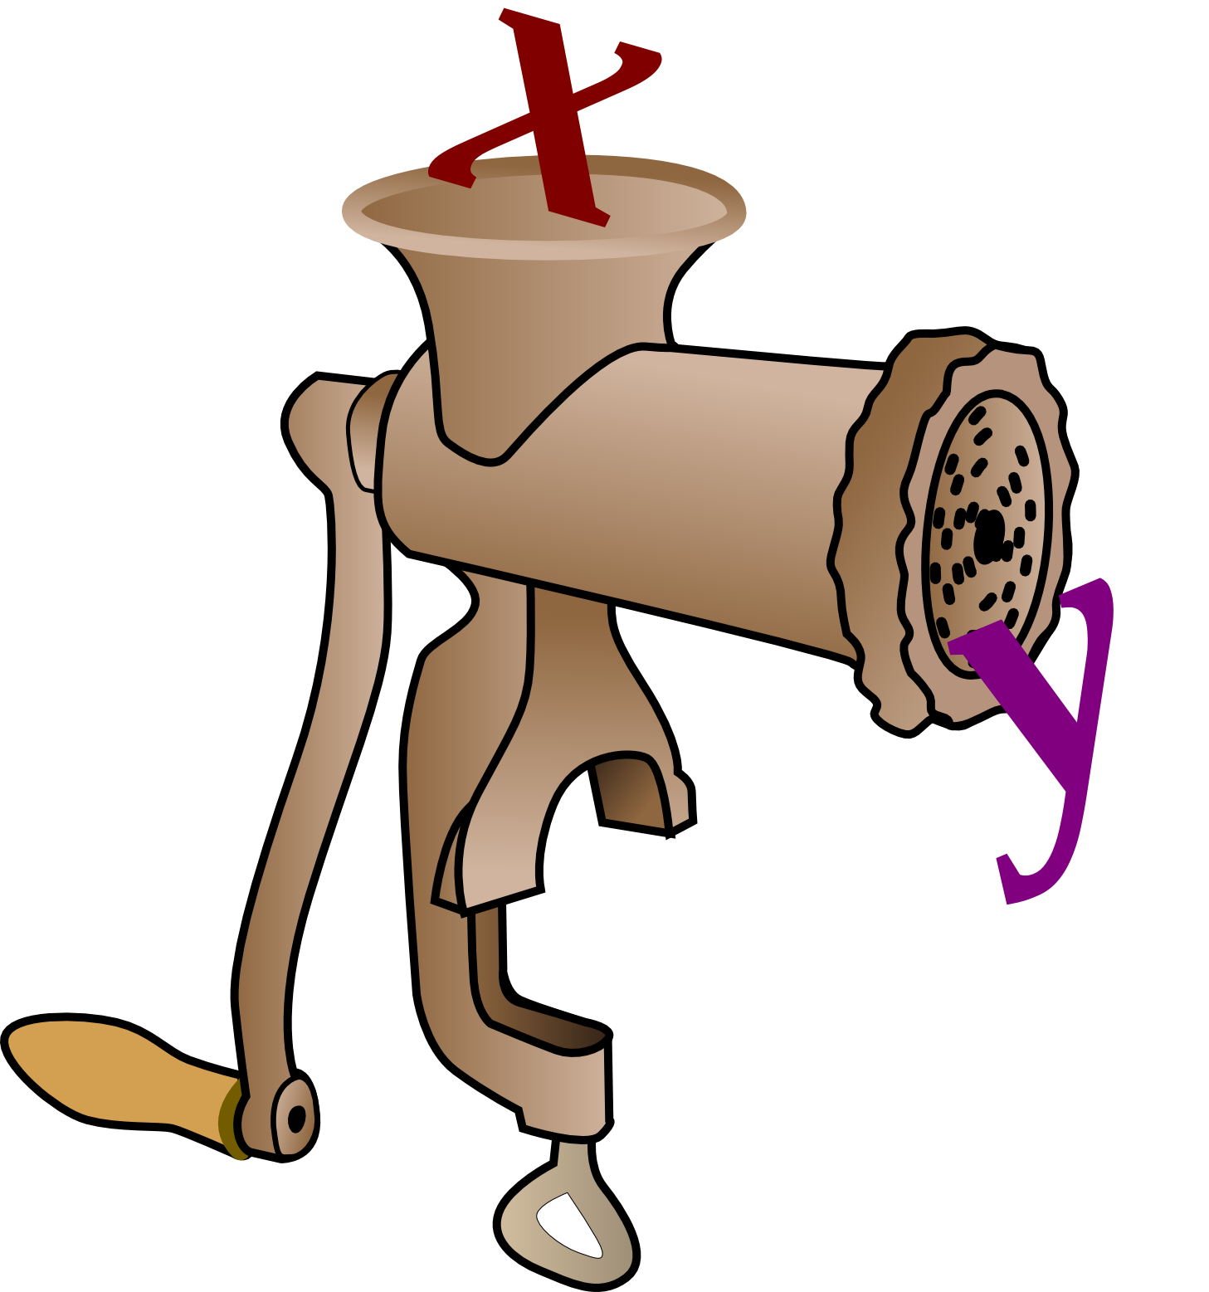
Functions
y = f(x)

Slide 302
Functions we have met
input(prompt)
bool(thing)
len(thing)
float(thing)
open(filename, mode)
int(thing)
print(line)
iter(list)
type(thing)
list(thing)
ord(char)
range(from, to, stride)
chr(number)
str(thing)
Not that many!
“The Python Way”:
If it is appropriate to an object,
make it a method of that object.
Notes:
This is the complete set of Python functions that we have met to date.
Actually it’s surprising how few there are, not how many. Python’s philosophy leads to functions that only make sense for a particular sort of object being methods of that object, not free-standing functions.
We are now going to write our own functions.

Slide 303
Why write our own functions?
Easier to …
… read
… write
… test
… fix
… improve
“Structured
programming”
… add to
… develop
Notes:
Why?
Moving our scripts’ functionality into functions and then calling those functions is going to make everything better. This is the first step towards “structured programming” which is where programming goes when your scripts get too long to write in one go without really thinking about it.

Slide 304
Defining a function
(y₁, y₂, y₃)
=
f
(x₁, x₂, x₃, x₄, x₅)
Identify the inputs
Identify the processing
Identify the outputs
Notes:
So what do we need to do?
Well any functions starts by defining what inputs it needs, what it does with those inputs to generate the results and exactly what results/outputs it generates.

Slide 305
A function to define: total()
Sum a list
[1, 2, 3]
6
[7, -4, 1, 6, 0]
10
[ ]
0
“Edge case”
Notes:
To give ourselves a simple but concrete example to keep in mind we will set ourselves the challenge of writing a function that sums the elements of a list.
This may sound trivial but immediately raises some interesting cases that need to be considered.
What is the sum of an empty list? Zero? Is that an integer zero or a floating point zero? (Or a complex zero?)
We will say it should sum to an integer zero.

Slide 306
Defining a Python function ― 1
define a function called …
name of function
inputs
def
total
( … )
:
colon
Notes:
We will plunge straight into the Python.
The Python keyword to define a function is “def”.
This is followed by the name of the function, “total” in this case.
This is followed by a pair of round brackets which will contain all the input values for the function.
Finally there is a colon to mark the end of the line and the beginning of the body of the function.

Slide 307
Defining a Python function ― 2
name for the input
def total(
numbers
):
This name is
internal to
the function.
Notes:
Our function takes a single input: the list of numbers to be summed.
What goes inside the brackets on the def line is the name that this list will have inside the function’s definition. This is the “x” in maths. This internal names is typically unrelated to the name the list has in the main body of the script.
It is always a good idea to name your inputs (and other variables) meaningfully. Please try to avoid calling them “x”, “y”, or “z”.
We will call ours “numbers”.

Slide 308
Defining a Python function ― 3
def total(numbers)
:
Colon followed by indentation
⇨
Notes:
As ever with Python a colon at the end of a line is followed by an indented block of code. This will be the body of the function where we write the Python that defines what the function actually does with the input(s) it is given.

Slide 309
Defining a Python function ― 4
def total(numbers):
sum_so_far = 0
for number in numbers:
sum_so_far += number
“Body” of function
Notes:
For our function this is particularly simple.

Slide 310
Defining a Python function ― 4
def total(
numbers
):
These variables exist only
within the function’s body.
sum_so_far
= 0
for
number
in numbers:
sum_so_far += number
Notes:
The numbers name we specified on the def line is visible to Python only within the function definition. Similarly any names that get created within the function body exist only within that function body and will not be visible outside. Nor will they clash with any other uses of those names outside the function body.
In our example code the name “numbers” is defined in the def line, the “sum_so_far” name is defined explicitly in the function body and the “number” name is defined by the for… loop as its loop variable.
None of these interact with the Python outside the function definition.

Slide 311
Defining a Python function ― 5
def total(numbers):
sum_so_far = 0
for number in numbers:
sum_so_far += number
This value
is returned
return
sum_so_far
return this value
Notes:
Finally we need to specify exactly what value the function is going to return. We do this with another Python keyword, “return”. The value that follows the return keyword is the value returned by the function.
When Python reaches the return statement in a function definition it hands back the value and ends the execution of the function body itself.

Slide 312
Defining a Python function ― 6
And that’s it!
def total(numbers):
sum_so_far = 0
for number in numbers:
sum_so_far += number
return sum_so_far
Unindented
after this
Notes:
And that’s all that is involved in the creation of a Python function.

Slide 313
Defining a Python function ― 7
And that’s it!
All internal names internal
No need to avoid reusing names
All internal names cleaned up
No need for del
Notes:
Note that because of this isolation of names we don’t have to worry about not using names that are used elsewhere in the script.
Also, as part of this isolation all these function-internal names are automatically cleared when the function finishes. We do not need to worry about deleting them.

Slide 314
Using a Python function ― 1
def total(numbers):
sum_so_far = 0
for number in numbers:
sum_so_far += number
return sum_so_far
print(
total(
[1, 2, 3]
)
)
The list we
want to add up
Notes:
We use this function we have defined in exactly the same way as we would use a function provided by Python.

Slide 315
Using a Python function ― 2
def total(numbers):
sum_so_far = 0
for number in numbers:
sum_so_far += number
return sum_so_far
print(
total(
[1, 2, 3]
)
)
The function we
have just written

Slide 316
Using a Python function ― 3
def total(numbers):
sum_so_far = 0
for number in numbers:
sum_so_far += number
return sum_so_far
print(
total(
[1, 2, 3]
)
)
Printing out
the answer

Slide 317
Using a Python function ― 4
def total(numbers):
sum_so_far = 0
for number in numbers:
sum_so_far += number
return sum_so_far
nb: Unix prompt
$
python3 total1.py
6
print(total([1, 2, 3]))
total1.py
Notes:
The file total1.py in your home directories contains exactly the code you see here.

Slide 318
Using a Python function ― 5
def total(numbers):
sum_so_far = 0
for number in numbers:
sum_so_far += number
return sum_so_far
$
python3 total2.py
6
10
0
print(total([1, 2, 3]))
print(total([7,-4,1,6,0]))
print(total([]))
Use the function
multiple times
total2.py

Slide 319
Progress
Functions
“Structured programming”
Defining a function
def function(input):
...
Returning a value
return output

Slide 320
Exercise 18
5 minutes

Slide 321
Reminder about indices
def total(numbers):
sum_so_far = 0
for number in numbers:
sum_so_far += number
return sum_so_far
total2.py
Equivalent
def total(numbers):
sum_so_far = 0
for index in range(len(numbers)):
sum_so_far += numbers[index]
return sum_so_far
total3.py
Notes:
Let’s quickly remind ourselves about how we can uses indices for lists rather than values from lists directly.
We found this particularly useful when we were traversing more than one list at once.

Slide 322
Example of multiple inputs
Want a function to add two lists of the same length term-by-term:
[1, 2, 3]
&
[5, 7, 4]
[6, 9, 7]
[10, -5]
&
[15, 14]
[25, 9]
[3, 7, 4, 1, 7]
&
[8, 4, -6, 1, 0]
[11, 11, -2, 2, 7]
Two inputs
Notes:
So how do we build functions that take in more than one input at once?

Slide 323
Functions with multiple inputs
Multiple inputs are
separated by commas
def add_lists(
a_list
,
b_list
):
sum_list = []
for
index
in
range(len(a_list))
:
sum
=
a_list[index]
+
b_list[index]
sum_list.append(sum)
return sum_list
Notes:
The Python syntax for multiple inputs is much the same as it is for a mathemtical function: we separate the inputs by commas.

Slide 324
Functions with multiple inputs
We have
two lists…
def add_lists(
a_list
,
b_list
):
sum_list = []
…so we have
to use indexing
for
index
in
range(len(a_list))
:
sum
=
a_list[index]
+
b_list[index]
sum_list.append(sum)
return sum_list
Notes:
Note that functions that take in more than one list typically need to use indices.

Slide 325
Multiple outputs
Write a function to find minimum and maximum value in a list
[1, 2, 3]
1
&
3
[10, -5]
-5
&
10
[3, 7, 4, 1, 7]
1
&
7
Two outputs
Notes:
But what if we want to return multiple values?
We can write a function that determines the minimum value in a list, and we can write a function that returns the maximum. What do we do if we want to find both?

Slide 326
Finding just the minimum
minlist.py
def min_list(a_list):
min_so_far = a_list[0]
List cannot be empty!
for
a
in
a_list
:
if a < min_so_far:
min_so_far = a
return
min_so_far
Returning a single value
Notes:
So here’s the function that determines the minimum value in a list…

Slide 327
Finding just the maximum
maxlist.py
def max_list(a_list):
max_so_far = a_list[0]
for
a
in
a_list
:
if a > max_so_far:
Only real change
max_so_far = a
return
max_so_far
Returning a single value
Notes:
…and just the maximum.

Slide 328
Finding both
def minmax_list(a_list):
min_so_far = a_list[0]
max_so_far = a_list[0]
for
a
in
a_list
:
if a < min_so_far:
min_so_far = a
if a > max_so_far:
max_so_far = a
return what?
This is the real question
Notes:
Combining the bodies of these two functions is quite straightforward.
But what do we return?

Slide 329
Returning both
minmaxlist.py
def minmax_list(a_list):
min_so_far = a_list[0]
max_so_far = a_list[0]
for
a
in
a_list
:
if a < min_so_far:
min_so_far = a
if a > max_so_far:
max_so_far = a
return
min_so_far, max_so_far
A pair of values
Notes:
Two return two values we simply put them both after the return statement separated by a comma, just as we would have done with the inputs.

Slide 330
“Tuples”
e.g.
min_value
,
max_value
Pair
min_value
,
avg_value
,
max_value
Triple
Commas
Often written with parentheses:
(
min_value
,
max_value
)
(
min_value
,
avg_value
,
max_value
)
Notes:
These sets of values separated by commas (but not in square brackets to make a list) are called “tuples” in Python. Sometimes they are written with round brackets around them to make it clearer that they come together. But it’s the comma that is the active ingredient making them a tuple, not the brackets.

Slide 331
Using tuples to return values
def
…
In the function definition
return
(min_value
,
max_value)
Using the function
(minimum
,
maximum)
= minmax_list(values)
Notes:
If we return a pair of values in a tuple, we can also attach a pair of names to them as a tuple too.

Slide 332
Using tuples to attach names
alpha
=
12
(
alpha
,
beta
)
=
(
12
,
56
)
beta
=
56
Notes:
We can do this outside the context of functions returning values, of course. We can do it anywhere.

Slide 333
Swapping values
>>>
alpha = 12
>>>
beta = 56
>>>
(alpha, beta) = (beta, alpha)
Swapping values
>>>
print(alpha)
56
>>>
print(beta)
12
Notes:
Because the entire right hand side is evaluated before the left hand side is considered this lets us use tuples for some particularly useful tricks. perhaps the most useful is swapping two values.

Slide 334
Assignment works right to left
alpha = 12
beta = 56
(alpha, beta) = (beta, alpha)
Stage 1:
(beta, alpha)
(56, 12)
Stage 2:
(alpha,
beta)
=
(56,
12)
Notes:
The values associated with the names are evaluated first. Then the names get reattached to those values, regardless of what names they might have had before.

Slide 335
Recall this “gotcha”:
!
a = 10
b = 7
a = a + b
a = 17
a has now changed!
b = a - b
b = a - b
= 17 - 7
= 10
b ≠ 10 - 7 = 3
Notes:
We can also use it to help us with our “change of coordinates” example.

Slide 336
Again: assignment works right to left
a = 10
b = 7
(a, b) = (a + b, a - b)
Stage 1:
(a+b, a-b)
(10+7, 10-7)
(17, 3)
Stage 2:
(a,
b)
=
(17,
3)
Notes:
This works in exactly the same way.

Slide 337
Progress
Multiple inputs
def thing(in₁, in₂, in₃):
Multiple outputs
return (out₁, out₂, out₃)
“Tuples”
(a, b, c)
Simultaneous assignment
(a, b) = (a+b, a-b)

Slide 338
Exercise 19
The script exercise19.py is an answer to exercise 16.
Edit it to turn it into:
1. the definition of a function file_stats() that takes a file
name and returns a triple (n_lines, n_words, n_chars)
2. a call to that function for file name treasure.txt
3. a print of that triple.
10 minutes

Slide 339
One object or many?
two objects
“a pair of objects”
one object
Notes:
Tuples tend to blur the boundary between multiple objects and a single object.

Slide 340
Tuples as single objects ― 1
>>>
x = 20
>>>
type(x)
<class 'int'>
>>>
y = 3.14
>>>
type(y)
<class 'float'>
>>>
z = (20, 3.14)
One name → Pair of values
>>>
type(z)
<class 'tuple'>
A single object
Notes:
We can treat a tuple as a single object. It has a type called , “tuple” unsurprisingly.

Slide 341
Tuples as single objects ― 2
>>>
z = (20, 3.14)
>>>
print(z)
(20, 3.14)
>>>
w = z
Single name → Single tuple
>>>
print(w)
(20, 3.14)
Notes:
We can manipulate the tuple as a single object quite happily.

Slide 342
Splitting up a tuple
>>>
print(z)
(20, 3.14)
>>>
(a,b) = z
Two names → Single tuple
>>>
print(a)
20
>>>
print(b)
3.14
Notes:
But a tuple is fundamentally made of separable pieces and can be split up.

Slide 343
How tuples are like lists
>>>
z = (20, 3.14)
>>>
z[1]
Indices
3.14
>>>
len(z)
Length
2
>>>
z + (10, 2.17)
Concatenation
(20, 3.14, 10, 2.17)
Notes:
Tuples are a lot like lists at first glance.

Slide 344
How tuples are not like lists
>>>
z = (20, 3.14)
>>>
z[0] = 10
Traceback (most recent call last):
File "<stdin>", line 1, in <module>
TypeError:
'tuple' object does not
support item assignment
“Immutable”
Notes:
They have one critical difference, though. A tuple is “immutable”. You cannot change individual elements in a tuple. You get the whole tuple and you can’t fiddle with it.

Slide 345
Progress
Tuples as single objects
thing = (a, b, c)
Splitting up a tuple
(x, y, z) = thing
Tuples as lists
thing[0]
len(thing)
thing + thing
Immutability
thing[0] = 10
✗

Slide 346
Functions we have written so far
total(list)
add_lists(list₁,list₂)
minmax_list(list)
Notes:
To date we have written a small number of functions ourselves.
Once we become serious Python programmers using the computer for our day job then we would expect to write many more.

Slide 347
Reusing functions within a script
def square(limit):
...
...
squares_a = square(34)
...
five_squares = squares(5)
...
squares_b = squares(56)
...
One definition
Multiple uses in
the same file
Easy!
Notes:
Within a script reusing a function is easy. We simply call the function whenever we want it.

Slide 348
Reusing functions between scripts?
def squares(limit):
...
One definition
...
squares_a = squares(34)
...
Multiple uses in
multiple files
...
five_squares = squares(5)
...
...
squares_b = squares(56)
...
How?
Notes:
But what happens if we want to use a function in more than one script?

Slide 349
“Modules”
def
square(limit)
:
...
...
five =
squares(5)
def
cubes(limit)
:
...
...
Definition
Use
Module: a container of functions
Notes:
Python has a mechanism to assist with this called “modules”. A module is a collection of functions (and other material) which can then be imported into a script and used within that script. If we can write our own module with our own functions then we can import them into our own scripts.

Slide 350
Modules: a worked example ― 1a
def squares(limit):
answer = []
for n in range(0,limit):
answer.append(n**2)
return answer
def total(numbers):
sum_so_far = 0
for number in numbers:
sum_so_far += number
return sum_so_far
text = input('Number? ')
number = int(text)
squares_n = squares(number)
total_n = total(squares_n)
print(total_n)
utils.py
Starts empty
sum_squares.py
Notes:
We will start with a file called sum_squares.py which uses two functions to add up the squares of numbers from zero to some limit. We want to transfer those function definitions into a different file which we will call utils.py (which starts empty) but still be able to use them in our original file.

Slide 351
Modules: a worked example ― 1b
$
python3 sum_squares.py
Number?
5
30
= 0 + 1 + 4 + 9 + 16
$
python3 sum_squares.py
Number?
7
91
= 0 + 1 + 4 + 9 + 16 + 25 + 36
Notes:
Just to prove I’m not fibbing, here it is working before we move anything about.

Slide 352
Modules: a worked example ― 2a
def squares(limit):
answer = []
for n in range(0,limit):
answer.append(n**2)
return answer
def total(numbers):
sum_so_far = 0
for number in numbers:
sum_so_far += number
return sum_so_far
text = input('Number? ')
number = int(text)
squares_n = squares(number)
total_n = total(squares_n)
print(total_n)
sum_squares.py
utils.py
Move the definitions
into the other file.
Notes:
Using the text editor we move the definitions from sum_squares.py to utils.py.

Slide 353
Modules: a worked example ― 2b
$
python3 sum_squares.py
Number?
5
Traceback (most recent call last):
File "sum_squares.py", line 4, in <module>
squares_n = squares(number)
NameError: name 'squares' is not defined
Because we have (re)moved its definition.
Notes:
Unsurprisingly, this breaks sum_squares.py.

Slide 354
Modules: a worked example ― 3a
def squares(limit):
answer = []
for n in range(0,limit):
answer.append(n**2)
return answer
def total(numbers):
sum_so_far = 0
for number in numbers:
sum_so_far += number
return sum_so_far
import utils
text = input('Number? ')
number = int(text)
squares_n = squares(number)
total_n = total(squares_n)
print(total_n)
sum_squares.py
utils.py
import: Make
a reference to
the other file.
import utils
and not
import utils.py
Notes:
We need to import the functioned defined in utils.py into sum_squares.py.
First, we add the instruction “import utils” to the top of the stm_squares.py file.
Note that we import “utils”, not “utils.py”.

Slide 355
Modules: a worked example ― 3b
$
python3 sum_squares.py
Number?
5
Traceback (most recent call last):
File "sum_squares.py", line 4, in <module>
squares_n = squares(number)
NameError: name 'squares' is not defined
Still can’t find the function(s).
Notes:
On its own this is not sufficient.

Slide 356
Modules: a worked example ― 4a
import utils
text = input('Number? ')
number = int(text)
squares_n = utils.squares(number)
total_n = utils.total(squares_n)
print(total_n)
squares()
utils.squares()
total()
utils.total()
sum_squares.py
utils.…: Identify
the functions
as coming from
the module.
Notes:
We have to indicate to Python that these functions it is looking for in sum_squares.py come from the utils module. To do this we include “utils.” at the start of their names.

Slide 357
Modules: a worked example ― 4b
$
python3 sum_squares.py
Number?
5
30
$
python3 sum_squares.py
Number?
7
☺
Working again!
91
Notes:
And now it works.

Slide 358
Progress
Sharing functions between scripts
“Modules”
Importing modules
import module
Using functions from modules
module.function()

Slide 359
Exercise 20
The script exercise20.py is an answer to exercise19.
Move the function file_stats() from exercise19.py
into utils.py and edit exercise19.py so that it still works.
5 minutes

Slide 360

The Python philosophy
A small core
language …
… plus lots
of modules
math
sys
“Batteries
included”
string
Notes:
We have met the majority of the Python language already! But obviously Python has facilities to do much more than we have seen so far. The trick is that Python comes with a large number of modules of its own which have functions for performing no end of useful things.
This philosophy is called “batteries included”. You probably already have the module you need to do your specialist application.

Slide 361
Example: the “math” module
>>>
import
math
Load in the “math” module.
Run the sqrt() function…
>>>
math.
sqrt(
2.0)
… from the math module.
1.4142135623730951
Notes:
Let’s see an example of an “included battery”. At the very start of this course we write ourselves a square root program. Now let’s see what Python offers as an alternative.
We import the “math” module. (No trailing “s”; this is the American spelling.)
In the math module is a sqrt() function. We can access this as math.sqrt().
Most of the fundamental mathematical operations can be found in the math moWe will see how to find out exactly what is in a module in a few slides’ time.

Slide 362
import module as alias
>>>
import math
Too long to keep typing?
>>>
math.
sqrt(2.0)
1.4142135623730951
>>>
import math as
m
“Alias”
>>>
m
.sqrt(2.0)
1.4142135623730951
Notes:
There are those who object to typing. If “math” is too long then we can use an aliasing trick to give the module a shorter name.
(The problem is rarely with math. There is a built-in module called “multiprocessing” though which might get tiresome.)

Slide 363
Don’t do these
>>>
from math import sqrt
!
Much better
to track the module.
>>>
sqrt(2.0)
1.4142135623730951
>>>
from math import *
!!
>>>
sqrt(2.0)
1.4142135623730951
Notes:
python does permit you to do slightly more than that. You can suppress the name of the module altogether.
You are beginners so please take it from an old hand on trust that this turns out to be a very bad idea. You want to keep track of where your functions came from!

Slide 364
What system modules are there?
Python 3.2.3 comes with over 250 modules.
glob
math
argparse
csv
io
cmath
datetime
html
os
random
getpass
json
signal
colorsys
logging
re
subprocess
email
pickle
string
sys
http
sqlite3
unicodedata
tempfile
webbrowser
unittest
xml
Notes:
There are many modules that come with Python.

Slide 365
“Batteries included”
>>>
help('modules')
Please wait a moment while I gather a list
of all available modules...
CDROM binascii inspect shlex
263 modules
bdb importlib shelve
Enter any module name to get more help. Or,
type "modules spam" to search for modules whose
descriptions contain the word "spam".
Not quite this simple
Notes:
To find out exactly what modules come with your version of Python ask the help system.
A word of warning, though. The text at the bottom “Enter any module name…” is not quite right.
If you give the help() command with no argument then you are dropped into an interactive help system. There you can type the name of a module or type “modules spam”, etc.
>>> help()
Welcome to Python 3.1! This is the online help utility.
…
help> modules subprocess
Here is a list of matching modules. Enter any module name to get more help.
subprocess - subprocess - Subprocesses with accessible I/O streams
help> quit
>>>

Slide 366
Additional downloadable modules
Numerical
Databases
numpy
pyodbc
scipy
psycopg2
PostgreSQL
MySQLdb
MySQL
cx_oracle
Oracle
Graphics
ibm_db
DB2
matplotlib
pymssql
SQL Server
Notes:
But, of course, there’s never the particular module you want. There are modules provided by people who want Python to interoperate with whatever it is they are offering.
There are three sets of additional modules that you may end up needing to know about.
The numerical and scientific world has a collection of modules called Numerical Python (“numpy”) and “scientific python” (”scipy”) which contain enormous amounts of useful functions and types for numerical processing.
Every database under the sun offers a module to let Python access it.
Finally there is a module to offer very powerful 2D graphics for data visualisation and presentation.

Slide 367
An example system module: sys
import sys
print(sys.argv)
$
python3 argv.py one two three
['argv.py',
'one',
'two',
'three']
index
0
1
2
3
argv.py
$
python3 argv.py 1 2 3
['argv.py',
'1',
'2',
'3']
Always strings
Notes:
We will take a brief look at another commonly used module to illustrate some of the things Python has hidden away in its standard set.
The “sys” module contains many systems-y things. For example, it contains a list called sys.argv which contains the argument values passed on the command line when the script was launched.
Note two things:
1. that item zero in this list is always the name of the script itself,
2. the items are always strings

Slide 368
sys.exit()
exit()
What we have been using
sys.exit
(rc)
What we should use
“Return Code”: an integer
0: Everything was OK
≠0: Something went wrong
Notes:
Also tucked away in the sys module is the sys.exit() function.
Up to this point we have been using the exit() function to quit our scripts early. However this function is something of a filthy hack and sys.exit() provides superior quitting and an extra facility we will be able to make use of.
The sys.exit() function takes an integer argument. This is the program’s “return code” which is a very short message back to the operating system to indicate whether the program completed successfully or not. A return code of 0 means “success”. A non-zero return code means failure. Some programs use different non-zero codes for different failures but many (most?) simply use a value of 1 to mean “something went wrong”.
If your script simply stops because it reached the end then Python does an automatic sys.exit(0).

Slide 369
An example system module: sys
But also…
sys.modules
All modules currently imported
sys.path
Directories Python searches for modules
sys.version
Version of Python
sys.stdin
Where input inputs from
sys.stdout
Where print prints to
sys.stderr
Where errors print to
sys.float_info
All the floating point limits
…and there’s more!
Notes:
And there’s plenty more…

Slide 370
Modules in Python
“How do I do
X in Python?”
“What’s the Python
module to do X?”
“Where do I find
Python modules?”
Notes:
So the Python philosophy places a lot of functionality into its modules.
This means that we have to be able to find modules and know what they can do.

Slide 371


Finding modules
Python:
Built-in modules
SciPy:
Scientific Python modules
PyPI:
Python Package Index
Search:
“Python3 module for X”
Notes:
Some useful URLs:
http://docs.python.org/py3k/py-modindex.html
This contains the list of all the “batteries included” modules that come with Python. For each module it links through to their documentation.
http://www.scipy.org/Topical_Software http://numpy.scipy.org/
Scientific Python contains very many subject-specific modules for Python. Most depend on the Numerical Python module numpy.
http://pypi.python.org/pypi (do check for Python3 packages)
This is the semi-official dumping ground for everything else.
http://www.google.co.uk/
And for everything else there’s Google (who are big Python users, by the way).

Slide 372
Help with modules
>>>
import math
>>>
help(math)
NAME
math
DESCRIPTION
This module is always available. It provides
access to the mathematical functions defined
by the C standard.
…
Notes:
I promised information on how to find out what is in a module. Here it is.
Once a module has been imported you can ask it for help.

Slide 373
Help with module functions
…
FUNCTIONS
acos(x)
Return the arc cosine (measured in
radians) of x.
…
>>>
math.acos(1.0)
0.0
Notes:
The help will always include information on every function in the module…

Slide 374
Help with module constants
…
DATA
e = 2.718281828459045
pi = 3.141592653589793
…
>>>
math.pi
3.141592653589793
Notes:
…and every data item.

Slide 375
Help for our own modules?
def squares(limit):
answer = []
for n in range(0,limit):
answer.append(n**2)
return answer
def total(numbers):
sum_so_far = 0
for number in numbers:
sum_so_far += number
return sum_so_far
>>>
import utils
>>>
help(utils)
NAME
utils
FUNCTIONS
squares(limit)
total(numbers)
FILE
/home/y550/utils.py
utils.py
Basic help already
provided by Python
Notes:
What help can we get from our own module?
By now you should have a utils.py file with some functions of your own in it. The help simply lists the functions the module contains and the file it is defined in.

Slide 376
Adding extra help text
def squares(limit):
answer = []
for n in range(0,limit):
answer.append(n**2)
return answer
def total(numbers):
sum_so_far = 0
for number in numbers:
sum_so_far += number
return sum_so_far
>>>
import utils
Fresh start
"""Some utility functions
from the Python for
Absolute Beginners course
"""
>>>
help(utils)
NAME
utils
DESCRIPTION
Some utility functions
from the Python for
Absolute Beginners course
FUNCTIONS
squares(limit)
total(numbers)
utils.py
Notes:
But we can do better than that.
If we simply put a Python string (typically in long text triple quotes) at the top of the file before any used Python (but after comments is fine) then this becomes the description text in the help.
Note: You need to restart Python and re-import the module to see changes.

Slide 377
Adding extra help text to functions
"""Some utility functions
from the Python for
Absolute Beginners course
"""
def squares(limit):
answer = []
for n in range(0,limit):
answer.append(n**2)
return answer
>>>
import utils
Fresh start
>>>
help(utils)
NAME
utils
DESCRIPTION
...
"""Returns a list of
squares from zero to
limit**2.
"""
FUNCTIONS
squares(limit)
Returns a list of
squares from zero to
limit**2.
utils.py
Notes:
If we put text immediately after a def line and before the body of the function it becomes the help text for that function, both in the module-as-a-whole help text…

Slide 378
Adding extra help text to functions
"""Some utility functions
from the Python for
Absolute Beginners course
"""
def squares(limit):
answer = []
for n in range(0,limit):
answer.append(n**2)
return answer
>>>
import utils
Fresh start
>>>
help(utils.squares)
squares(limit)
Returns a list of
squares from zero to
limit**2.
"""Returns a list of
squares from zero to
limit**2.
"""
utils.py
Notes:
…and in the function-specific help text.

Slide 379
Progress
Python a small language…
Functionality
Module
…with many, many modules
System modules
Foreign modules
Modules provide help
help(module)
Doc strings
help(module.function)

Slide 380
Exercise 21
Add help text to your utils.py file.
5 minutes

Slide 381
Recap: Lists & Indices
greek = ['alpha', 'beta', 'gamma']
list
str
5
a
l
p
h
a
greek[0]
3
str
Position 0
4
b
e
t
a
greek[1]
Position 1
str
Position 2
5
g
a
m
m
a
greek[2]
Notes:
We have one last Python type to learn about. To give it some context, we will recap the list type that we have spent so much time using.
A list is basically an ordered sequence of values. The position in that sequence is known as the index.

Slide 382
“Index in ― Value out”
list
index
value
Must be
a number
1
greek
[1]
'beta'
Notes:
If we now forget about the internals of a list, though, we can think of it as “some sort of Python object” that takes in a number (the index) and spits out a value.

Slide 383
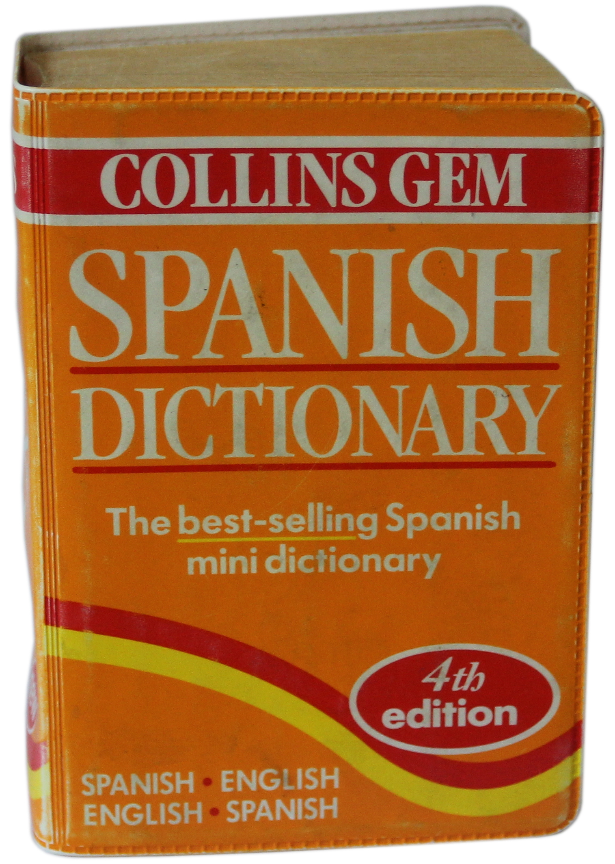
Other “indices”: Strings?
dictionary
English
Spanish
dictionary
'cat'
'gato'
'dog'
'perro'
'mouse'
'ratón'
Notes:
Can we generalise on this idea by moving away from the input (the index) needing to be a number?
Can we model a dictionary where we take in a string (a word in English, say) and give out a different string (the corresponding word in Spanish, say).
(Note: the author is fully aware that translation is not as simple as this. This is just a toy example.)

Slide 384
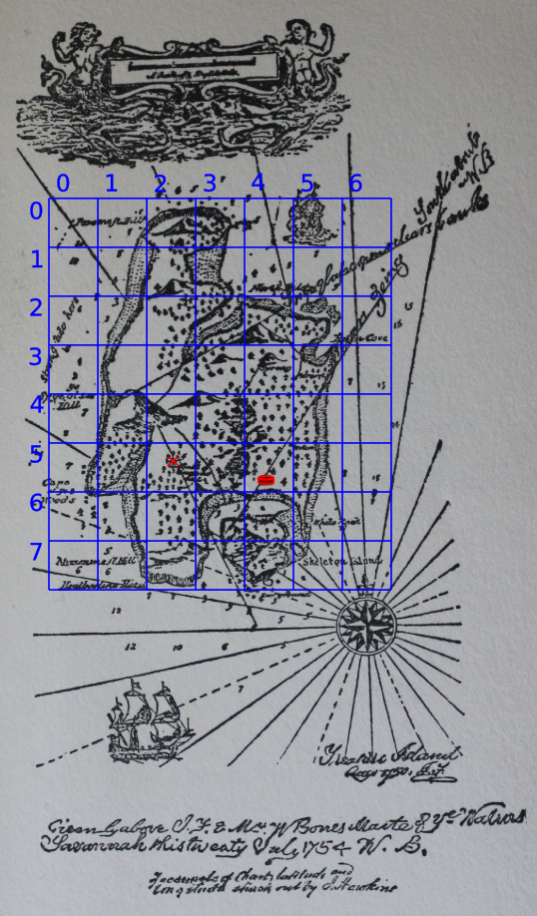
Other “indices”: Tuples?
dictionary
(x, y)
Objects
dictionary
(2,5)
'Treasure'
(4,5)
'Fortress'
Notes:
Or, perhaps, pairs of numbers (x,y) in and items on a map out?

Slide 385
Python “dictionaries”
>>>
en_to_es = { 'cat':'gato' , 'dog':'perro' }
>>>
en_to_es['cat']
'gato'
Notes:
Python does have exactly such a general purpose mapper which it calls a “dict”, short for “dictionary”.
Here is the Python for establishing a (very small) English to Spanish dictionary that knows about two words.
We also see the Python for looking up a word in the dictionary.
We will review this syntax in some detail…

Slide 386
Creating a dictionary — 1
Curly brackets
Comma
{
'cat':'gato'
,
'dog':'perro'
}
'cat' → 'gato'
'dog' → 'perro'
Notes:
First we will look at creating a dictionary. In the same way that we can create a list with square brackets, we can create a dictionary with curly ones.
Each item in a dictionary is a pair of values separated by a colo
They are separated by commas.n.

Slide 387
Creating a dictionary — 2
'cat'
:
'gato'
{
'cat'
:
'gato'
,
'dog'
:
'perro'
}
“key”
:
“value”
Notes:
The pairs of items separated by colons are known as the “key” and “value”. The key is what you put in (the English word in this example) that you look up in the dictionary and the value is what you get out (the translation into Spanish in this example).

Slide 388
Using a dictionary — 1
>>>
en_to_es = { 'cat':'gato' , 'dog':'perro' }
Creating the dictionary
>>>
en_to_es['cat']
Using the dictionary
'gato'
Notes:
Now we have seen how to create a (small) dictionary we should look at how to use it.

Slide 389
Using a dictionary — 2
Square brackets
en_to_es
[
'cat'
]
'gato'
dictionary
key
value
Notes:
To look something up in a dictionary we pass it to the dictionary in exactly the same way as we passed the index to a list: in square brackets. Curly brackets are just for creating a dictionary; after that it’ square brackets again.

Slide 390
Missing keys
>>>
en_to_es = { 'cat':'gato' , 'dog':'perro' }
>>>
en_to_es['dog']
✓
'perro'
>>>
en_to_es['mouse']
✗
Traceback (most recent call last):
File "<stdin>", line 1, in <module>
KeyError: 'mouse'
Error message
Notes:
The equivalent to shooting off the end of a list is asking for a key that’s not in a dictionary.

Slide 391
Dictionaries are one-way
!
>>>
en_to_es =
{
'cat':
'gato'
,
'dog':
'perro'
}
>>>
en_to_es['dog']
✓
'perro'
>>>
en_to_es['perro']
✗
Traceback (most recent call last):
File "<stdin>", line 1, in <module>
KeyError:
'perro'
Looking for a key
Notes:
Also note that dictionaries are one-way.

Slide 392
Adding to a dictionary
>>>
en_to_es
= { 'cat':'gato' , 'dog':'perro' }
Initial dictionary has no 'mouse'
>>>
en_to_es['mouse'] = 'ratón'
Adding 'mouse' to the dictionary
>>>
en_to_es['mouse']
'ratón'
Notes:
Adding key-value pairs to a dictionary is a lot easier than it is with lists. With lists we needed to append on the end of a list. With dictionaries, because there is no inherent order, we can simply define them with a simple expression on the left hand side.

Slide 393
Removing from a dictionary
>>>
print(en_to_es)
{'mouse': 'ratón',
'dog': 'perro',
'cat': 'gato'}
>>>
del en_to_es[
'dog'
]
>>>
print(en_to_es)
{'mouse': 'ratón', 'cat': 'gato'}
Notes:
We can use del to remove from a dictionary just as we did with lists.

Slide 394
Progress
Dictionaries
Key
Value
{ key₁:value₁ , key₂:value₂, key₃:value₃ }
Looking up values
dictionary[key]
value
Setting values
dictionary[key] = value
Removing keys
del dictionary[key]

Slide 395
Exercise 22
Complete exercise22.py to create
an English to French dictionary.
cat
chat
dog
chien
mouse
souris
snake
serpent
5 minutes

Slide 396
What’s in a dictionary? ― 1
>>>
en_to_es
{'mouse': 'ratón', 'dog': 'perror', 'cat': 'gato'}
>>>
en_to_es.keys()
dict_keys
(['mouse', 'dog', 'cat'])
Orders
match
>>>
en_to_es.values()
dict_values
(['ratón', 'perro', 'gato'])
Just treat them like lists
(or convert them to lists)
Notes:
To date we have created our own dictionaries. If we are handed one how do we find out what keys and values are in it?
Dictionaries support two methods which return the sort-of-lists of the keys and values. We mention them here only for completeness.
Don’t forget that you can always convert a sort-of-list into a list with the list() function.

Slide 397
What’s in a dictionary? ― 2
>>>
en_to_es
.items()
Most useful method
dict_items([('mouse', 'ratón'), ('dog', 'perro'),
('cat', 'gato')])
(Key,Value) pairs/tuples
>>>
for (english, spanish) in en_to_es.items():
...
print(spanish, english)
...
ratón mouse
perro dog
gato cat
Notes:
By far the best way to get at the contents of a dictionary is to use the items() method which generates a sort-of-list of the key-value pairs as tuples. Running a for… loop over this list is the easiest way to process the contents of a directory.

Slide 398
What’s in a dictionary? ― 3
Common simplification
>>>
list
(en_to_es.items())
[('mouse','ratón'), ('dog','perro'),('cat','gato')]
Notes:
Don’t be afraid to convert it explicitly into a list. Unless you dictionary is huge you won’t see any problem with this.

Slide 399
Getting the list of keys
list()
list of
keys
dictionary
{'the': 2, 'cat': 1, 'sat': 1, 'on': 1, 'mat': 1}
['on', 'the', 'sat', 'mat', 'cat']
Notes:
Unfortunately when you convert a dictionary directly into a list you get the list of keys not the list of )(key,value) pairs. This is a shame but is a compromise for back compatibility with previous versions.

Slide 400
Is a key in a dictionary?
>>>
en_to_es['snake']
Traceback (most recent call last):
File "<stdin>", line 1, in <module>
KeyError: 'snake'
Want to avoid this
>>>
'snake' in en_to_es
False
We can test for it
Notes:
Because of this conversion to the list of keys we can ask if a key is in a dictionary using the in keyword without having to know its corresponding value.

Slide 401
Example: Counting words ― 1
words = ['the','cat','sat','on','the','mat']
counts = {'the':2,'cat':1,'sat':1,'on':1,'mat':1}
Notes:
Let’s have a serious worked example.
We might be given a list of words and want to count the words by how many times they appear in the list.

Slide 402
Example: Counting words ― 2
words = ['the','cat','sat','on','the','mat']
counts = {}
Start with an empty dictionary
for word in words:
Work through all the words
Do something
Notes:
We start by creating an empty dictionary. It’s empty because we haven’t read any words yet.
Then we loop through the list of words using a standard for… loop.
For each word we have to do something to increment the count in the dictionary.

Slide 403
Example: Counting words ― 3
words = ['the','cat','sat','on','the','mat']
counts = {}
for word in words:
✗
counts[word] += 1
This will not work
counter1.py
Notes:
Unfortunately a simply increment of the value in the dictionary isn’t enough.

Slide 404
Why doesn’t it work?
counts = {'the':1, 'cat':1}
The key must already
be in the dictionary.
✓
counts['the'] += 1
counts['the'] =
counts['the']
+ 1
Key is not in
the dictionary!
✗
counts['sat'] += 1
counts['sat'] =
counts['sat']
+ 1
Notes:
We cannot increment a value that isn’t there. Until the program meets a word for the first time it has no entry in the dictionary, and certainly not an entry with numerical value 0.

Slide 405
Example: Counting words ― 4
words = ['the','cat','sat','on','the','mat']
counts = {}
for word in words:
if word in counts:
counts[word] += 1
else:
Do something
Need to add the key
Notes:
So we have to test to see if the word is already in the dictionary to increment it if it is there and to do something else if it is not. Note how we use the “if key in dictionary” test.

Slide 406
Example: Counting words ― 5
words = ['the','cat','sat','on','the','mat']
counts = {}
for word in words:
if word in counts:
counts[word] += 1
else:
counts[word] = 1
counter2.py
print(counts)
Notes:
That something else is to create it with its initial value of 1 (because we have met the word once now).

Slide 407
Example: Counting words ― 6
$
python3 counter2.py
{'on': 1, 'the': 2, 'sat': 1, 'mat': 1, 'cat': 1}
!
You cannot predict the order of the
keys when a dictionary prints out.
Notes:
Dictionaries are unordered entities. You cannot predict the order that the keys will appear when you print a dictionary or step through its keys.

Slide 408
Example: Counting words ― 7
✗
print(counts)
Too ugly
items = list(dictionary.items())
Better
items.sort()
for (key, value) in items:
print(key, value)
counter3.py
Notes:
Simply printing a dictionary gives ugly output.
We can pull out the (key,value) pairs and print them individually if we want.
Notice the use of pulling out the items, converting them into a list and then sorting them.

Slide 409
Example: Counting words ― 8
$
python3 counter3.py
cat 1
mat 1
on 1
sat 1
the 2

Slide 410
Progress
Inspection methods
dictionary.keys()
dictionary.values()
dictionary.items()
Testing keys in dictionaries
if key in dictionary:
...
Creating a list of keys
keys = list(dictionary)

Slide 411
Exercise 23
Complete exercise23.py to write
a function that reverses a dictionary.
{
'mouse':
'ratón',
'cat':
'gato',
'dog':
'perro'}
{
'ratón':
'mouse',
'gato':
'cat',
'perro'
:'dog'}
10 minutes

Slide 412
Formatted output
$
python3 counter3.py
cat 1
mat 1
on 1
Ugly!
sat 1
the 2
cat
mat
on
sat
the
1
1
1
1
2
We want data
nicely aligned
Notes:
We have one last topic to cover. The output from our word counter is not as pretty as it might be. The last topic we will cover is Python text formatting.
Full details of the formatting system can be found online at
docs.python.org/py3k/library/string.html#formatspec

Slide 413
The format() method
>>>
'xxx{}yyy{}zzz'.format('A', 100)
'xxxAyyy100zzz'
'
xxx
{}
yyy
{}
zzz
'
'
xxx
A
yyy
100
zzz
'
Notes:
In Python 3 the string type has a method called format() which takes arguments and returns another string which is the original with the method’s arguments inserted into it in certain places. Those places are marked with curly brackets in the string.
Curly brackets are otherwise quite normal characters. It’s only the format() method that cares about them.
In its simplest form, the format() method replaces each pair of curly brackets with the corresponding argument.

Slide 414
String formatting ― 1
>>>
'xxx{:5s}yyy'.format('A')
'xxxA␣␣␣␣yyy'
'
xxx
{:5s}
yyy
'
{:5s}
'
xxx
A␣␣␣␣
yyy
'
s ― substitute a string
5 ― pad to 5 spaces
(left aligns by default)
Notes:
The real fun starts when we put something inside those curly brackets. These are the formatting instructions.
The simplest examples start with a colon followed by some layout instructions. (We will see what comes in front of the colon in a few slides time.) The number indicates how many spaces to allocate for the insertion and the letter that follows tells it what type ob object to expect. “s” stands for string.

Slide 415
String formatting ― 2
>>>
'xxx{:<5s}yyy'.format('A')
'xxxA␣␣␣␣yyy'
'
xxx
{:<5s}
yyy
'
{:<5s}
'
xxx
A␣␣␣␣
yyy
'
< ― align to the left (←)
Notes:
By default strings align to the left of their space. We can be explicit about this by inserting a left angle bracket, which you can think of as an arrow head pointing the direction of the alignment.

Slide 416
String formatting ― 3
>>>
'xxx{:>5s}yyy'.format('A')
'xxx␣␣␣␣Ayyy'
'
xxx
{:>5s}
yyy
'
{:>5s}
'
xxx
␣␣␣␣A
yyy
'
> ― align to the right (→)
Notes:
If we want right aligned strings then we have to use the alignment marker.

Slide 417
Integer formatting ― 1
>>>
'xxx{:5d}yyy'.format(123)
'xxx␣␣123yyy'
'
xxx
{:5d}
yyy
'
{:5d}
d ― substitute an integer
'
xxx
␣␣123
yyy
'
(digits)
5 ― pad to 5 spaces
(right aligns by default)
Notes:
If we change the letter to a “d” we are telling the format() method to insert an integer (“digits”). These align to the right by default.

Slide 418
Integer formatting ― 2
>>>
'xxx{:>5d}yyy'.format(123)
'xxx␣␣123yyy'
'
xxx
{:>5d}
yyy
'
{:>5d}
> ― align to the right (→)
'
xxx
␣␣123
yyy
'
Notes:
We can be explicit about this if we want.

Slide 419
Integer formatting ― 3
>>>
'xxx{:>5d}yyy'.format(123)
'xxx␣␣123yyy'
'
xxx
{:<5d}
yyy
'
{:<5d}
< ― align to the left (←)
'
xxx
123␣␣
yyy
'
Notes:
And we have to be explicit to override the default.

Slide 420
Integer formatting ― 4
>>>
'xxx{:05d}yyy'.format(123)
'xxx00123yyy'
'
xxx
{:05d}
yyy
'
{:05d}
0 ― pad with zeroes
'
xxx
00123
yyy
'
Notes:
If we precede the width number with a zero then the number is padded with zeroes rather than spaces and alignment is automatic.

Slide 421
Integer formatting ― 5
>>>
'xxx{:+5d}yyy'.format(123)
'xxx␣+123yyy'
'
xxx
{:+5d}
yyy
'
{:05d}
+ ― always show sign
'
xxx
␣+123
yyy
'
Notes:
If we put a plus sign in front of the number then its sign is always shown, even if it is positive.

Slide 422
Integer formatting ― 6
>>>
'xxx{:+05d}yyy'.format(123)
'xxx␣+0123yyy'
'
xxx
{:+05d}
yyy
'
{:05d}
+ ― always show sign
'
xxx
+0123
yyy
'
0 ― pad with zeroes
Notes:
And we can combine these.

Slide 423
Integer formatting ― 7
>>>
'xxx{:5,d}yyy'.format(1234)
'xxx1,234yyy'
'
xxx
{:5,d}
yyy
'
{:5,d}
, ― 1,000s
'
xxx
1,234
yyy
'
Notes:
Adding a comma between the width and the “d” adds comma breaks to large numbers.

Slide 424
Floating point formatting ― 1
>>>
'xxx{:5.2f}yyy'.format(1.2)
'xxx 1.20yyy'
'
xxx
{:5.2f}
yyy
'
{:5.2f}
f ― substitute a float
'
xxx
␣1.20
yyy
'
5 ― 5 places in total
.2 ― 2 places after the point
Notes:
Floating point numbers are slightly more complicated. The width parameter has two parts, separated by a decimal point. The first number is the width of the entire number (just as it is for strings and integers). The number after the decimal point is the number of decimal points of precision that should be included in the formatted output.

Slide 425
Floating point formatting ― 2
>>>
'xxx{:f}yyy'.format(1.2)
'xxx1.200000yyy'
'
xxx
{:f}
yyy
'
{:f}
'
xxx
1.200000
yyy
'
{:.6f}
Notes:
The default is to have six decimal points of precision and to make the field as wide as it needs to be.

Slide 426
Ordering and repeats ― 1
0
1
2
>>>
'X
{:s}
X
{:d}
X
{:f}
X'.format(
'abc',
123,
1.23
)
0
1
2
'X
abc
X
123
X
1.230000
X'
0
1
2
Equivalent
>>>
'X
{0:s}
X
{1:d}
X
{2:f}
X'.format(
'abc',
123,
1.23
)
0
1
2
'X
abc
X
123
X
1.230000
X'
0
1
2
Notes:
What comes before the colon?
This is a selection parameter detailing what argument to insert.
The arguments to format() are given numbers starting at zero. We can put these numbers in front of the colon.

Slide 427
Ordering and repeats ― 2
>>>
'X
{0:s}
X
{2:f}
X
{1:d}
X'.format(
'abc',
123,
1.23
)
0
1
2
'X
abc
X
1.230000
X
123
X
'
0
2
1
>>>
'X
{0:s}
X
{1:d}
X
{1:d}
X'.format(
'abc',
123,
1.23
)
0
1
2
'X
abc
X
123
X
123
X
'
0
1
1
Notes:
We can also use them to change the order that items appear in or to have them appear more than once (or not at all).

Slide 428
Formatting in practice
...
formatting = '{:3} {:1}'
for (word, number) in items:
print(formatting.format(word,number))
$
$
python3 counter4.py
cat
mat
on
sat
the
1
1
1
1
2
Notes:
The script counter4.py is the same as counter3.py but with the new formatting for its output.

Slide 429
Progress
Formatting
string.format(args)
Numbered parameters
{0}
{1}
{2}
Substitutions
{:>6s}
{:+06d}
{:+012.7f}

Slide 430
Exercise 24
Complete exercise24.py
to format the output as shown:
[(Joe,9), (Samantha,45), (Methuselah,969)]
Joe 9
Samantha 45
Methuselah 969
5 minutes

Slide 431
And that's it! (And “it” is a lot!)
Text
“if” test
Reading files
Prompting
Indented blocks
Writing files
Numbers
Lists
Functions
Arithmetic
Indices
“Structured programming”
Comparisons
Object methods
Tuples
Booleans
Built-in help
“for” loops
Variables
“for” loops
Modules
Deleting names
“Treat it like a list…”
Dictionaries
“while” loop
Values direct/via index
Formatting
Notes:
And congratulations!
You have completed an introductory course on Python. Well done.
It is only an introductory course and there is more. But do not let that dishearten you; just take a look at what you have accomplished. You now have a firm grounding to go further with Python or to start learning other programming languages. (But the author would like you to stick with Python.)

Slide 432
But wait! There’s more…
Advanced topics: Self-paced introductions to modules
Object-oriented programming in Python
Notes:
If you do want more Python the UCS offers a selection of self-paced courses on some additional language features and on various Python modules to let you learn how to use Python for a specific purpose. We also offer a taught course introducing you to the world of object-oriented programming where you get to write your own methods and types.

Slide 433

Congratulations!
Text
“if” test
Reading files
Prompting
Indented blocks
Writing files
Numbers
Lists
Functions
Arithmetic
Indices
“Structured programming”
Comparisons
Object methods
Tuples
Booleans
Built-in help
“for” loops
Variables
“for” loops
Modules
Deleting names
“Treat it like a list…”
Dictionaries
“while” loop
Values direct/via index
Formatting
Notes:
So thank you and congratulations again.

